Slide 1
Revitalization Training
Session # 10

Slide 2
Online Training 10 Sessions
Session | Title
1 | 7 Church Revitalization Tools: Tools 1 and 2
2 | 7 Church Revitalization Tools: Tools 3-5
3 | 7 Church Revitalization Tools: Tools 6-7
4 | 12 Church Health Components: 1-3
5 | 12 Church Health Components: 4-6
6 | 12 Church Health Components: 7-9
7 | 12 Church Health Components: 10-12
8 | Certification and Consulting
9 | Consulting: Comprehensive Church Health Assessment
10 | Consulting and How To Launch a Consulting Practice

Slide 3
Session #10 Agenda and Topics
1
2
Facilitating: Strategic Ministry Planning
Preparing for: Strategic Ministry Planning
3
Starting a Consulting Practice

Slide 4
Alternative Names for This
Church Revitalization
Church Turnaround
Church Strengthening
Strategic Envisioning
Long Range Planning
Strategic Planning
Strategic Ministry Planning
A Branded Name: e.g. VisionTune

Slide 5
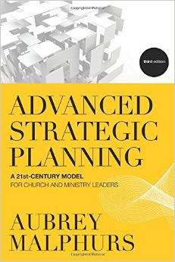
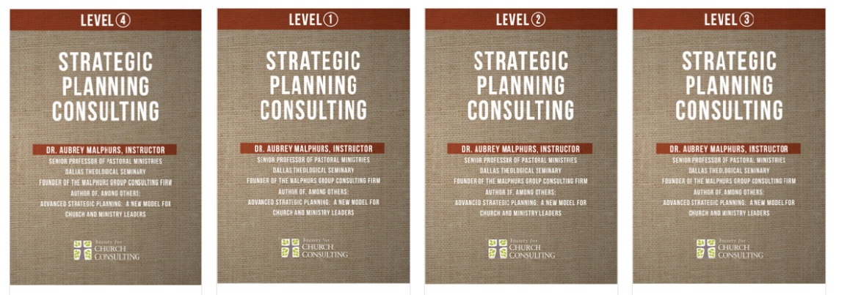
Resources/References Dr. Aubrey Malphurs
Editions 1, 2, 3
of the same book
1999, 2005, 2013
Society Strategic Planning Consulting Level 1-4 DVD Track
Based on edition 2
2012
High Def at DTS
70% member renewal
discount

Slide 6
Relationship with Church Health Assessment
Heath Assessment
Today’s Reality
Strategic Ministry Planning
Planning to move to a Preferable Future
- CHA is best start for Revitalization
- Revitalization includes Today’s Reality
- Sometimes a gap of 3 mos. – 1 year

Slide 7
A Strategic Planning Service: VisionTune
VisionTune is an intensive, team-based 6-month effort, facilitated by the consultant, leading to a strategic plan.
The consultant works with the Primary Board, a Strategic Focus Team, and selected Ministry Working Groups, seeking to define who the church is, where it is going, and how it will get there. He or she motivates the team as it fine-tunes the strategic leadership requirements of God’s plan for the church. This service includes training in plan refreshing and execution.

Slide 8
Why Team-Based?
Rt
High Relational Low Task
RT
High Relational High Task
rT
High Task Low Relational
rt
Low Task Low Relational
12%
80%
12%
Work
With
Me!
Support
Me
5%
4%
4%
4%
Let
Me
Tell
Me
Percept Demographic Studies of American Culture
Leadership Preference See ethos p. 15 and Source Book p. 71

Slide 9
Strategic Focus Team Formation
Who | Primary board members (including the chair), pastoral ministry staff, and key lay leaders
How Many | 20-25 for all church sizes
How Recruited | Consultant coaches Lead Pastor
A Guiding Covenant | See Handout
A smaller number in very small churches
Gender, Age, and Ethnic Diversity

Slide 10
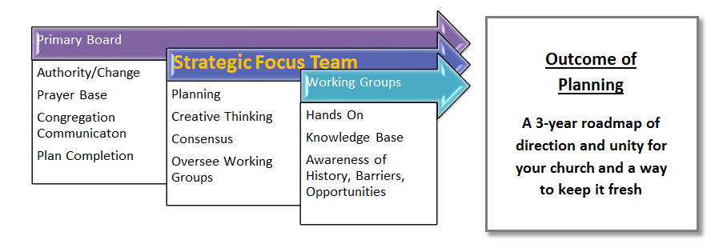
Strategic Focus Team in Context
4 hours/mo.
6 hours/mo.
Make myself available but never used
Working Group Formation by Primary Board and SFT
See Working Group Launching Guidelines for Primary Board

Slide 11
Alternative/Optional Schedules for SFT Meetings
Each of these is once a month for 6 months:
Fri 7:00-9:00 PM and Sat 8:00-Noon
(works well with board meeting Sat aft)
OR
Sat 8:00-2:00 (working lunch)
OR
Mon Noon-6:00 (Staff-led church)

Slide 12
Survey Monkey: Strengths and Weaknesses and Readiness for Change Assessments
Helpful to have SFT Own Weaknesses
And be aware of openness to or
barriers to change. Revitalization = Change
Create a survey and have SFT respond at least a week
Or 10 days prior to your first meeting (time to graph)
Survey Monkey purchased service; others available
Malphurs book has Readiness for Change Appendix
45 Areas for SFT to respond Strength, Weakness, Neutral

Slide 13
Strengths Weaknesses Assessment 45 Categories
29 The Functions of the Church Acts 2:40-47 and
the ministries of our church
worship, evangelism, fellowship,
disciple making, ministry, prayer
5 Staff and Governance (ministry)
Support or admin. functions (ministry)
Strategic Aspects: mission, values, vision, etc.
DEFINE IN COOPERATION WITH LEAD PASTOR

Slide 14
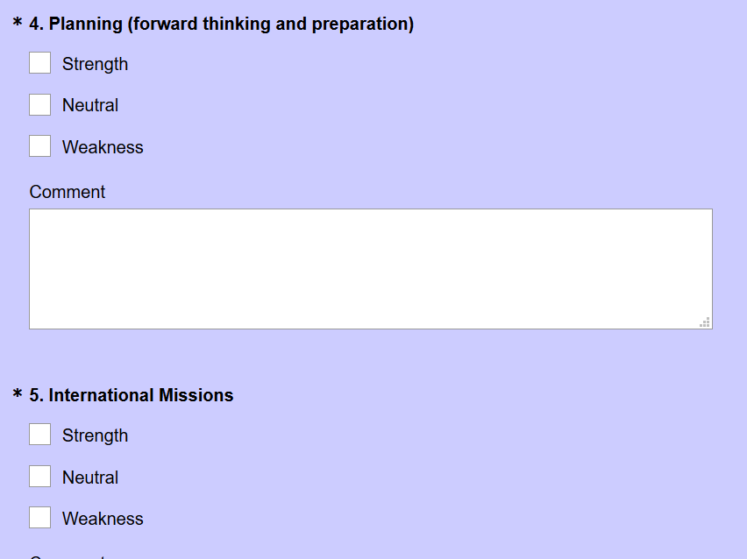
Survey Monkey Strengths and Weakness Questions Sample

Slide 15
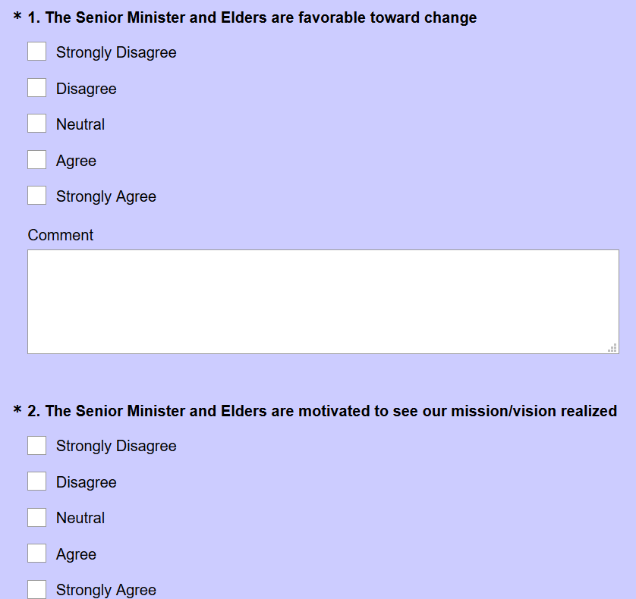
Survey Monkey Readiness for Change Questions Sample

Slide 16
Excel:
Horizontal Stacked
Bar Chart
Top 15
Strengths

Slide 18
Potential Areas
where you will
form Working Groups
Bottom 15

Slide 19
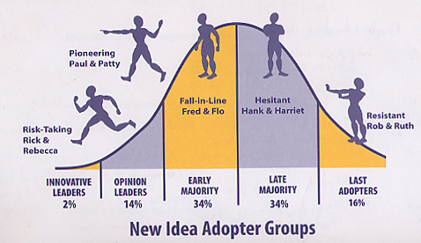
Why Probe on Readiness for Change?
Revitalization by definition
requires change and change
is led by leaders.
“… he who leads, with
diligence” Rom. 12:8
A
B
Proistemi - put before,
to set over, to rule

Slide 20
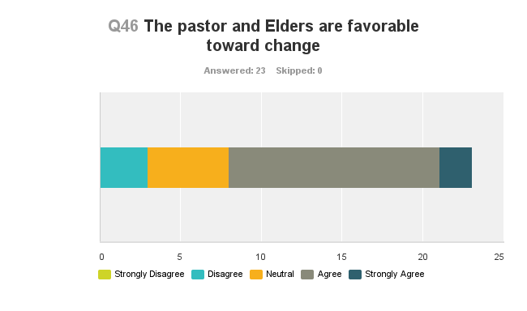
Change Orientation

Slide 21
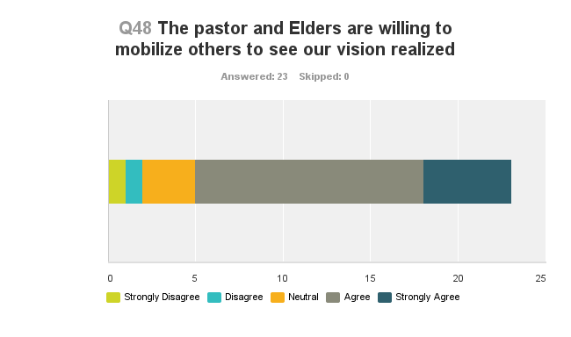
Change Orientation

Slide 22
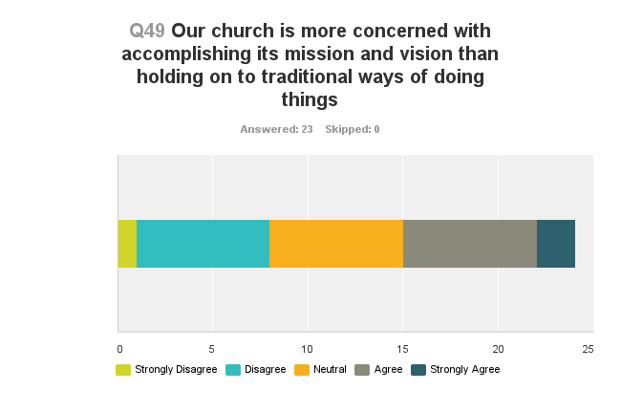
Change Orientation

Slide 23
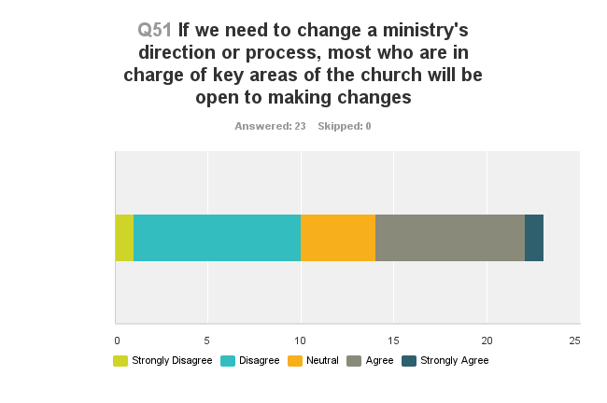
Change Orientation

Slide 24
Session #10 Agenda and Topics
1
2
Facilitating: Strategic Ministry Planning
Preparing for: Strategic Ministry Planning
3
Starting a Consulting Practice

Slide 25
SFT and Working Group Master Calendar Months 1-6
Generate interest in how progress can be made
Invite ownership of the schedule
Demonstrate SFT and Working Group “Rhythm”
of launching groups and have them report
Remind Primary Board of their decision-making and
reporting responsibility
Create realistic expectations
(what we will/won’t do;
who is writing plan, etc.)

Slide 26
SFT and Working Group Master Calendar Months 1-3
Month | Strategic Focus Team | Group Reporting
1 | Startup and Covenant Bridging the Vision Gap VisionTest /Survey Monkey Working Group Selection | None
2 | Our Mission Our Values Our Growth Philosophy Launch: Working Group 1 | Primary Board
3 | Writing Our Plan Launch : WG 2-4 | Primary Board WG 1

Slide 27
SFT and Working Group Master Calendar Months 4-6ff
Month | Strategic Focus Team | Group Reporting
4 | Launch WG 5-6 | Primary Board WG 2-4
5 | Launch WG 7 First “Draft”: Plan/Strategies Plan Rollout Exercise | Primary Board WG 5-6
6 | 2nd Draft of Plan: Finalize Strategic List Plan Rollout Discussion #2 Annual Rhythm Training | Primary Board WG 7
???? | Final Written Plan /Video Launch Plan and Implement VP 1-2-3 Implement | Primary Board working with Consultant with “banked hours”

Slide 28
SFT Meeting 1 of 6 (6 Hours)
1
The Benefits of Planning
2
4
5
Structure / Teams / Calendar
3
Bridging the Vision Gap
Today’s Reality: Survey; VisionTest
6
Working Group Selection
Our Team Covenant
Prayer and Communications
8 more slides

Slide 29
Interplay of SFT, Working Groups, and Primary Board
1. Focus Team Launches Working Group
Month 1
2. Working Group Discussion
Before Month 2
3. Working Group Reports to the SFT
Month 2
4. Focus Team Discussion with Working Group
Month 2
5. Focus Team Recommends to Primary Board
Month 2
3 Recommendations
Any barriers to change

Slide 30
Common “Working Groups”
Disciplemaking
Outreach/Assimilation
Prayer
Volunteer Mobilization
Pastoral Care
Worship
Facilities
Finance
Communications
Office Automation / IT
Governance and Staffing
(Primary Board leads)
SFT
Target for
7 total

Slide 31
Working Group Selection
Let Survey and Health Assessment inform
SFT exercise: recommend to Primary Board
Make a list of options and give SFT 5 post it
Votes each with rule of no more than 1 vote for
each possible Working Group

Slide 32
Working Groups Leaders, Participants and Strategic Sequence
Working Group | SFT Leader(s) | Possible Participants | Launch Sequence
Evangelism | Tom | xxxxxx | 2
Discipleship | Kristi | xxxxxx | 3
Assimilation | Bill | xxxxxx | 4
Volunteer Mobilization | Sonya | xxxxxx | 1 Our Early Win
Facilities | Henry | xxxxxx | 5 Support Function
Communications | Amanda | xxxxxx | 6 Support Function
Governance | Board | Board | 7 Governance

Slide 33
SFT Team Working Group Launch
VisionTest CHA Outcome and Recommendations
SFT Strengths & Weaknesses (Survey Monkey)
Barber Church Consulting Thoughts and Trends
SFT Team Processing of input to Working Group
Team Launch and Report in Next SFT

Slide 34
Example: Assimilation Working Group Exercise – SFT Groups of 5-6 Each
Take 10-15 minutes to discuss this and then plan to
report out
What question(s) do you want the Group to answer?
Are there any exercises to complete
(e.g. a report, statistics)
Is there anything else important
for this group to address?

Slide 35
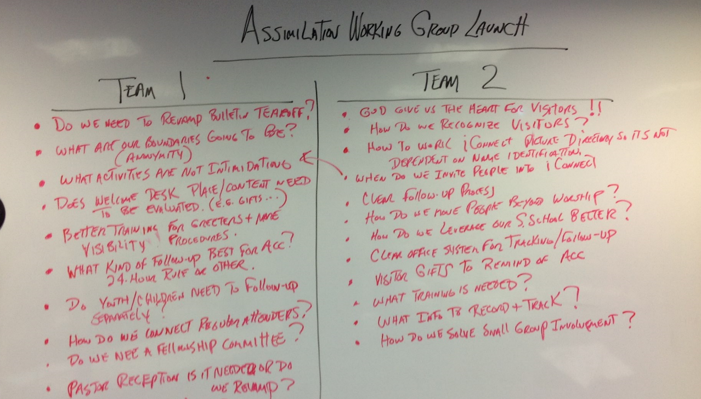
SFT Input to Working Group

Slide 36
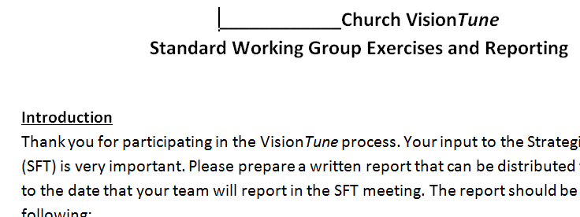
Working Group Expected Report
See handout: Working Group Exercises and Reporting
Have Group review CHA and SFT Survey
Have Group answer SFT questions
Have Group complete an exercise
Have Group discuss alignment
3 prioritized Recommendations
Barriers to improving alignment
Instructions for reporting to SFT

Slide 37
SFT Meeting 2 of 6
1
Primary Board Report (W. Groups)
2
Our Values
3
4
Our Growth Philosophy
Working Group Launch: Volunteer Mobilization
2
Our Mission
5
Prayer and Communication
Closure for all sessions

Slide 38
SFT Meeting 3 of 6
1
Primary Board Reporting (mission, values, preparing for growth)
2
4
Launch W. Groups: Evangelism, Discipleship, Assimilation
Volunteer Mobilization Group Report
5
Prayer and Communication
3
Writing Our Plan

Slide 39
SFT Meeting 4 of 6
1
Primary Board Reporting (Vol. Mob. and forming a writing team)
2
3
Launch: Facilities, Communication
4
Prayer and Communication
Working Group Reports: Evangelism, Disc., Assimilation

Slide 40
SFT Meeting 5 of 6
1
Primary Board Reporting (long list ☺)
2
3
4
Plan Content Exercise
Plan Rollout Exercise
5
“Launch” Governance Assessment
Working Group Reports: Facilities and Communications
6
Prayer and Communication

Slide 41
SFT Meeting 6 of 6
1
Primary Board Reporting
2
3
4
Plan Rollout Discussion #2
Plan Execution: Annual Rhythm Training
5
Prayer and Communication
Plan Content Discussion #2
See Session #3 How to Align…

Slide 42
Session #10 Agenda and Topics
1
2
Facilitating: Strategic Ministry Planning
Preparing for: Strategic Ministry Planning
3
Starting a Consulting Practice

Slide 43
4 Things to Think About Before Launching a Consulting Practice
Think Calling not Job
“Don’t Quit Your Day Job”
Plan, don’t Plod
Get Help: Financial, Legal, IT, Society…

Slide 44
Consulting Practice Launch Plan
Consulting Practice Plan Outline
Executive Summary
Consulting Practice Description and Vision
Definition of the Market
Description of Your Products / Services
Organization and Management
Marketing and Sales Strategy
Financial Management
Gantt Chart
See: http://web.sba.gov/busplantemplate/BizPlanStart.cfm
See: Undergraduate Marketing Class

Slide 45
Consulting Practice Launch: Sample Gantt Chart
Number | Task | Start | End | Jan | Feb | Mar | Apr | May | Jun
1 | Consulting Practice Plan
1.1 | -Define Market | 0 | 0
1.2 | -Describe Products | 0 | 0
1.3 | -Marketing Strategy
1.4 | -Financial Projection
2 | Incorporation
3 | Insurance Coverage
4 | Services Detail
4.1 | -Leadership Coaching
4.2 | -Church Health Assessment
4.3 | -Vision Clarity
4.4 | -Role Clarity
5 | Develop Website
5.1 | -Select Service
5.2 | -Design Site
5.3 | -Build Site
Incomplete
Sample

Slide 46
Consulting Market Definition
Organizational Sector Market
For profit, non profit, faith based, church
Denominational Market
Independents, my denom., all evangelical denom., mainline, etc
Geographical Market
local, county, state, regional, national, international
Church Size Market
very small, small, medium, large, very large…

Slide 47
Consulting Pricing Options
An hourly rate
A Retainer
Per Project Fees
Tiered Project Fees by church size
Cluster Pricing
Discounts
Bundling: discount if you do two or more services
Option: discount if you exercise option by ____

Slide 48
Church Consulting Starter Kit
30% discount for Spring Rev Training all 10 / 50% for Premium Mbrs.
Introduced 2017
Home Page, $295
Helpful for those starting
or revitalizing a practice
Not a substitute for training
and certification
Takes this training and
coaches you through it all
with a Planning Reference
Manual and a Working
Document
Over 60 guiding steps
(Note: The Kit is an electronic toolbox of files, a webinar, and coaching time. The box is symbolic)

Slide 49
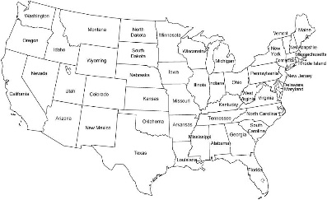
Church Consulting Starter Kit Interplay of Manual and Working Document
Reference Manual
Working
Document
Geographical target
My Geographical Target
Another consideration is what geographical area you will serve. Are you planning to serve churches locally, within your city, county, the nation, or internationally? Planning this now will save you time later.
Reflect, discuss with spouse, write your plan

Slide 50
Church Consulting Starter Kit
Includes instructional 15-minute webinar
Includes one free hour coaching
Premium Members can use coaching hours
Additional hours for purchase

Slide 51
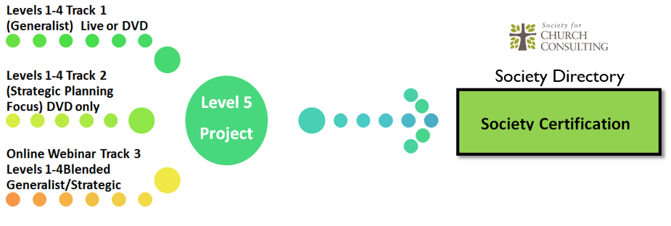
Society Certification Next Steps
Congratulations on completing Levels 1-4!
Let me know how I can assist you if you plan
to complete certification
See Session #8 for the path

Slide 52
Chat Questions and Discussion
- What questions do you have?
- What have you found most interesting?
- What troubles you about the material?

