Slide 1

Revitalization Training
Session #9

Slide 2
Online Training 10 Sessions
Session | Title
1 | 7 Church Revitalization Tools: Tools 1 and 2
2 | 7 Church Revitalization Tools: Tools 3-5
3 | 7 Church Revitalization Tools: Tools 6-7
4 | 12 Church Health Components: 1-3
5 | 12 Church Health Components: 4-6
6 | 12 Church Health Components: 7-9
7 | 12 Church Health Components: 10-12
8 | Certification and Consulting
9 | Consulting: Comprehensive Church Health Assessment
10 | Consulting and How To Launch a Consulting Practice

Slide 3

Comprehensive Health Assessment Defined
A Church Health Assessment
Spiritual Foundation
Data, Survey, Demo- graphics, Analysis
Recommend
Interviews / Observe
Report

Slide 4
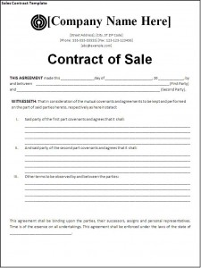

Health Assessment Engagement
Some do this informally or as part of their
denominational practices or relationships
Others will use a formal agreement
For certification may want to do free or
deeply discounted
Session #10: Pricing
See example

Slide 5
Session #9 Agenda and Topics
1
Process and Gantt Chart
2
Sample Documents
3
Detailed Steps and Gantt Chart
4
Case Study

Slide 6

Administer
Schedule
Pray
Purchase
Focus
Discern
Tour/Inspect
Analyze
Interview
Recommend
Report

Slide 7
Summary Process
Major Categories
Spiritual Foundation
Data, Survey, Demog. & Analysis
Recommend
Interviews / Observe
Report

Slide 8
CHA Gantt Chart
A project schedule with interrelated tasks that have
start and end dates leading to project completion

Slide 9
Session #9 Agenda and Topics
1
Process and Gantt Chart
2
Sample Documents
3
Detailed Steps and Gantt Chart
4
Case Study

Slide 10
Sample Document Summary
Sample Contract and 2 Versions of Gantt Chart
Data Request (Session #8)
Church Health Survey and Report (Session #2)
3 Percept Reports for Andover MN (Session #2)
“Andover Andy and Christine”
How to Conduct Church Health Assessment Interviews
Sample Interview Questions
Facilities Checklist and Worship Assessment Checklist
Sample Written Report
  Description of Contents
  Consulting Summary
  Church Health Defined
  Consulting Report Analysis
  5 Steps to Church Health Assessment Recommendations
  Recommendations Detail
Sample PowerPoint Presentation

Slide 11
Session #9 Agenda and Topics
1
Process and Gantt Chart
2
Sample Documents
3
Detailed Steps and Gantt Chart
4
Case Study

Slide 12

Activity #1 Prayer 1/15
See left column Start wk 1 / end wk 15
The consultant and the church
Church prayer team or concert(s) of prayer
Suggestions:
- Wisdom James 1:5
- Openness to Change
- Sense of Priorities
- Cooperative participants
- Church unity
- Break through perspectives

Slide 13

Activity #2 Calendar 1/2
Define key parts of process with specific dates
Present this to your primary contact:
- Senior or lead pastor
- Large churches could be executive pastor
- Could be a board member or chairman
Goal: Buy-in to a realistic schedule
- Data by _________
- CHS by __________
- Interviews of ____ by _____
- Site review by ___________
- Final report date _________

Slide 14

Activity #3 Request for Data 2/1
See Barber Church Consulting pdf example
Critique this – refine it or create your own
Mine will change when BCC Org. Health Survey complete
Looking for multiple windows into the church
Both Quantitative and Qualitative info important
      Compare to a baseline sense of health
      Becomes a source for analysis and
      important part of the raw material for
      interview questions and eventually for
      recommendations

Slide 15

Activity #4 Reply to Data Request 2/7
With the amount of data requested, it will come from
more than one person and they may:
- lose track of response
- not have some of it
Must monitor response and follow up as needed
Balance: remind without hassling
      Observe not only the data but how easily
      it is for them to obtain and report to you
      Follow up with questions from data analysis
      I now do a “Master List of Follow Up …”

Slide 16
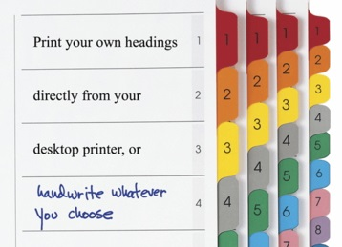
Activity #5 Report, Binders … 2/2
To the church: Two 3-Ring Binders with 8 Tabs
and all electronic files (I keep one 3-Ring Binder)
Process: Start early and keep it moving as you go
Tab
1 Description of Contents 1 p.
2 Consulting Summary 3 pp.
(write this last)
3 Church Health Defined 5 pp.
4 Consultant’s Analysis 25-35 pp.

Slide 17
Activity #5 Report, Binders … 2/2
Tab
5 Recommendations Detail 7-10 pp.
6 Church Health Survey 42 pp.
7 Percept Demographics 40 pp.
8 About Barber Church 2 pp.
Consulting
Total: 125-138 pp.

Slide 18

Activity #6 Percept Order 3/1
One of the easiest things to complete – order early
Recommended radius of 10 miles (20 min. drive time)
Simple circle or polygon of any shape: rivers, metro areas . Get church buy-in to shape using 20 minute drive time (See instructions Session #2)
www.ministryarea.com
Society members get
a discount
Denom. Clients Link 2 Lead $5000 per yr.
Report is immediate
by email

Slide 19

Activity #7 CHS Order 3/1
The Church Health Survey is based on the functions of the early church seen in Acts 2:40-47
25 questions each: evangelism, discipleship,fellowship
worship, ministry, prayer,
www.thelawlessgroup.com
Order from Pam Lawless
Online version at churchhealthreport.com
Society members discount waiting for online code
Have survey sent to the church and have point person
develop a sampling list including key leaders (staff/board) and others with mix of male/female, age, ethnicity. Not a random sample. (See the 12 spies!!)

Slide 20

Activity #8 Analyze Percept 3/4
Goal: glean key info from 40 pages of data
See Session 2 7-Go-to-Areas
Enough to be able to write an Andover Andy and Christine
Examples:
% that believe in God
%s strong faith involvement, somewhat, none
Compare decadal age to church decadal age
(or ethnicity)
Worship style preferences/ Leadership Style Pref.
Average income

Slide 21
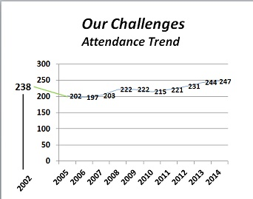
Activity #9 Analyze Data 3/7
What are the main points of the data?
Attendance pattern, budget mix/%s, staff ratio
Weeks of cash reserve
Church polity
Website: current? switch?
Assimilation Practices
Disciplemaking /Lead. Dev.
Facility Master Plan?
Look for Strengths and Weaknesses

Slide 22
Activity #10 Write Analysis 3/7
Main Point: Write as you go while it’s fresh
Be Objective and Disciplined (25-35 pages)
15 sections of report
5 Main Components of CHA | Description of Consulting Work (What I Did ) | Observations Made (What I Saw) | Conclusions From Observations (So What?)
Data Request
CHS
Percept
Interviews
Site Visit

Slide 23
Types of Analysis
    Inwardly focused? Life Cycle Curve
    b. Attractional / Missional
    c. Assimilation processes
    d. Small group ratio: 7:100
    e. Clearly defined disciplemaking
    f. Defined leadership development
    g.Volunteer Mobilization Methods
Notes:
Church Diagnostic Tools
1. Research from around the country; No research is infallible!
Are these issues we need to raise?
a. “Return likelihood” – especially if they are visiting several churches
Do people come back? (Keep good records!)
If people don’t come back…why?
b. Win Arn!
- 12-15 people
- Flavel Yeakley Friends 1:7

Slide 24
Types of Analysis
  h. Philosophy of growth: on site? plant?
  Strategic Vocabulary
  Cultural Relevance
  Resistance or open to change
  Pace of decision-making (structure)
  m. Unity or conflict
  n. Facility Traffic Light
Notes:
Church Diagnostic Tools
1. Research from around the country; No research is infallible!
Are these issues we need to raise?
a. “Return likelihood” – especially if they are visiting several churches
Do people come back? (Keep good records!)
If people don’t come back…why?
b. Win Arn!
- 12-15 people
- Flavel Yeakley Friends 1:7

Slide 25
Types of Analysis
Financial
Fiscal 2016 Budget | $’s in 000’s | % of Total | Aubrey Malphurs Guidelines | % Differences
Ministries (less Missions, plus office) | $58 | 11% | 20% | -9%
Missions | 54 | 10% | 10-15% | Within Range
Facilities (Mort if any) | 120 Includes interest expense | 22% | 20-25% | Within Range
Staff Comp/Ben and Staff Trans. | 309 | 57% | 40-60% | Upper end of Range
Total Expenses | $541 | 100% | 100%
Weeks of Cash: Undesignated Cash/ (Total Expenses/52)
E.C.F.A. post-Great Recession guideline is 7-13 weeks
Notes:
Church Diagnostic Tools
1. Research from around the country; No research is infallible!
Are these issues we need to raise?
a. “Return likelihood” – especially if they are visiting several churches
Do people come back? (Keep good records!)
If people don’t come back…why?
b. Win Arn!
- 12-15 people
- Flavel Yeakley Friends 1:7

Slide 26
Activity #11 CHS Process/Analysis 4/6
Lawless
Church
Lawless
You
You
Online version will streamline this
Consultant orders from Lawless
Lawless Group sends to church
Church administrates
Back to Lawless Group
Consultant needs report for interviews

Slide 27
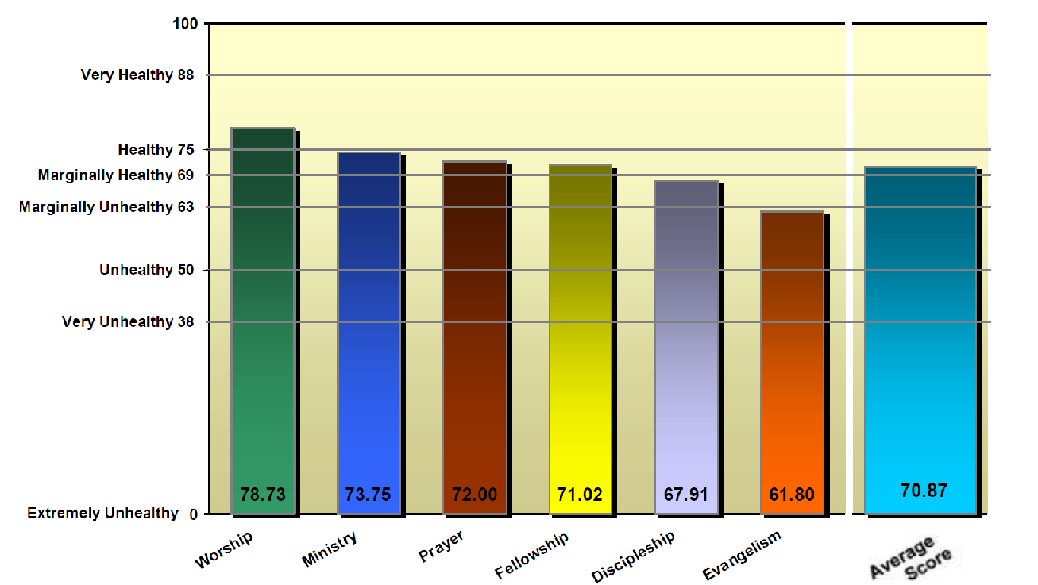
Activity #11 CHS Process/Analysis 4/6

Slide 28
Activity #11 CHS Process/Analysis 4/6
25 questions: Possible score of 4.0 for each question
Draw out strengths and weaknesses
Anything 2.2 or less is low and red flag
Help church understand “negatively worded” questions
Fellowship Q5 We have several cliques in our church
SA A Undecided D SD
0 1.0 2.0 3.0 4.0

Slide 29
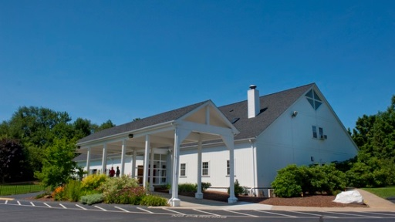
Activity #12 Facility Review 8/1
Minimum of 1.5-2.0 hour interview and walk through
Ask for most knowledgeable person(s)
Go room-by-room, every room, exterior, take pictures
Ask to go over any master plans
Understand developable capacity
Ask about relationship with city
Use Society training of ratios
Assess attention to maintenance, cleanliness, signage,
visibility from road, parking, capacity or full

Slide 30
Facilities Analysis
  Signs are very important. Maze syndrome
  The auditorium should be light and bright
  Sound must be quality
  Prioritize the upkeep of the ladies’ restrooms
  Young parents will evaluate your church by the nursery.

Slide 31
Facilities Traffic Light Example
Capacity for Growth in one service
Worship
Parking
Fellowship
Education
Land
80%
15%
92%
50%
42%

Slide 32
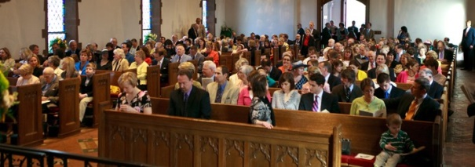
Activity #13 Observe Worship 9/1
Arrive early enough to observe greeters – observe how long they stay at their entrance
Observe if anyone introduces themselves to you
Observe Church Security
Observe quality of ministry, technology, culture of dress, style of preaching, use of story, humor, testimony,
1/3 through sermon, count heads, go observe fullness of education rooms, and go count empty parking spaces After service, observe availability of space for fellowship and provision of a coffee time

Slide 33

Activity #14 Interview Questions 10/1
The Hinge: Allow all prior info to inform
“ … the most effective way to influence
both individual and institutional behavior
is to ask questions.”
Lyle E. Schaller
The Interventionist
Abingdon Press
1997

Slide 34

Activity #14 Interview Questions 10/1
Ask them if they know why you are here. Then tell them.
Write/Ask questions to verify or clarify Health Survey
Write/Ask open ended questions requiring thought
Closed questions will allow simple yes or no.
Ask about their experience and emphasize that the board has allowed this so their honesty is constructive.
Promise general confidentiality if asked.
I.e. “I heard this in my interviews”
versus , “Bob said this in my interview”.
Exceptions would be revelation of
immorality, or a major conflict, or similar.

Slide 35
Activity #14 Interview Questions 10/1
Sample Questions
From the Church Health Survey, it looks like 20% do 80% of the ministry in this church. Do you agree with that? Why, or why not?
On a scale of 1 being completely inward-focused, and 10 being completely outward-focused, what number would you use to describe your church? Why?
Tell me what you experienced when you first came. Called? Letter(s)? Invitation to serve or groups?
Closing Question: Is there anything we haven’t discussed that you hoped that I would bring up today?

Slide 36
Activity #15 Interviews 11/2
Recommended order of interviews
Paid Staff members one on one
Key Lay Leaders one on one
General Board/Council Group
Trustees Group
Attendees > 10 years Group (6-8)
New Attendees < 2 years Group (6-8)
Elder/Overseer Board Group
Sr. (Lead) Pastor one on one
“ I have heard
___________.
Agree?”

Slide 37
Activity #16 Complete Analysis 13/2
Activity #10, you have been writing all along. With the
on site and interviews complete you can now complete it
Resist the urge to leap to recommendations and complete the recording of objective observations and conclusions
The more thorough the analysis, the better the foundation from which to write your recommendations
What I Did, What I Saw, and So What?

Slide 38

Activity #17 Recommendations 14/1
I recommend that you target for at least 4 and not more than 7 recommendations for improvement with a timeline of 1-3 years in mind. Include elements of SMART goals.
Keep the Great Commission and Acts 2:40-47 (The Church Health Survey) in mind to make sure you are going after “Big Rock” priorities.
Seek a balance of health, ministry
functions, growth, support functions.
State the main thought of the
recommendation in 1-2 sentences,
followed by 1-2 pages of depth.
Show path or optional paths forward (granularity)

Slide 39
Activity #17 Recommendations 14/1
Examples of Actual Recommendations Made
- Conduct Strategic Planning (Revitalization)
- Enhance Evangelism and Assimilation Practices
- Simplify/Clarify Disciple Making Practices
- Identify your philosophy of growth: on site, and/or
church planting, and/or multi-site
- Enhance your staffing in this area: __________
- Develop a master plan to build on site
- Improve your financial practices by ________

Slide 40
Ministry
S-Curve
Structure
Diagnosis
Nostalgia
Goals
Questioning
Cure
Beliefs
Polarization
Dream
Dropout
Prevention
Notes:
Nostalgia is doubt structure: A common mistake is to restructure. Band-Aid!
Since structure grows out of organizational goals, the cure is usually found in the goals. Does the structure mesh with the goals?
Preventative medicine always goes back to sharpening the original Kingdom dream.
Hoover

Slide 41
Activity #18 Written Report 14/1
With your Recommendations complete, you can now
complete a Consulting Summary. Use your 1-2 sentence recommendations in the summary.
The summary should inform the casual reader with
little time to understand what you did, why its important, and a high level summary of your recommendations.
Complete what you will hand off to the church when you deliver your final presentation. For me, that is two 3-ring notebooks and all electronic files.

Slide 42
Activity #19 PowerPoint 14/1
Information
Inspiration
Encouragement
Motivation
Clarity of Recommendations
Text with Visuals
About 40 slides
Consulting Methodology and Report Content 2
Strengths of the Church I have observed 4
Key Data Findings 4
Health Survey outcome – unhealthy areas 10
Demographic Data – need for evangelism 5
Recommendation Detail and Rationale 15

Slide 43

Activity #20 Presentation 15/1
Let church decide who is in the room
May be just board and Sr. Pastor: 7-9
May be them plus ministry staff 9-15
May be them plus lay leaders 25
I ask for 2 hours total
Interactive Q&A style: I stick to my PPT but invite
questions and discussion as we go – defer as needed
Handoff the written reports
Promise to send electronic files the next morning
Offer follow up consulting services

Slide 44
CHA Follow Up
Depends on your specialty services / church readiness
Mine:
- Facilitated Strategic Planning
- Staffing Analysis
- Governance Transitions
- Leadership Development Training/Coaching
- Senior Pastor Coaching
Yours will be unique to your experience/strengths
Consider option contracts and bundling

Slide 45
Session #9 Agenda and Topics
1
Process and Gantt Chart
2
Sample Documents
3
Detailed Steps and Gantt Chart
4
Case Study

Slide 46
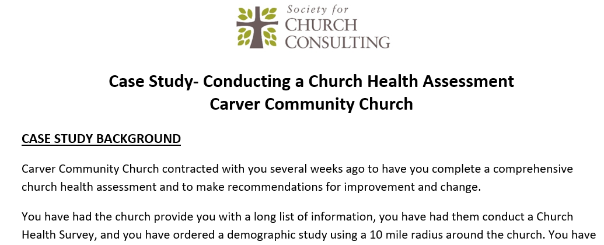
Church Health Assessment
Case Study
Contact me to discuss if you would like to

Slide 47


Questions
What questions do you have?
What troubles you about the material?
jim@churchconsulting.org
1-866-221-6313

