Slide 1
Revitalization Training
Session #8

Slide 2
Online Training 10 Sessions
Session | Title
1 | 7 Church Revitalization Tools: Tools 1 and 2
2 | 7 Church Revitalization Tools: Tools 3-5
3 | 7 Church Revitalization Tools: Tools 6-7
4 | 12 Church Health Components: 1-3
5 | 12 Church Health Components: 4-6
6 | 12 Church Health Components: 7-9
7 | 12 Church Health Components: 10-12
8 | Certification and Consulting
9 | Consulting: Comprehensive Church Health Assessment
10 | Consulting and How To Launch a Consulting Practice

Slide 3
Basic Church Consulting Concepts
1
What is Church Consulting?
2
Who Consults?
3
Types of Consultations
4
Society Certification Path

Slide 4
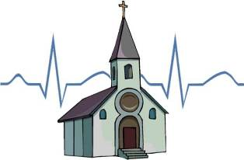
Basic Church Consulting Concepts Society Definition
“A church consultation is a process in which an individual or a team provides insights, recommendations and guidance to improve the overall health of a church, or to assist in a
specific area of church need.”

Slide 5
Basic Church Consulting Concepts Society Definition
“A church consultation is a process in which an individual or a team provides insights, recommendations and guidance to improve the overall health of a church, or to assist in a
specific area of church need.”
May be a few days, weeks, or months, or a few months with follow up
over years

Slide 6
Basic Church Consulting Concepts Society Definition
“A church consultation is a process in which an individual or a team provides insights, recommendations and guidance to improve the overall health of a church, or to assist in a
specific area of church need.”
There are consulting individuals and groups

Slide 7
Basic Church Consulting Concepts Society Definition
“A church consultation is a process in which an individual or a team provides insights, recommendations and guidance to improve the overall health of a church, or to assist in a
specific area of church need.”
Consult a church versus coaching an individual

Slide 8
Basic Church Consulting Concepts Society Definition
“A church consultation is a process in which an individual or a team provides insights, recommendations and guidance to improve the overall health of a church, or to assist in a
specific area of church need.”
There are Generalists and Specialists

Slide 9
Basic Church Consulting Concepts General Consulting Terms
Revitalize: New life, vision and vision path
Train: From your experience (do – teach – consult)
Facilitate: Making the decision-making
processes of the church leadership team easier
Analyze: Acting as an objective outsider assessing the
church from a standard or standards
Recommend: From your analysis, stating focused actions
the church can take to improve
Encourage/Motivate: Exhorting the church to change

Slide 10
Basic Consulting Concepts The Interventionist Lyle E. Schaller Abingdon 1997
A church consultant is:
An outside third party (to denom./church,
board/staff)
A change agent
Gifted for it or learned skills or both
Able to formulate relevant questions
Active listener and a learner
Able to offer a diagnosis
Has a conceptual framework from which to analyze

Slide 11
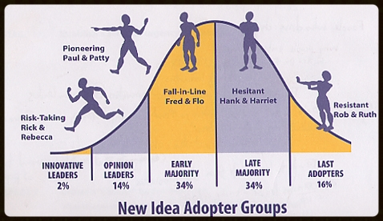
Basic Consulting Concepts The Interventionist Lyle E. Schaller Abingdon 1997
A church consultant is: A change agent
Credit: Dave Travis, Leadership Network
Everett Rogers, Diffusion of Innovations

Slide 12
Basic Consulting Concepts The Interventionist Lyle E. Schaller Abingdon 1997
A church consultant formulates questions and is an active listener.
“… the most effective way to
influence both individual and
institutional behavior is to ask
questions.”
The Interventionist p.15
“But what about you?” he asked.
“Who do you say I am?” Mt 16:15

Slide 13
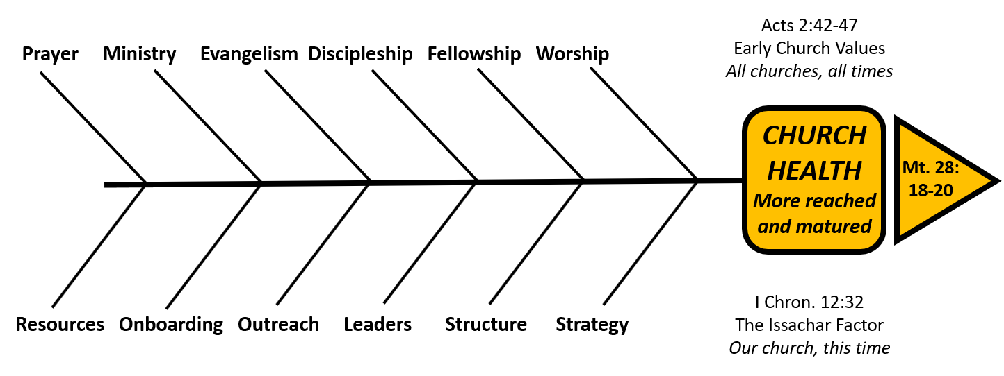
Basic Consulting Concepts The Interventionist Lyle E. Schaller Abingdon 1997
A church consultant has a conceptual framework from which to analyze.
The Fishbone Diagram is a framework

Slide 14
Consulting versus… i.e. what consulting is not
 | Primary Relationship | Need Addressed | Relational Activities
Consulting | Organization Leadership | Mission and Strategies, Specialty, Conflict | Observe Recommend Train / Facilitate
Coaching | Individual | How to achieve goals | Drawing out Hold accountable
Mentoring | Individual | Learn from others experience | Sharing and Showing
Discipling | Individual | Spiritual Growth | Train -Encourage
Counseling | Individual | Mental/Emotional Health | Reflecting on and resolving the past

Slide 15
One Coaching Definition
“Coaches are change experts who help leaders take
responsibility for their lives and act to maximize their
own potential.”
“… the essence of coaching is believing in people.”
Leadership Coaching, Tony Stoltzfus, Coach22, 2005

Slide 16
Consulting and Coaching
Consulting
Coaching
There can be overlap
Some get certifications for both
E.g. see christiancoachingmag.com and coachfederation.org

Slide 17
Basic Church Consulting Concepts
1
What is Church Consulting?
2
Who Consults?
3
Types of Consultations
4
Society Certification Path

Slide 18
Who Consults? The trend is a wider circle
Historically, just published professors,
influential pastors, and some denominational
leaders, predominantly male.
The circle has widened to include
trained men and women, usually
with ministry experience, some
with business experience, and
ethnic diversity.
The wider circle comes from the need, from
more pathways, and partly “retiring” or later-phase
baby boomers.

Slide 19
Who Consults? Denominational “Consultants”
Many denominations staff Church Health Strategy
positions at the national, regional, state, or
multi-county level.
They perform most of the same functions of a
generalist as described in this training (overall
church health).
They typically have served as a pastor/minister in that
denomination.

Slide 20
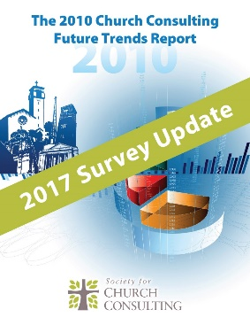
Who Consults? (See Session #1) Many who mix it with other careers
Most are not
full time
Gary McIntosh on how to launch a church consultancy: “Don’t quit your day job!”

Slide 21
Who Consults? Future Trends Report Full time / Part time

Slide 22
Who Consults? Some in Groups

Slide 23
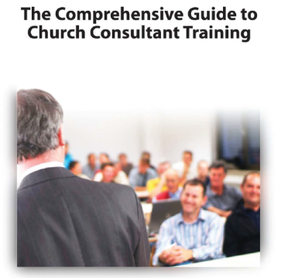
Who Consults? Free Training Guide Self-assessment
1. Do you have more than five years of experience
serving on a church staff?
2. Do you understand how a church can be unhealthy?
3. Do you feel a deep desire to help churches become healthy?
4. Do you currently have an adequate source of income?
5. Do you have any experience in the business world?
6. Do you know of at least three churches that are in significant decline?
7. Have you ever been involved in resolving serious church conflict?
One point for every “Yes” – then find your score below.

Slide 24
Self-Assessment Quiz – Cont’d
SCORE: 6-7
You have the highest chance of success if you decide
to pursue church consulting.
You have the experience, desire and opportunity necessary to help struggling churches. You are a natural candidate for professional training.
SCORE: 3-5
You have a good chance of success if you decide to pursue church consulting.
If you scored in this range, you should not consider becoming a full-time consultant, but you still have what it takes to revitalize churches. We recommend that you investigate various resources and training to equip you for this work.
SCORE: 0-3
Modest to low chance of success if you decide to pursue consulting.
As you evaluate your next steps in ministry and life, we advise that you consider focusing your time, efforts and resources on your home church rather than consulting others.

Slide 25
Basic Church Consulting Concepts
1
What is Church Consulting?
2
Who Consults?
3
Types of Consultations
4
Society Certification Path

Slide 26
Society Future Trends Report 2010 Motivations to Seek a Consultant
This informs the types of services that will be in demand.
Consultants provide a supply for demand

Slide 27
Comprehensive Generalist Consulting
A Church Health Assessment
Spiritual Foundation
Data, Survey, Demo- graphics, Analysis
Recommend
Interviews / Observe
Report
Session #9 will be devoted to this

Slide 28
Comprehensive Generalist Consulting
Data Request: attendance trend, financials,
staff pt or ft, ministry participation, by laws,
geographical attendance, adult age by
decade, etc. (See sample request)
Survey: see thelawlessgroup.com Church Health Survey
15% of attendance, 160 questions, Acts 2:40-47
(See sample summary report in Session #2)
Percept Demographics and Psychographics (beliefs, preferences)
see Ministryarea.com draw a radius, 40+pages
(See sample summary First View Report – Andover – Session #2)
Analysis: read, measure ratios, measure against church standards,
compare internal to external, etc.

Slide 29
Comprehensive Generalist Consulting
Data Request: attendance trend, financials,
staff pt or ft, ministry participation, by laws,
geographical attendance, adult age by
decade, etc.
Survey: see thelawlessgroup.com Church Health Survey
15% of attendance, 160 questions, Acts 2:40-4
alternatives: Transformational Church Assessment Tool –LifeWay
NCD, or Macchia CHAT
Percept Demographics and Psychographics (beliefs, preferences)
see Ministryarea.com draw a radius, 40+pages
alternatives: see MissionInsite.com and thearda.com
(Archive of Religious Data – free)

Slide 30
Modified Generalist Consulting #1
Administrate the process of helping
the church complete a church health
survey. Possibly analyze the report.
Spiritual Foundation
Just the Survey
Report

Slide 31
Modified Generalist Consulting #2
Administrate the survey and getting
the demographic info and possibly
interpret the reports somewhat.
Spiritual Foundation
Survey and Demo- graphics, Analysis
Report

Slide 32
Modified Generalist Consulting #3
Do everything but come on site to do
interviews and observe worship and the
facilitate.
Spiritual Foundation
Data, Survey, Demo- graphics, Analysis
Recommend
Report

Slide 33
Alternative Pricing
Think about the value of the service, the
complexity of the size church, and price
accordingly. (More in Session #10)
See barberchurchconsulting.com
 | Small Church (1-300) | Medium Church (301-699) | Large Church (700+)
Survey Only
Above plus Demographics
Above plus Data Analysis
Above plus interviews and on site

Slide 34
Consulting with very small churches: Cluster Consulting
Sometimes used with 5 or more churches when each one cannot afford your fees. You design a service with large group sessions and breakout sessions charging a large discount for each church. See Dr. Ray Ellis:
http://churchconsultingnetwork.org/cluster_consultation.html

Slide 35
Specialties Mentioned Thus Far…
“specific area of church need”
Conflict Resolution
Strategic Planning
Facility Construction
Launching new ministries

Slide 36
“Church Consulting” Study 2010 First 200 websites on Google, Jim Barber
Page 1 of 2
Developing a church Vision Strategic Planning
Organization Design Board Governance
Role of the Staff vs. Board Facility Design/Expansion
Stewardship/Fundraising Worship Ministry
Multi-Venue or Multi-Site Branding/Marketing
Community Service Incorporation of Non Profits
Systems Design/Implementation Administration
General Coaching By-Law Redrafting
Ministry Audits Relocation

Slide 37
34 Consulting Specialties!
Page 2 of 2
Leadership Assessment
Financial Analysis/Policy/Accounting
Financing Cultural Change
Small Groups Hospitality and Guests
Aligning Vision and Practice Gift Training
Human Resource Management Demographic Studies
Salary and Benefit Planning Outreach
Technology Missions
Security Education and Training

Slide 38
Future Trends Report Specialties

Slide 39
Example: My Specialties
Strategic Revitalization and Planning
Working with a church leadership team to help
them develop a 3-year ministry plan in light of
today’s reality (with primary emphasis years 1-2)
Vision and Partnering 1-2-3
Training a leadership team how to annually refresh
strategies and align staff, programs, and budget
Leadership Structure
Facilitating congregational and elder rule church
transitions into new governance forms

Slide 40
Two paths a church may follow to your specialty
Introductory Relationship
Generalist
Specialist
Path #1: You start a relationship as a generalist which gives you
credibility and a trust relationship to help with your specialty.
Example: Church Health Assessment followed by Leadership Structure

Slide 41
Two paths a church may follow to your specialty
Introductory Relationship
Specialist
Generalist
Path #2: You start a relationship as a specialist which gives you
credibility and a trust relationship to help as a generalist.

Slide 42
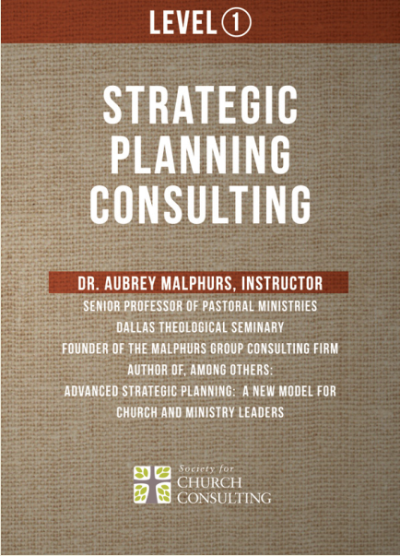
Specialty of Strategic Planning and Church Revitalization
Session #10 will address
Levels 1-4 Training
Strategic Planning Track
A Consulting Specialty
DVDs on website
No Live Training Planned
Based on Aubrey’s book
Advanced Strategic Planning
and his consulting practice.

Slide 43
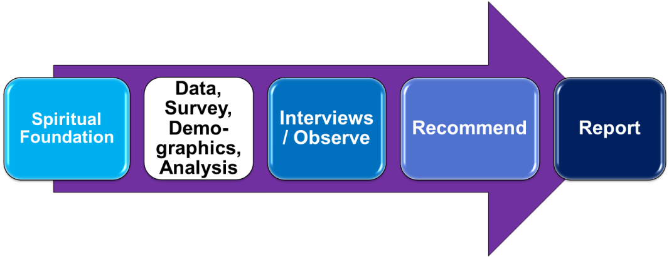
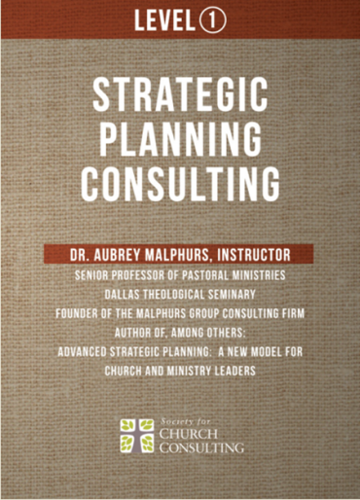
Complementary Church Health Assessment and Strategic Planning
Assess Today’s
Reality
(3 months)
Facilitate
Development of
A 3-year Ministry Plan
(6 months)

Slide 44
Basic Church Consulting Concepts
1
What is Church Consulting?
2
Who Consults?
3
Types of Consultations
4
Society Certification Path

Slide 45
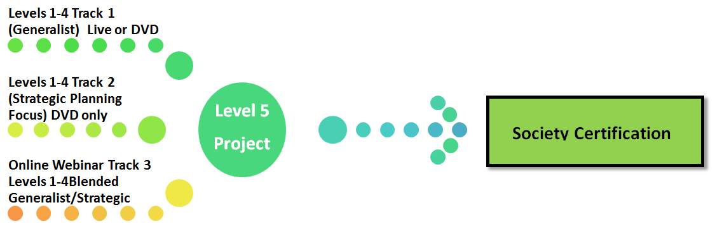
Society Path to Certification
Society Directory
Three Alternative
Training Tracks
Two Methods:
Coached
Shadow
Other Certification Requirements

Slide 46
Level 5 Coached Training Project
A live, comprehensive church consultation with a church that agrees to use your services (not your church)
Coached by Dr. Chuck Lawless. Your communication with Dr. Lawless will be by e-mail and phone
Recommended but not required that
you use the Church Health Survey
in your consultation.
You may also use Track 2 Strategic
Planning Consulting
16 people in last two years have opted for
this coached method

Slide 47
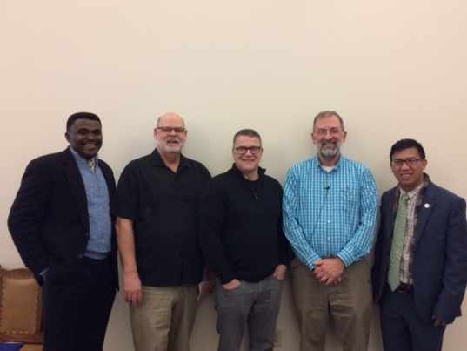
Level 5 Shadowed Training Project
A live, comprehensive church consultation with a church conducted by a certified church consultant
You agree on the level of involvement and fees
You shadow the consultant by phone, email, with online meetings and possibly in person
You write a 1000 word report
- 23 people have shadowed since January 2017
- Churches in SC, ND, FL
- 21 from the U.S., 1 from U.K., 1 from Malaysia

Slide 48
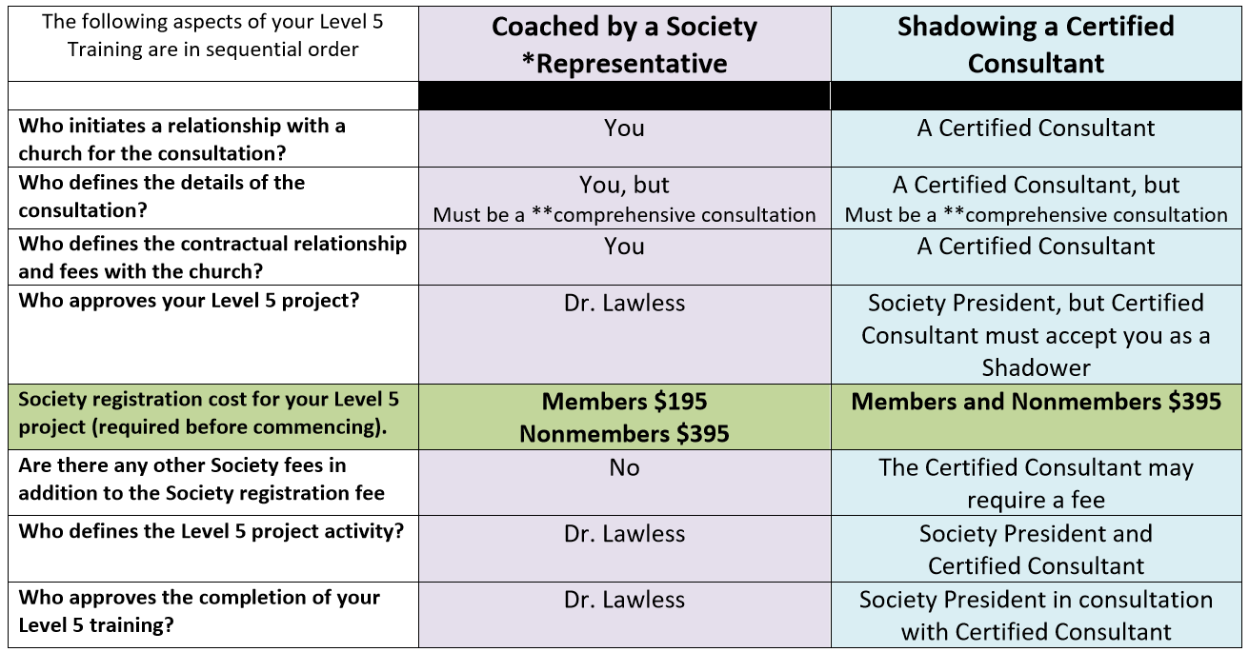
Level 5 Coached Versus Shadowing

Slide 49
Certification Requirements
Must be a Society Member in good standing
2) Minimum of 5 consecutive years church consulting OR
adequate training (Levels 1-5 with the Society or
equivalent training by another body)
3) 1000-word paper on your philosophy of consulting
4) Submit two church consultation reports (one can be
your Level 5 Project)
5) Submit three ministry reference letters
6) Agree to abide by the Consultant’s Code of Ethics
7) Fee $189

Slide 50
Society Code of Ethics
1) Work under the Lordship of Christ and hold to
the authority of the Bible
(See our Mission, Code and Statement of Faith in About Us)
Be honest and do not knowingly misrepresent facts
Divulge any potential conflicts of interest as soon
as they are known
Only accept consulting projects which can be
completed in a professional and timely manner
Safeguard any confidential information or
documents

Slide 51
Society Code of Ethics
6) Do not divulge any confidential information without consent of the church/client
7) Abide by all laws in the jurisdictions where they work
8) Report all time worked and expenses incurred
accurately and honestly
9) Meet all requirements to maintain integrity as a
certified consultant

Slide 52
Questions
What questions do you have?
What troubles you about the material?
jim@churchconsulting.org
1-866-221-6313

