Slide 1
Revitalization Training
Session #7

Slide 2
Online Training 10 Sessions
Session | Title
1 | 7 Church Revitalization Tools: Tools 1 and 2
2 | 7 Church Revitalization Tools: Tools 3-5
3 | 7 Church Revitalization Tools: Tools 6-7
4 | 12 Church Health Components: 1-3
5 | 12 Church Health Components: 4-6
6 | 12 Church Health Components: 7-9
7 | 12 Church Health Components: 10-12
8 | Certification and Consulting
9 | Consulting: Comprehensive Church Health Assessment
10 | Consulting and How To Launch a Consulting Practice
Top Components
Bottom Components

Slide 3
Session #7 Outline
1
Outreach
2
Onboarding - Assimilation
3
Resources
Onboarding - Back Door
4

Slide 4
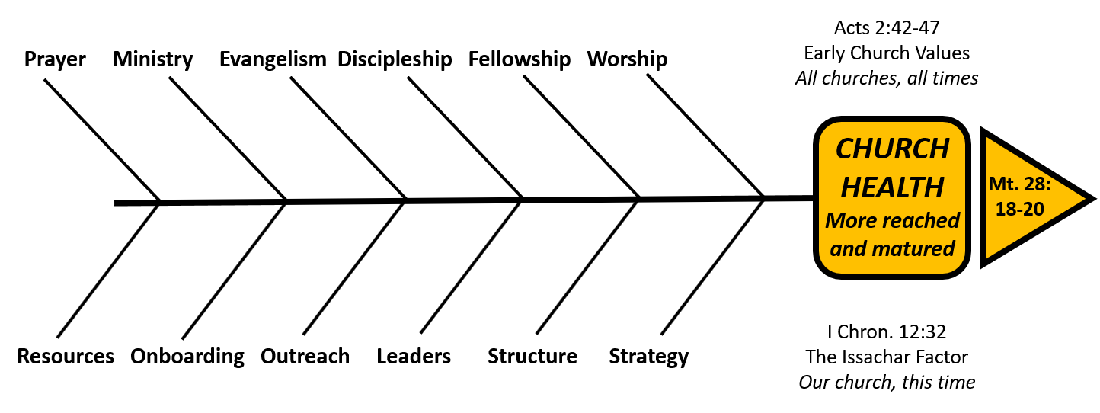
Outreach
A Church Organizational Health Definition
Outreach is a component of organizational health that complements the truth of evangelism with the proof of changed lives through service. It is grounded in a biblical
perspective and a contextual understanding of community needs. Leaders affirm the need for this type of service beyond the walls of the church. They also create an environment that supports the Spirit’s motivation of the church to obey God and love their neighbors. This may be spontaneous acts or organized gestures working collaboratively with social service and government agencies.

Slide 5
Outreach
Standard Classification Format for this Component of Church Health
Organic or Organizational | Organizational
Side of the Fishbone Diagram | Bottom
Relational or Task | Both
Timeless or Timebound/Contextual | Timebound/Contextual
Acts 2 Reference | 47 enjoying favor of all the people …. Lord added … those being saved
Complimentary Component | Evangelism

Slide 6
Outreach:
Compare/Contrast with Evangelism
 | Evangelism | Outreach
Foundational Theology | Great Commission Mt 28:18-20 | Great Commandment Mt. 22: 35-40 Erickson: Social Concern Grudem: Mercy
Commonality | Relationships outside of the church | Relationships outside of the church
Contrasting characteristics | Verbal proclamation and persuading Truth | Loving and serving with good deeds Proof
Cultural Sensitivity | A slave to win 1 Cor. 9:19 | Postmodernism communication style

Slide 7
Outreach:
A Biblical Perspective
Pv. 14:21 “It is a sin to despise one’s neighbor, but blessed is the one who is
kind to the needy”
Pv. 31:20 “She opens her arms to the poor and extends her hands to the needy”
Mt 5:16 “…let your light shine before others, that they may see your good deeds
and glorify your Father in heaven
1 Pet. 2:12; 3:15 “Live such good lives … they may see your good deeds and glorify God …”
“…be prepared to give an answer to everyone who asks….”
Gal 6:10 “ … let us do good to all people, especially to those who belong to the
family of believers.”

Slide 8
Outreach:
Author’s Component of Health
Christian Author | How defined as a component of health
Lawless Q16, Q52 | Reaching out to area/community
Rainer/Stetzer TCAT | Show Jesus through word and action
Barna 9 Habits | Serve the needy people in the community
Macchia 10 Traits | Have an outward focus
Schwartz NCD 8 Qualities | Need oriented evangelism
Callahan 12 Keys | Shepherd the unchurched
I came to a place where I had a degree from a Bible college, a masters degree,
and my doctorate, and I said to myself, “where did these 2,000 verses in my Bible
come from that talk about taking care of the poor?” Rick Warren

Slide 9
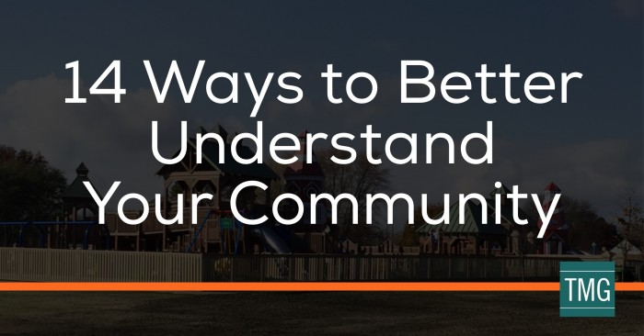
Outreach:
Contextual Understanding
How to Exegete Your Culture: Ed Stetzer
2. 14 Ways to Better Understand Your Community:
TMG (The Malphurs Group)
The Percept Demographic Tool:
A Purchased Service

Slide 10
Outreach:
Leaders Affirm and Support
Define it theologically, etc.
Read about what others are doing
Pray
Assign a leader with gift(s) and passion for it
Consider making it a % of a person’s ministry

Slide 11
Outreach:
Next Practical Steps
.
.
.
Sermon Series to share biblical/theological values
Interview city, county, school system, and social service leaders
Study homelessness and poverty statistics of community
Network with other churches and businesses to see current outreach activity
Create an action plan to bridge from today to vision

Slide 12
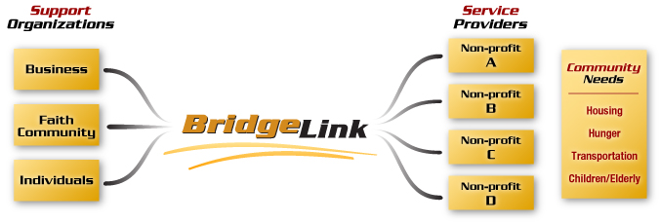
Outreach: Practical Solutions The BridgeLink Story
www.bridgelinkanoka.org
Founded as a 501(c)(3) in 2005 and active today

Slide 13
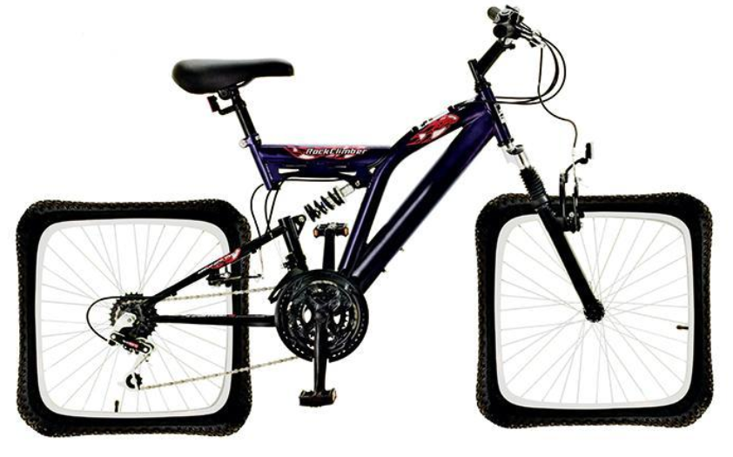
BridgeLink Major Lessons Learned
Don’t reinvent the wheel – serve those doing it
Work at the county level: human service needs
Don’t “wag the dog” – find out what they need and do that versus doing what you want to
(e.g. used computers, Serve Day vs. every day)

Slide 14
BridgeLink Major Lessons Learned
Be realistic about the cost – use what you have and don’t become immobilized (2 fish and 5 loaves)
Focus to avoid being a mile wide and an inch thick
The balance of Gt. Commission/Gt. Commandment is in our peoples hearts; they are waiting to be led

Slide 15
Session #7 Outline
1
Outreach
2
Onboarding - Assimilation
3
Resources
Onboarding - Back Door
4

Slide 16
Onboarding
A Church Organizational Health Definition
Onboarding is a component of organizational health that ensures effective ministry to people that are new to the church (the front door), and to those that are becoming disengaged (the back door). Leaders affirm the need for these types of ministry and they create an environment where all of the components of health seen in Acts 2:42-27 are promoted with each of these groups. Systems are developed to identify these people, and intentional ministries seek to help them want to be an active part of the church.

Slide 17
Onboarding
Standard Classification Format for this Component of Church Health
Organic or Organizational | Organizational
Side of the Fishbone Diagram | Bottom
Relational or Task | Both
Timeless or Timebound/Contextual | Timebound/Contextual
Acts 2 Reference | Vs. 46 favor of all the people Vs. 47 added to their number
Complimentary Component | Ministry (It is a specialty ministry)

Slide 18
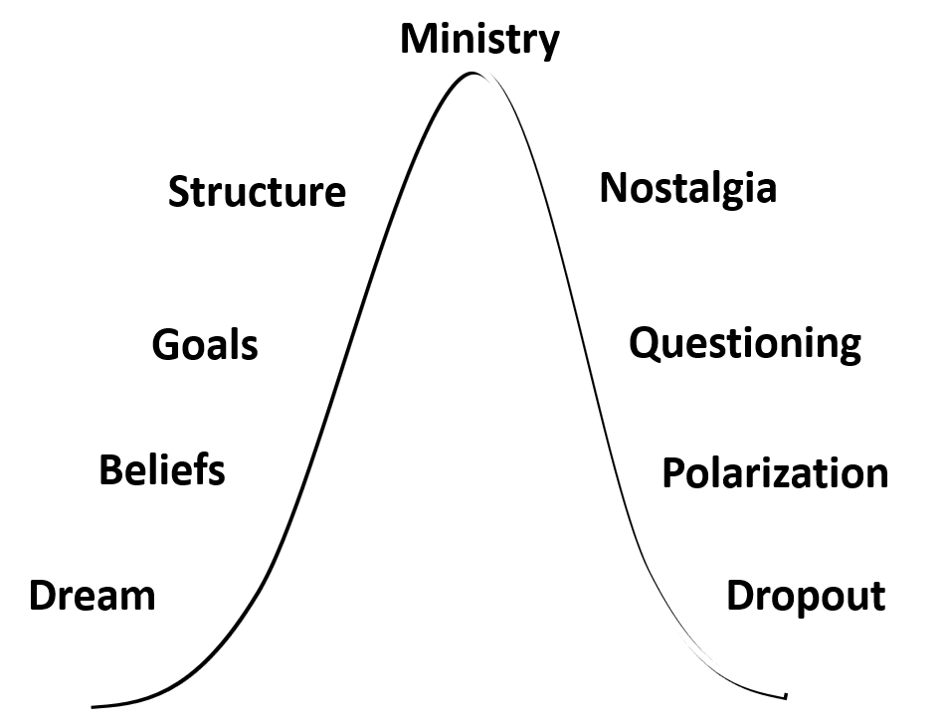
Onboarding: Understand Assimilation Math
Front Door Statistics
Back Door Statistics
Churches generally only
retain 16% of guests.
Declining churches
do not have enough guests
and potentially weak
assimilation practices
to offset the “natural” loss
of people out the back door.
Churches generally lose
10% of the flock per year
- People Move
- People get Mad
- People Die (Muerte)
- People attend church less
frequently (Mobility)

Slide 19
Onboarding
Barriers
Small church few guests – easy to dismiss
Pastor already at limit with ministry not delegating
Willing helpers need leadership
Introverted pastor at limit of relationships
Internal focus on people we know / active
Changing attendance (decreased frequency) last 10-15 years

Slide 20
Onboarding (Front and Back Door)
Barriers
Assuming people know more than they do
Assuming people also know how to easily connect
Weak discipleship: (member onboarding)
Weak ministry processes
Weak ecclesiology
Ignorance of Assimilation Math (next 3 slides)

Slide 21
Assimilation Math 1. Back Door Reality
Back Door
National Avg. from
Move
Mad
Muerte
10% loss
New one is
Sporadic attendance
- Mobility Math
Today’s Attendance: 274
Back Door: -27

Slide 22
Assimilation Math 2. Desired Growth
Back Door
National Avg. from
Move
Mad
Muerte
10% loss
New one is
Sporadic attendance
- Mobility Math
Today’s Attendance: 274
Back Door: -27
Net 247
Front Door Assim. +54
10% Growth
Attend. at yearend 301

Slide 23
Assimilation Math
3. Front Door Inviting/Receiving Required
How?
Front Door
Back Door
National Avg. from
Move
Mad
Muerte
10% loss
New one is
Sporadic attendance
- Mobility Math
Assimilate 54
Avg. Retention 16%
54/.16 = 338
Guests annually
Guests weekly= 7
338/52 weeks
Guests annual/person
(338/247) 1.4
Today’s Attendance: 274
Back Door: -27
Net 247
Front Door Assim. +54
Attend. at yearend 301

Slide 24
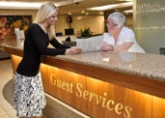
Assimilation
Attitude
All churches believe they are friendly
Hospitality means love of strangers
Treat guests like family
Love guests as yourself
We were once guests too
3. Without “sticking” guests, a church cannot grow
Notes:
Assimilation starts with right attitude
EXTERNAL FOCUS
Even w/right attitude may face barriers
Start by understanding Assim. MATH

Slide 25
Assimilation: A 4-Step Plan
1. Call guests within 24 hours
Acknowledgment
2. Ask guests for their opinions
Enhancement
3. Send a thank-you letter within 2 days
Appointment
4. Place guests on the mailing list
Commitment
5. Invite them to return
Notes:
So we need an external attitude
We need intentionality
… finally we need a process

Slide 26
Assimilation: A 4-Step Plan
1. Mail a special thank- you card
Acknowledgment
2. Deliver a gift to their home
Enhancement
Appointment
3. Explain the pathways
to receptions, groups, ministry
Commitment
Notes:
Idea is to progressively build
Requires some form of database

Slide 27
Assimilation: A 4-Step Plan
1. Call to ask about their interests and needs
Acknowledgement
Enhancement
2. Send special brochures
Appointment
3. Invite to the pastor’s dessert event
Commitment
See Rainer article
Oct. 2016
Quoting Pew Research
Seven Key Reasons People Choose A Church:
79% say welcoming by leaders
Notes:
Pastor’s event can be DELEGATED
Phone callers
Meal provider
Hosts - Home

Slide 28
Assimilation: A 4-Step Plan
Acknowledgement
1.Invite them to your newcomer’s class with optional membership
Enhancement
2. Ask if they would like
to join a group
3. Ask if they would like help joining a ministry
Appointment
Commitment
Notes:
Note progression
Casual to involvement

Slide 29
Session #7 Outline
1
Outreach
2
Onboarding - Assimilation
3
Resources
Onboarding - Back Door
4

Slide 30
Back Door What Can We Control / Influence?
Back Door
We have no control over
when people Move.
We do have some control
over when people get Mad.
We can minister to the
families of people who die.
We also have some control
over the sporadic attendance
of those with Mobility.
National Avg. from
Move
Mad
Muerte
10% loss
New one is
Sporadic attendance
- Mobility Math
Today’s Attendance: 274
Back Door: -27

Slide 31
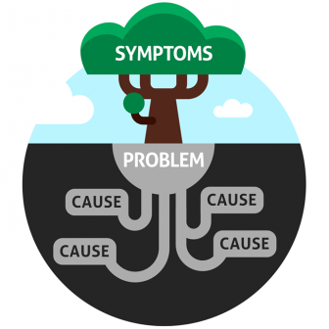
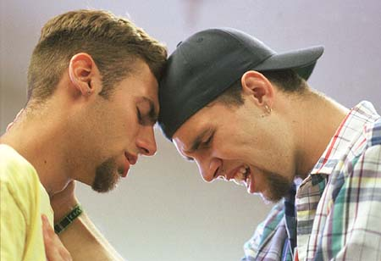
Back Door When People Get Mad
See Session #4 on Fellowship
It is a leadership responsibility to follow up
be aware of your conflict style
be Spirit-controlled, pray, use Word of God
Try to get to root issues
If it is philosophical, defend church values
If it is biblical, defend biblical values
Accommodate if possible
Bless their future path if necessary

Slide 32
Back Door Understand Macro American Culture
See Generis e-book with forward by Rainer, 2018
Faithful who attended 3-4 times, now less than 2
Understand why:
Sports, medical, aging parents, “the cabin”, vacation
Understand the math: with you, but less engaged
Small groups, ministry, giving (if have mobile method) not as affected

Slide 33
Back Door Understand Micro Culture: i.e., Your Church
Study attendance patterns in worship, ministry,
groups and giving patterns
- We cannot manage what we do not measure
- Facts are our Friends
Survey competition with worship Sunday AM
Survey interest in alternative service options
Measure % of electronic giving (Generis rec.60%)
?

Slide 34
Back Door Design Practical Systems
Measure group participation versus worship
Create a reporting system to “red flag” people that have attended worship less than X # of weeks and have that compared to group attendance, serving, and giving. Review report monthly.
Staff meet to discuss list and screen as needed
Create follow up system such as a designed postage- paid card to: acknowledge they are missed; how can we pray for; would you like an Elder to give you a call?
!

Slide 35
Back Door Design Any Necessary Response
!
Generis ideas
Alternative worship service time
Video streaming of services
More electronic giving options
More Volunteer Mobilization
Group leader training and content

Slide 36
Session #7 Outline
1
Outreach
2
Onboarding - Assimilation
3
Resources
Onboarding - Back Door
4

Slide 37
Resources
A Church Organizational Health Definition
Resources is a component of organizational health that supports the church through its facilities, financial practices, stewardship emphasis, office management, information technology, and other administrative systems. Leaders affirm the need for health in this area and they actively support their development. As the church grows, the base of Resources must grow simultaneously or in advance of numerical attendee growth. Growing churches practice an abundance mentality believing that God supplies what is needed.

Slide 38
Resources
Standard Classification Format for this Component of Church Health
Organic or Organizational | Organizational
Side of the Fishbone Diagram | Bottom
Relational or Task | Primarily Task/Admin.
Timeless or Timebound/Contextual | Timebound/Contextual
Acts 2 Reference | V 44 everything in common V45 sold property and possessions to give to anyone V 46 meet in temple courts, homes
Complimentary Component | No

Slide 39
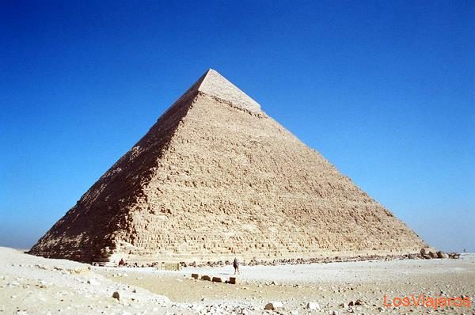
Resources: Pyramid Principle
David Womack,
Bethany Fellowship
1977
You have to expand the
base of infrastructure or
the organic growth will
fall on itself
Infrastructure in addition to Volunteers, Structure and Leaders:
Facilities Financial Management Financial Stewardship
Office Management Information Technology
Employee Handbook Policy Manual Legal Services Agreement

Slide 40
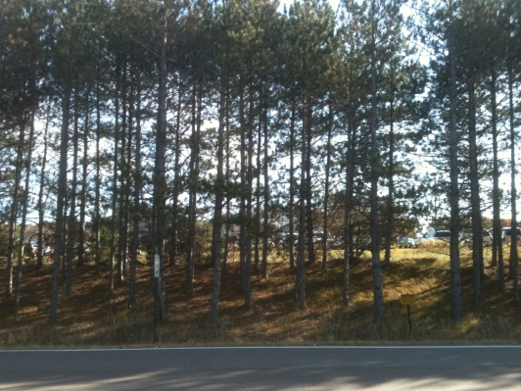
Resources:
Facilities Design and Adequacy
Callahan 12 Keys: Open Accessibility; High Visibility; Parking, Land, and Landscaping; Space and Facilities
Signage External and Internal
80% Rule
Design Parity: Balance of Worship space, education, etc.
“the design … and campus are far more critical in telling your story than most people realize.” Tim Cool

Slide 41
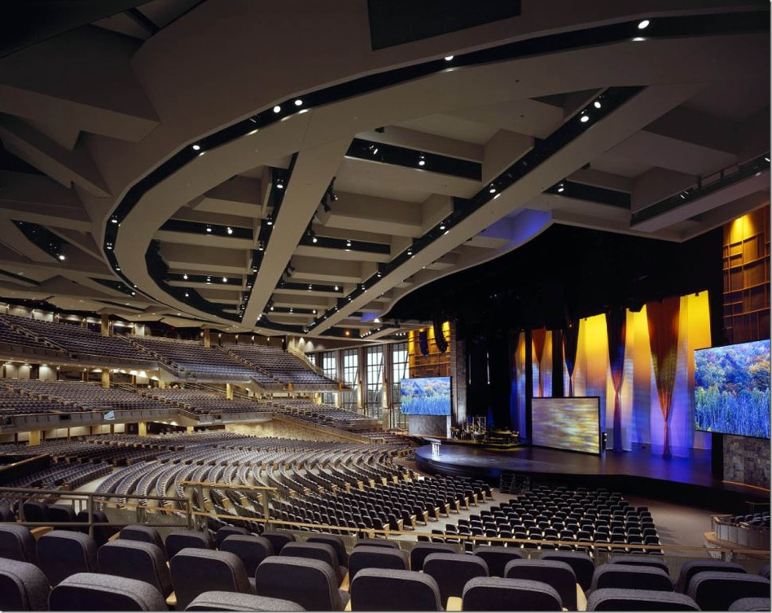
Resources: Facilities Design Parity Story
Worship Pastor from my church
Asked to lead worship in friend’s church in another state
Friend had told him all about new worship space
He didn’t tell him the whole story …
A beautiful Sanctuary

Slide 42
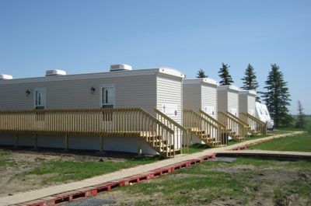
Resources: Facilities Design Parity Story
Worship Space Education Space
The whole story was an ugly imbalance
Parity applies to land, parking, fellowship space also

Slide 43
Resources:
Facilities Management, Cleanliness,
Safety and Security
Scheduling Policy and Software
Maintenance: ongoing; major projects
Adequate cleaning including detail cleaning
Security procedures, system, keying
Commercial mindset vs. residential
Fire safety system
Security policy, law enforcement, training, readiness

Slide 44
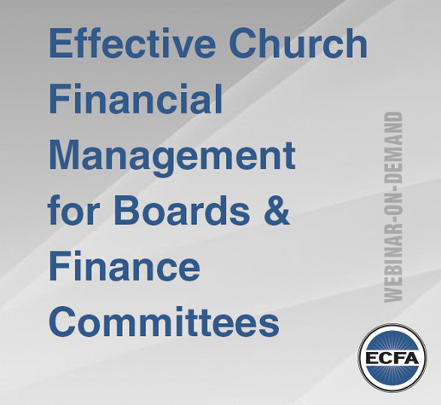
Resources:
Financial Management
Minimum number of checking accounts
Cash Reserve Policy (6-9 wks. of cash minimum)
Health Insurance Policies: property and liability,
workers comp., employee liability
Audits annually, preferably by a CPA
e.g. woman who didn’t want steps replaced ☺
Eventually accrual accounting (produce a full balance sheet)

Slide 45
Resources:
Financial Stewardship Development
Funding follows Vision and Mission
Train group leaders to emphasize
Always Thank and Ask
For guests, let plate pass, this is for regular attenders
Send personal statements monthly with cover letter
Have vision-based capital campaigns as needed

Slide 46
Resources:
Office Management and Info. Technology
User friendly church management database / software
Separate ministry prep area from office
Leased copiers and automatic folding machine
Ministry calendaring software
Staff network, security, email
Office and Public wifi
Dynamic website and social media presence

Slide 47
Resources:
Employment Handbook
At will employment versus contracts
Hiring / Firing / Giving Notice procedures
Employee classifications types and vs. independent contr.
Hours and time off
Pay determination and ranges
Benefits
Workplace Environment, Behavior, Safety
Performance Development and Evaluation
Grievances

Slide 48
Resources:
Policy Manual
Separate from Employee Handbook
Intellectual Property:
Law gives ownership to church (Willow Creek)
Policy can trump law and give to person (Saddleback)
Facility Use and Scheduling
VP 1-2-3
Security and Building Security Training

Slide 49
Resources:
Legal Services Agreement
Real Estate Transactions
Policy Review
Employee Handbook Review
Contract Review (e.g. Construction)
Reference for family law
Incident Counsel: e.g. potential abuse

Slide 50
Questions / Comments
What questions do you have?
Or comments + or – about the material?
jim@churchconsulting.org
1-866-221-6313

