Slide 1
Revitalization Training
Session #6

Slide 2
Online Training 10 Sessions
Session | Title
1 | 7 Church Revitalization Tools: Tools 1 and 2
2 | 7 Church Revitalization Tools: Tools 3-5
3 | 7 Church Revitalization Tools: Tools 6-7
4 | 12 Church Health Components: 1-3
5 | 12 Church Health Components: 4-6
6 | 12 Church Health Components: 7-9
7 | 12 Church Health Components: 10-12
8 | Certification and Consulting
9 | Consulting: Comprehensive Church Health Assessment
10 | Consulting and How To Launch a Consulting Practice
Top Components
Bottom Components

Slide 3
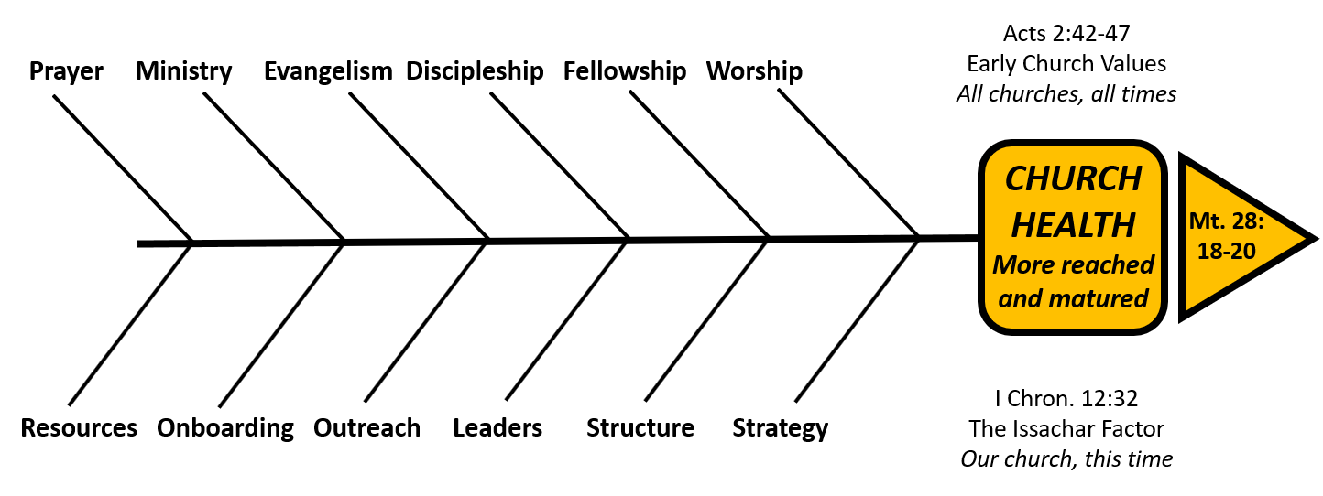
Complimentary Nature of Components
Organic/Relational
Organizational/Task
“The dynamic (organic) pole always creates organization (structures, institutions, rules, or
programs). The purpose of this organization is … to develop further the dynamic (organic)
pole. As long as this cycle is in tact … there is a highly creative relationship…. It can be
demonstrated that churches where this is evident are typically healthy and growing.”
Christian Schwartz, Natural Church Development
p.85 in 1996 book

Slide 4
Session #6 Outline
2
Strategy
3
Structure
4
Leaders
Introduction to Bottom Components
1

Slide 5
Introduction to first three Bottom Components
The sequencing of Strategy, then Structure, and then Leaders is intentional.
This sequence is also biblical.
And, secular wisdom, the philosophy of men support this as well.

Slide 6
Biblical Sequencing
Strategy, Structure, Leaders
 | Moses | Jesus | Apostles | Church
 | Ex. 18:13-2 | Mk 3:13-19 | Acts 6:1-7 | Titus 1; 1 Tim. 3
Strategy | Preserve the Exodus | Establish the Church | Establish the Church – prayer/Word | Establish the Church- set in order/straighten
Structure | Leaders of 1000s, 100s,50s,10s | 12 followers (and 3 close) | 7 to serve meals | Elders in every city Deacons, Deaconesses (wives)
Leaders | Teach them, Select able | Those whom He wanted, To be with Him | Good reputation, full of Spirit and wisdom | Above reproach, God’s steward… Managers of household, able to teach
1st Step
2nd Step
3rd Step

Slide 7
Secular Philosophical Wisdom
Strategy, then Structure, then Leaders
Strategy
Purpose-Vision-Values
- Who we are.
Where we are going.
Strategies that will get us there.
1
People
5
2
Structure
LAST
Hiring Practice
Fit with 1-4
Organization needed.
Gifts, talents, character
Relationship of staff
board, congregation
4
3
Designing Organizations, Jay R. Galbraith, Jossey-Bass, 2001
www.jaygalbraith.com (MIT, Wharton, USC)
Reward
Process
How we will make decisions
Policies and Practices
Top Down, Bottom Up, Team
Intrinsic
Salaries/Benefits

Slide 8
Session #6 Outline
2
Strategy
3
Structure
4
Leaders
Introduction to Bottom Components
1

Slide 9
Introduction to Component Detail
A Church Health Definition
Standard Classification Format
Organic or Organizational
Side of the Fishbone Diagram
Relational of Task
Timeless or Timebound/Contextual
Acts 2 Reference
Complimentary Component
Health, unhealth, and action steps for revitalization

Slide 10
Strategy
A Church Organizational Health Definition
Strategy is a component of organizational health that starts with clarity about the biblical mission of the church. Based on that understanding, the first healthy practice of strategy is assessing the organic components of health (Acts 2:42-47), the other components of organizational health, and the cultural context of the church. It also requires the capacity to plan and execute steps toward greater health, a vision for a preferable future. Strategy can create a culture of change for mission, if it has freedom to influence all other components of health.

Slide 11
Universal Nature of Strategy
A Church Organizational Health Definition

Slide 12
Strategy
Standard Classification Format for this Component of Church Health
Organic or Organizational | Organizational
Side of the Fishbone Diagram | Bottom
Relational or Task | Task
Timeless or Timebound/Contextual | Timeless and Contextual
Acts 2 Reference | None specifically although devotion to the components of health is strategic.
Complimentary Component | No

Slide 13
Strategy (Session 3)
1. Plan
Cultural Change/
Revitalize
Missional Refresh Every 3-7 years
Daily, Weekly, Monthly Coaching
Annual Cultural “P&L”
More in Strategy
3. Assess
And Align
2. Coach
More in Leaders

Slide 14
Strategy and Planning
I define strategic planning as the envisioning process that a point leader uses with a team of leaders on a regular basis to think and act so as to design and redesign a specific ministry model that accomplishes the Great Commission in their unique ministry context.
- Malphurs pg. 26
Detail in Session #10

Slide 15
Strategy – Malphurs
Who are we?
Identity
Where are we going?
Direction
How will we get there?
Strategy
Mission
Values
Assessing Strength
Admitting Weakness
Vision
Preferable Future
A New Apple
Bridging the Gap
Selecting from Palette
Focused Initiatives
This is 50,000 foot view.
Detail in Session 10

Slide 16
Strategy Source - Church Size
Factors | Small Church | Medium Church | Large Church
Size | 15-200 | 201-400 | 400+
Pastor | Lover | Administrator | Leader
Decisions | Congregation | Committees | Staff / Leaders
Change | Bottom up Through key People | Middle out through key committees | Top down through key leaders
Dr. Gary McIntosh Typology of Churches , One Size Doesn’t Fit All, Revell, 1999

Slide 17
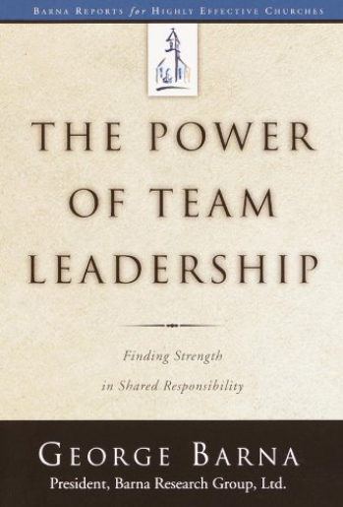
Strategy Source– A Type of Leadership
Directing: Motivational
Strategic: Analytical Planners
Team-Building: Organizing for Cause
Operational: Create Systems
Four Leadership Aptitudes
Need all 4
But leaders usually have only
One of these aptitudes
So who can and will facilitate Strategy?
1
2
3
4

Slide 18
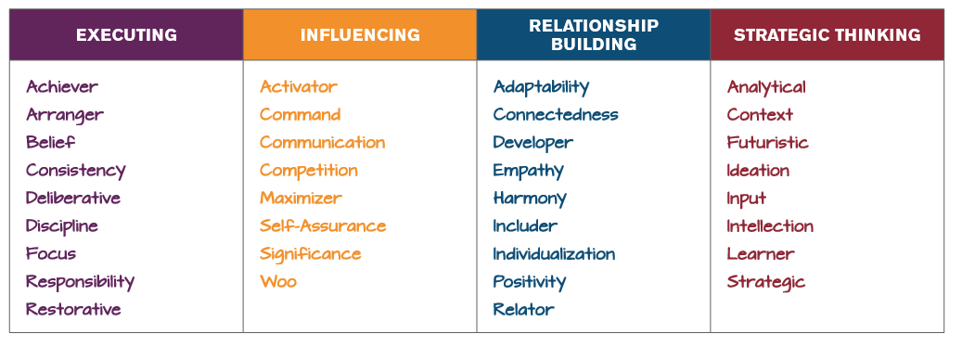
Strategy Source – Strengthsfinder

Slide 19
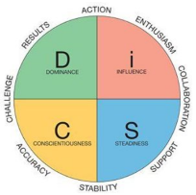
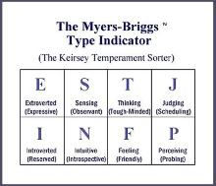
Strategy Source– A Type of Leadership
Look for a mix of at least 50% on the Elders with the gifts of leadership or administration
Look for these types on the DISC and MBTI profiles”
DISC: DI, ID, I, D
MBTI: ESTJ, ENFP, ESFJ, ISTJ
see Re:VISION The Key to Transforming Your Church
Dr. Aubrey Malphurs and Dr. Gordon Penfold, BakerBooks, 2014
research across denominations and DISC and MBTI profiles of turnaround pastors in all 50 states, and 10 Canadian Provinces

Slide 20
3 Strategic Assessments
For Consideration
1
Do we believe in church growth?
2
What is our definition of a disciple? Is it biblical?
3
Should we teach the difference between a political Christian and a disciple?
What is our growth path?: on site; plant; multi-site; merger; combination? He who aims at nothing will surely hit it!
How well are we using our definition to make disciples? More than pulpit?
See Myth of a Christian Nation, Greg Boyd, 2009 219 Reviews (Risk / Opportunity)
I believe that this was the last SBC annual meeting where the messengers will hear a political speech. (After V.P. Pence spoke) Tweet by Ed Stetzer June 13, 2018 #SBC18
See handout by Stetzer June 16, 2018 : Political Campaigning and the Great Commission

Slide 21
Session #6 Outline
2
Strategy
3
Structure
4
Leaders
Introduction to Bottom Components
1

Slide 22
Structure
Standard Classification Format for this Component of Church Health
Organic or Organizational | Organizational
Side of the Fishbone Diagram | Bottom
Relational or Task | Task
Timeless or Timebound/Contextual | Timeless and Contextual
Acts 2 Reference | None specifically, but we see a precursor to Elder rule in devotion to apostles teaching and leadership
Complimentary Component | Fellowship

Slide 23
Structure
A Church Organizational Health Definition
Structure is a component of organizational health that should be driven and defined by mission and Strategy. It is one of the answers to how the church will get where it is trying to go. It is the alignment and clear, written, definition of the organizational relationships of our staff, our board(s), our congregation, our ministries, and our ministry participants. Structure includes the biblical conviction that we have the freedom, within our polity, to change role responsibilities as needed for mission.

Slide 24
Structure – The Church
is not a democracy
Church is not a democracy even within congregationalism.
Leaders are supposed to have a different role, and lead.
“American church is driven more by its national polity than by biblical theology”
2006, p. 183

Slide 25
Structure – Need Written
Clarity of Roles/Ministries
.
.
.
We need clarity about the role of the board(s), staff
Every ministry should report
to someone
Every person should report to someone
Define these things in writing
and put them in bylaws or
constitution if you need to.
Train people in new roles how
things work “around here”.

Slide 26
Structure – Ministries
Cannot serve two masters
“No one can serve two masters. Either you will hate the one and love the other, or you will be devoted to the one and despise the other. You cannot serve both God and money.
Jesus Mt 6:24
A common mistake that boards make:
Requiring a ministry that is overseen by a Staff member to simultaneously report to them. Outcomes:
Demoralizes the staff member
Confuses (angers) the ministry
Board
Staff
Staff
Staff
Ministry
Much better alternative: Sr. Pastor and board let staff member lead and then Sr. pastor coaches him/her in one-on-ones

Slide 27
Structure – Freedom to Change
Bible is silent on exact location of authority between congregants,
board(s), and staff members.
Structure must submit to Spirit - Erwin McManus, Mosaic Church
Wisdom of God gave flexibility to churches in different contexts,
at different sizes in different times
Note changes in early church: adding deacons, elders.
Bylaws/Constitution are not Scripture, should change
to serve the church

Slide 28
Right Sizing: The Star Model
Designing Organizations, Jay R. Galbraith, Jossey-Bass, 2001
www.jaygalbraith.com (MIT, Wharton, USC)
Strategy
Purpose-Vision-Values
- Who we are.
Where we are going.
Strategies that will get us there.
LAST
Hiring Practice
Fit with 1-4
1
People
Structure
5
2
Organization needed.
Gifts, talents, character
Relationship of staff
and board
Intrinsic
Salaries/Benefits
4
3
Reward
Process
How we will make decisions
Policies and Practices
Top Down, Bottom Up, Team

Slide 29
Right Sizing: Small to Medium Size
Growth leads to complexity of ministry
Congregation becomes out of touch with church-wide
matters and decision-making
Transition Success Factors:
Demonstrate Hindrance from Structure
Limit Congregation Decisions to Short List
Celebrate release of Congregation to Ministry
Demonstrate Board /Staff Capacity to make more decisions
- Members - Annual Budget
- St. of Faith - By-laws
- Elders/Sr. Pastor - Real Estate/Debt/Dissolution

Slide 30
Right Sizing: Medium to Large Church
Trust Economics
 | Board | Paid Staff | Paid Staff
Number | 7 | 3 | 7
Approx. Size |  | 300 | 700
Hours per week | 11 | 45 | 45
Total hrs per week | 77 | 135 | 315
Involvement Ratio |  | 1.8:1 | 4.1:1
Trust Demand |  | Growing | Very High
Morale without Delegation |  | Decreasing | Very Low or Extreme

Slide 31
Right Sizing Governance Forms (congregationalism polity bias)
Think Center of Gravity not who makes all of
the decisions.
In all cases, each makes some decisions.
Each is a healthy form. Numerical growth leads
to Board-Led and Staff-Led forms.
Family-Led
Board-Led
Staff-Led

Slide 32
Right Sizing: Resources for Change
Zondervan, 2010
Role of Sr. Pastor, Board, Staff,
Congregation
BakerBooks, 2005
Policy Governance
Role of the Board / Staff

Slide 33
Session #6 Outline
2
Strategy
3
Structure
4
Leaders
Introduction to Bottom Components
1

Slide 34
Leaders
A Church Organizational Health Definition
Leaders is a component of organizational health that concerns itself with ensuring that we have a fit between our
Strategy, our Structure, and those that are leading the church. Board members, paid ministry staff, lay ministry leaders, and group leaders translate Strategy into reality through Structure. They must be recruited well, developed, and coached to perform their role in fulfilling the mission of the church. Some will not be a fit and should be coached to a new place of ministry. For the Sr. Pastor, all ministry is “interim” ministry, and succession planning is essential for them and the church .

Slide 35
Leaders
Standard Classification Format for this Component of Church Health
Organic or Organizational | Organizational
Side of the Fishbone Diagram | Bottom
Relational or Task | Relational and Task
Timeless or Timebound/Contextual | Timeless and Contextual
Acts 2 Reference | The leadership role of the apostles is evident.
Complimentary Component | Discipleship

Slide 36
Leaders:
Terminology and Vocabulary
There is a Gift of leadership: Romans 12:8
The divine enablement to cast vision, motivate, and direct people to harmoniously
accomplish the purposes of God.
They have a plan and motivate people to help see the plan accomplished.
Not all in a leadership role require the gift of leadership
Leadership development is a part of discipleship for leaders
Biblically, there are leaders, administrators, and shepherds and in
our terminology we sometimes lump them all together and call them all “leaders”

Slide 37
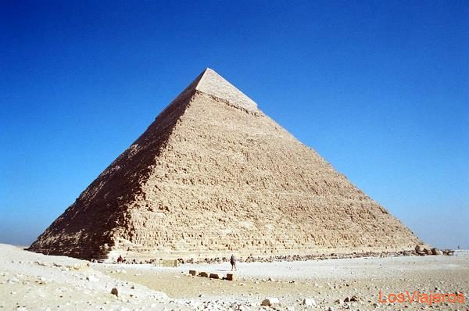
Leaders: Pyramid Principle
David Womack,
Bethany Fellowship
1977
You have to expand the
base of infrastructure or
the organic growth will
fall on itself
e.g. Exodus 18; Acts 6
Infrastructure:
Leaders: Paid Staff Leadership Development Governance structure
More in Session 7 Resources: Facilities, Finances, Admin. Systems, IT

Slide 38
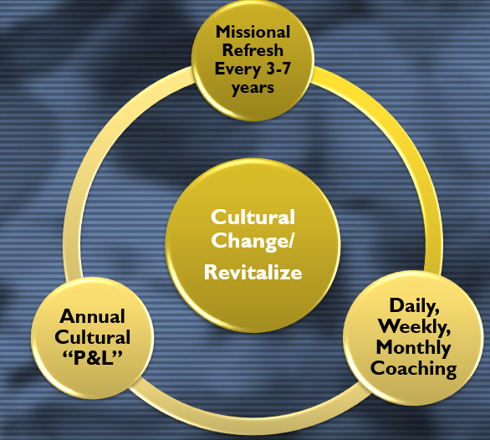
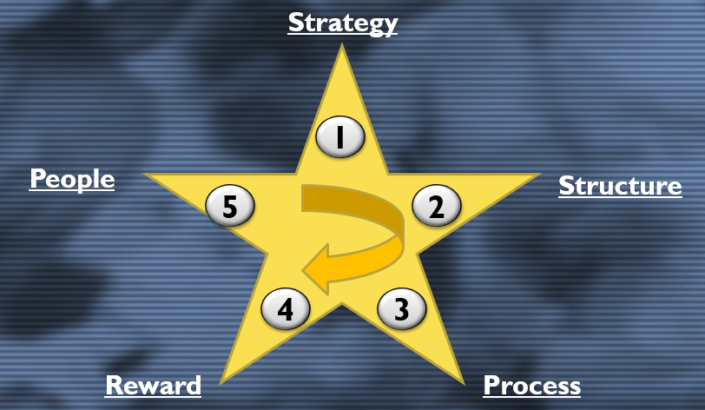
Leaders:
Recruiting, Selecting, Developing

Slide 39
Recruit
Our Strategy
Our Structure
Select
Develop, Coach
Leaders:
Recruiting and Selection
Write job descriptions that reflect who the church is, who it
is trying to be, and how it is organized.
Define the role you are recruiting for based on the needs of the church. What gifts are needed? What experience? What capacity
and aptitude is needed? Best predictor of future performance is past
performance. Good recruiting/selection precedes coaching.

Slide 40
Recruit
Our Strategy
Our Structure
Select
Develop, Coach
Leaders: Board Members
Board members should ideally select new board members.
“Guarding the Gate”
Fit: Is this a doing board, an approving board, a reviewing board,
or a direction and boundary setting board?

Slide 41
Recruit
Our Strategy
Our Structure
Select
Develop, Coach
Leaders: Sr. Pastor and
Paid Ministry Staff
Ministry Staff should be screened by resume, and phone, before
being asked to complete one or more testing vehicles to assess
Gifts, DISC profile, MBIT. Another helpful measure is Motivated role (Ministry Match) which measures a continuum of
Conceptualizer, Prototyper, Implementer, Refiner, and Manager.
Do background checks as well.
https://www.go-cce.com/ministry_match.php

Slide 42
Recruit
Our Strategy
Our Structure
Select
Develop, Coach
Leaders: Lay Ministry and
Small Group Leaders
Lay ministry and small group leaders should be recruited with
written job descriptions which define necessary gifts and abilities.
Require a gift and personality assessment.
Interview with Strategy and Structure as part of the interview.

Slide 43
Leadership Development: What
- Fruit of Spirit, etc. Mk 10:45 Servant Leadership
- Mission, Values, Vision, Strategy
- Skills: position descriptions, recruiting,
team-building, delegation, being leaders
of leaders versus doers of ministry,
giving feedback, goal-setting, budgeting, budget management, how to lead a meeting, IT skills,
public speaking, etc.
- How to have an Anti-Silo Mentality

Slide 44
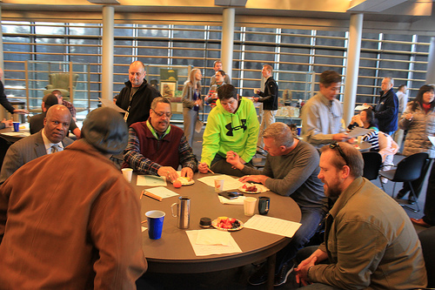
Leaders: Development
How?
What | Frequency
One-on-one with overseer | Weekly or twice a month
Staff meeting | Weekly
Management by Walking Around | Casual, weekly or so, listen
Leadership Development Forum Large group training, development, vision casting, new initiatives “Leadership Roundtable” “L.E.A.D.” | Monthly, 8 times a year, at least quarterly
Vision and Partnering 2 Personal Development goals, review, Ministry Goals | Annual
Vision and Partnering 3 Budget | Annual

Slide 45
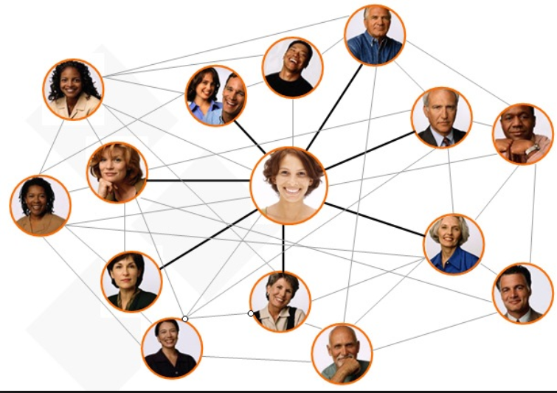
Leaders: Development
How?
Provided a ministry accountable fund with expectation that some will be used for books, development resources, and conferences. Talk about in one-on-ones. Do for board members too.
Encourage and motivate staff to attend denominational meetings, and network beyond their denomination, especially with larger churches. Talk about in one on ones. Use content for
leadership development forum.

Slide 46
Leaders: Redirecting
Follow your policies in performance assessing
“At will” employment policy is essential
If paid staff or lay staff are not a fit, address it
Redirect staff within the church if possible
Develop the mentality that this is best for them and for the church

Slide 47
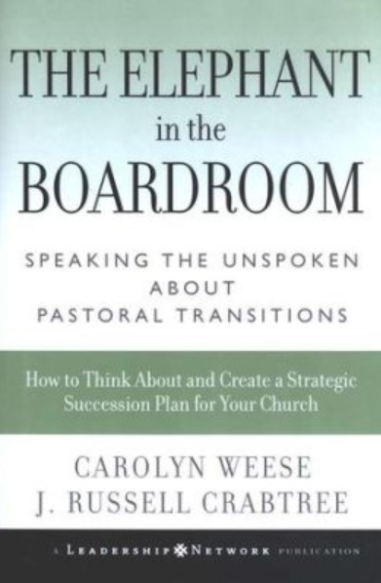
Leaders: Pastoral Succession
Prepare for this vs. stumble into
Both books will help
Recognize there are many models
Recognize God will direct sometimes around your model

Slide 48
Leaders: Pastoral Succession
Christian Staffing “Headhunters”, Examples

Slide 49
Questions / Comments
What questions do you have?
Or comments + or – about the material?
jim@churchconsulting.org
1-866-221-6313

