Slide 1
Revitalization Training
Session #5

Slide 2
Online Training 10 Sessions
Session | Title
1 | 7 Church Revitalization Tools: Tools 1 and 2
2 | 7 Church Revitalization Tools: Tools 3-5
3 | 7 Church Revitalization Tools: Tools 6-7
4 | 12 Church Health Components: 1-3
5 | 12 Church Health Components: 4-6
6 | 12 Church Health Components: 7-9
7 | 12 Church Health Components: 10-12
8 | Certification and Consulting
9 | Consulting: Comprehensive Church Health Assessment
10 | Consulting and How To Launch a Consulting Practice
Top Components
Bottom Components

Slide 3
Session #5 Outline
1
Evangelism
2
Ministry
3
Prayer

Slide 4
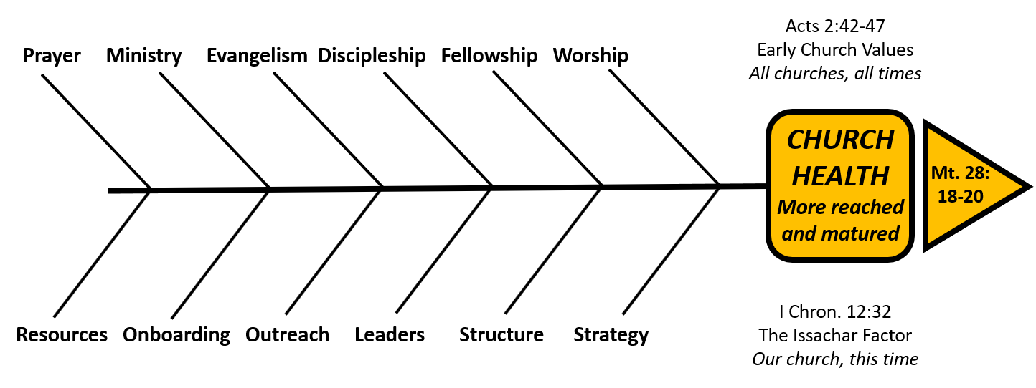
Evangelism
The Church Health Encyclopedia Definition
Evangelism is... “the proclamation of the historical, biblical Christ as Savior and Lord, with a view to persuading people to come to him personally and so be reconciled to God. The results of evangelism include obedience to Christ, incorporation into his church, and responsible service to the world.”

Slide 5
Evangelism
Standard Classification Format for this Component of Church Health
Organic or Organizational | Organic
Side of the Fishbone Diagram | Top
Relational or Task | Relational
Timeless or Timebound/Contextual | Timeless, all churches, all times
Acts 2 Reference v. 44 those who had believed vs. v. 47 the people and those being saved (3 groups) | 47 enjoying the favor of all the people 47 Lord added to their number daily those being saved
Complimentary Component | Outreach

Slide 6
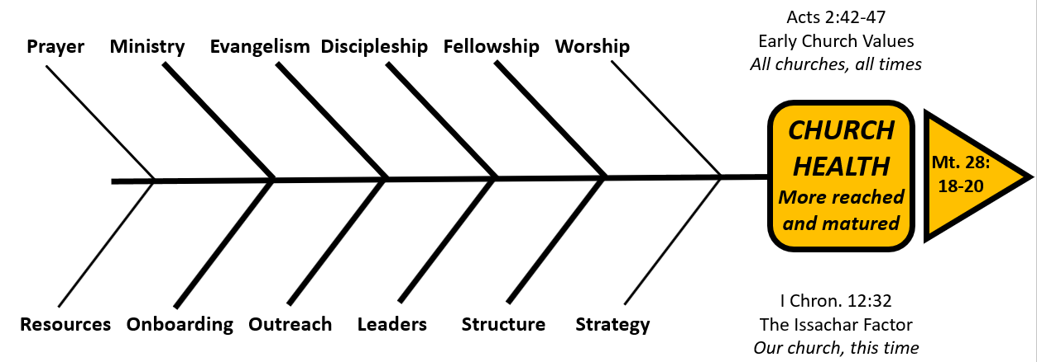
Evangelism
Complimentary component is Outreach
Evangelism: Proclamation of the gospel and persuading - Truth
Outreach: Love and good deeds e.g. 1 Peter 2:11-12; 3:15 - Proof

Slide 7
Evangelism Defined
Eph 4:11 “… some as evangelists…”
2 Tim 4:5 “ do the work of an evangelist”
Acts 2:47
… enjoying the favor of all the people. And the Lord added to their
number daily those who were being saved.
See too: Acts 6:7, 11:21, 16:5, 17:12
Romans 10:14-15
How, then, can they call on the one they have not believed in?
And how can they believe in the one of whom they have not heard?
And how can they hear without someone preaching to them?
And how can anyone preach unless they are sent? As it is written:
“How beautiful are the feet of those who bring good news!

Slide 8
Evangelism: Today’s Reality
Church Growth Statistics – Session #1
Church Health Survey Results
- Worship usually highest
- Fellowship, Ministry, Prayer in middle
- Discipleship next to last
- Evangelism: usually the lowest

Slide 9
Evangelism: Today’s Reality
Church Health Survey Results
- Evangelism: usually the lowest
Sample Questions:
Q4 People in our church share their faith regularly
Q40 I have fears … that keep me from sharing my faith
Q82 Our church provides opportunities for evangelism training
Q28 Our S. School or groups seek to reach people outside
of our groups

Slide 10
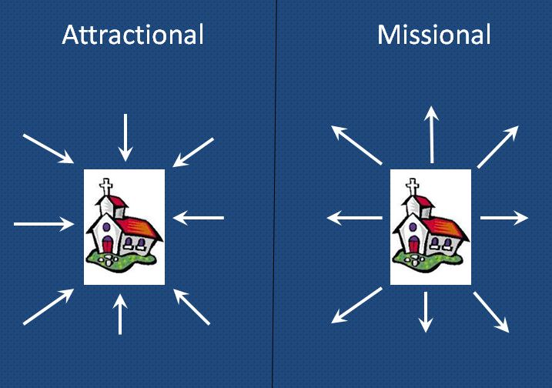
Evangelism: Attractional Bias
“We don’t understand why more people haven’t
come since we moved into this new facility.”
Attractional: Making our ministries and facility attractive and
expecting the unchurched to come to us
Missional: Going to them

Slide 11
10 Reasons churches are not reaching the unchurched
Spiritual lethargy
Growing inclusivism- “good” religions
will allow people into heaven
3. The growing disbelief in hell
4. Busyness
5. Fear of rejection
Notes:
Facts Of the 6-Purposes of the Church, evangelism is the most neglected.
Most churches have not had a conversion in past 12 months
Most churches trying to copy models that won’t work for them
88% declining
Pastor’s afraid
Fear of new people and change
Rainer, REACHING THE UNCHURCHED, Chapter 9 (page 216): 10 reasons we have not reached the unchurched…
Spiritual Lethargy – problem for many Xian's is that they are simply not growing spiritually and a lack of spiritual growth leads to a diminished desire to share Christ with others.
Growing inclusivism – Many years ago there was a growing belief in universalism, which holds that all are saved; everyone will go to heaven. The doctrine waned in post WWII years, when the atrocities of Hitler and Nazism became apparent. Very few wanted to believe that such evil people could actually go to heaven. Universalism gained a slight momentum until…then w/9/11 it once again waned. One of the faster-growing beliefs today is pluralism, which holds that all religions lead to God and heaven for those faithful to whatever their religious beliefs. A variation of pluralism is inclusivism…this view affirms that Jesus is the only way of salvation but that he can be found in other “good” religions. What this view holds is that explicit faith in Jesus Christ isn’t necessary to be saved (Rainer tells of consulting w/church – wasn’t growing in Georgia. During consultation visited SS class of men. Prominent man in the community had died – exemplary leader, wonderful example of ethics and integrity, well respected but a Mormon. Men in the class impressed Rainer w/biblical knowledge – discussion was pleasant but intense as they tried to reconcile the claims of scripture, especially John 14:6 w/the fact that this man in the community was such a moral, upright man. Finally, the de facto leader of the class spoke up. His words were: “Men, we just cannot pretend that the Bible teaches any other way of salvation other than Jesus. But we know that our God is a God of love and mercy, and there’s no way he would let a man such as this fellow go to hell. We simply have to believe that Jesus will take care of him in eternity.”
The growing disbelief in hell – more and more people are denying the existence of hell. An increasing number of Christians hold to a belief that those who do not place their faith in Christ simply cease to exist at death—called annihilationism.
Why are Christians NOT evangelistic? Chuck Lawless gives the following reasons…
62% afraid of embarrassment
51% do not know what to say
45% do not know answers to questions they may be asked (APOLOGETICS)
32% rarely think about evangelism
27% say they have not found their style
24% are too shy or insensitive to others
5% do not want to witness alone
No Urgency! Luke 15

Slide 12
10 Reasons churches are not reaching the unchurched-cont’d
6. A desire to be tolerant
Losing the habit of witnessing
Lack of accountability
Failure to invite
Our churches don’t emphasize it
Notes:
Busyness – one of the things, as a consultant, you may wish to do in a church that hires you to help them understand why they are not reaching the lost and growing as a church is to have the staff – without, of course, revealing to them that you want to see how much of their week is devoted to sharing Christ with an unchurched person – keep a journal of a week in ministry. Just keep a log of how they conduct their work and ministry. Think you’ll discover that they are spending biggest bulk of time in administration, pastoral care, counseling, committee meetings, etc. Reggie McNeal in REVOLUTION IN LEADERSHIP says, “Busier Christians are not necessarily more spiritual. They are just more tired and burned out on church programming” (p.101).
Fear of rejection – everybody likes to be liked and sometimes Christians will not share their faith because they are afraid someone is going to reject them.
A desire to be tolerant – Contemporary society has convinced us that intolerance is a sin. So, when a Christian takes a stand o moral issues and moral values, our society has basically labeled anyone who takes a stand as an intolerant person. But, the Ten Commandments are pretty intolerant. Many Christians just don’t want to be labeled “intolerant.”
Losing the habit of witnessing – some Christians were, at one time, very active about sharing their faith but, for a myriad of reasons, have gotten out of the habit. Witnessing, like prayer and Bible study, is a discipline. “Witnessing,” says Rainer, “is a habit to learn, to retain, and, if lost, to regain” (p.226).
Lack of accountability – an accountability group could help many Christians. When you’re consulting, this is a great suggestion to make in addition to suggesting to a church to broaden their instructional methods for inspiring the congregation to become an evangelistic church. Be sure that they include ways of encouraging accountability.
Failure to invite – Rainer found in their research of churches that very few Christians were inviting unchurched people even to come to church much less witnessing to them with any regularity. A few will invite other Christians looking for a church home, but most will invite no lost. This must be, in part, because many of these Christians no longer have many unchurched friends.
We go to churches that do not reach the unchurched – we reach only 1 person for Christ each year for every 85 church members in the US. That is a frightening ratio and, of course, one of the key reasons we do not reach the unchurched, is that most Christians in America are members of churches that do not reach the unchurched. Many well-intending Christians can be very active in his or her church and never challenged to reach the lost.

Slide 13
Evangelism: Scriptural Solutions
God
Matthew 4:19 “…Follow Me” (relationship 1)
“and I will make you
fishers of men.” (relationship 2)
1
Me
2
Others

Slide 14
Evangelism: Scriptural Solutions
I Peter 3:15 “but sanctify Christ as
Lord in your hearts (relationship 1),
always being ready to make a defense to
everyone who asks you to give an account
for the hope that is in you,
yet with gentleness and reverence.”
(relationship 2)
God
1
Me
2
Others

Slide 15
Evangelism: Scriptural Solutions
My town
The world
My county/region
“but you shall receive power when the Holy Spirit
has come upon you (relationship 1);
and you shall be My witnesses” Acts 1:8
(relationship 2)

Slide 16
Evangelism: Practical Solutions
Bill Hybels’ formula:
HP + CP + CC = MI
HP = High potency (power)
CP = Close proximity
CC = Clear communication
MI = Maximum impact
Notes:
Donald McGavran “Bridges to God”
“Will my friend attend with me?”

Slide 17
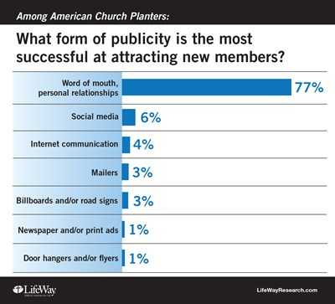
Evangelism: Proximity and Communication
The 2015 National Church Planting Study report analyzes 843 churches started in 2008 or later that continue to exist today. The study was sponsored by 17 denominations and church planting networks that participate in the Church Planting Leadership Fellowship

Slide 18
Evangelism:
Proximity and Communication
Why people first come to Christ and the church:
Special Need 4 - 5%
Walk-In 2 - 3%
Visitation 1 - 2%
Church Program 2 - 3%
Mass Evangelism ¹/₂%
Sunday School 2 - 5%
Pastor/Staff 1 - 6%
Friend/Relative 75 - 90%
See What Every Pastor Should Know
The Friendship Ratio Gary McIntosh and Charles Arn

Slide 19
Evangelism: Practical Programs
Many options:
a. Evangelism Explosion
b. Alpha
c. The Story
d. F.A.I.T.H.
e. R.E.A.C.H.
f. Soularium
g. Etc.
Notes:
3. Vary the training methods
Vary the training method. People suffer from the Copernicus Syndrome – inward focused, they think their church is the center of the universe. Not everyone is at the same place developmentally and there needs to be more than one option for people to grow. Growth is not linear, it is zigzagged or up and down. Learn as many evangelism training modules as possible. As a consultant, you must be a student of curriculums and products. What is LifeWay, Beacon Hill, Pathway, etc. producing?
Here are some of the more popular…
Evangelism Explosion: D. James Kennedy – one of the oldest and still one of the best methods of training.
Alpha: a 10-week course of study to explore the validity and relevance of the Christian faith to your life today. It is a practical intro to the basics of Christianity centered around a meal, a talk, and small group discussion.
Becoming a Contagious Christian: birthed at Willow Creek, this is a highly practical, skill-based seminar designed to help you learn to communicate your faith in a style that reflects your personality. It offers help in crafting one’s story, practice sharing it, and is a good program for small group training settings. And, it does so by teaching 6 different styles of evangelism.
F.A.I.T.H. – Written by Bobby Welch, co-pastor of FBC, Daytona Beach, hundreds of Christians each week gather and share their faith in the community. This has resulted in the FBC of Daytona Beach leading most all churches in conversions and baptisms in the state of Florida every year. This program uses the SS as the arm of evangelism in the local church and takes members on a 16-week journey of instruction in making outreach visits, ministry visits, and teaches members how to share their faith.
R.E.A.C.H. – Developed by John Ewart (one of our instructors), the REACH process, which stands for Reaching Every Available Community Household, is a small group ministry outreach program in which every active church member is expected to make one contact every week asking someone in their neighborhood, workplace, or unsaved family if they have a prayer need. Since 80% of Americans pray, this is an effective way to witness through love.

Slide 20
Evangelism: Practical Programs
…. Church-sponsored program, group, or activity in which a nonmember can become comfortably involved … on a regular basis…. develop relationships
“Affinity Groups”
e.g golf, motorcycling, other sports ministry
drama, community involvement
While front doors provide a way for people to come to your church, side doors provide a way for your church to go to people.
2013

Slide 21
Session #5 Outline
1
Evangelism
2
Ministry
3
Prayer

Slide 22
Ministry
The Church Health Encyclopedia Definition
Ministry is... a Christian using his or her spiritual gifts for the edification of the church and in service to a lost world. God uniquely gifts his people with abilities in order that his Church may advance. Serving and ministering go together in God’s kingdom.

Slide 23
Ministry
Standard Classification Format for this Component of Church Health
Organic or Organizational | Organic
Side of the Fishbone Diagram | Top
Relational or Task | Relational
Timeless or Timebound/Contextual | Timeless, all churches, all times
Acts 2 Reference | 43 many wonders and signs 45 sharing … as any had need (pre-teaching of Rom 12, 1 Cor 12, Eph 4, 1 Peter 4)
Complimentary Component | Onboarding Front and back door ministry

Slide 24
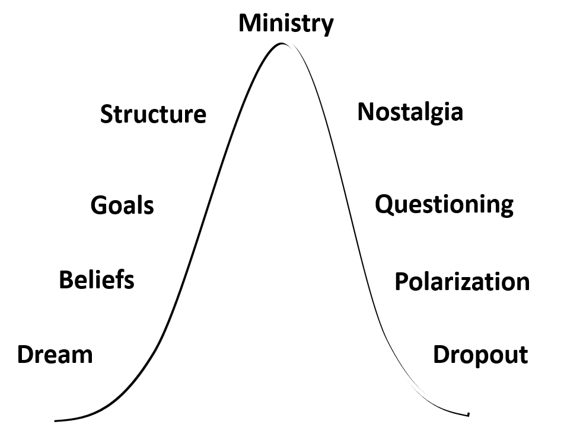
Ministry: Complimentary Component
Front Door
Onboarding
Back Door
Onboarding
House Behavior
MINISTRY

Slide 25
Ministry
Gifts Diversity gives sense of Ministries intended
Prophecy Evangelism
Shepherding Teaching
Leadership Administration
Encouragement Mercy
Wisdom Knowledge
Giving Faith
Discernment Helps
Hospitality
See handout with groupings; needs met

Slide 26
Ministry
Gifts plus passion, plus natural abilities, plus personality, plus experience (S.H.A.P.E) creates amazing diversity and impact
⁴ Now there are varieties of gifts, but the same Spirit. ⁵ And there are varieties of ministries, and the same Lord. ⁶ There are varieties of effects, but the same God who works all things in all persons. 1 Cor 12:4-6
Note too the Trinity: Spirit, Lord (J.C.), God (the father)
Tri-unity of God manifested in diversity and unity of church
Unity of body of Christ manifests and proclaims God

Slide 27
Ministry: Today’s Reality
Church Culture
External Culture
Opportunities
Service
Unemployment
Mission-focus
Opportunities
Sports
Entertainment
Self-focus
Notes:
One of complaints often heard

Slide 28
Ministry: Preferable Future
Church Culture
External Culture
HOW?
When recruiting occurs, people respond more frequently
Notes:
How can we get the pull of church
need for volunteers to trump
the pull of external culture?

Slide 29
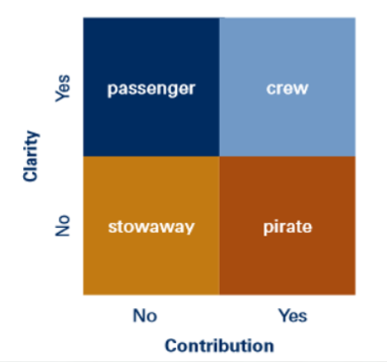
Ministry: Today’s Reality
We would like everyone
to be a crew member
On board
Clarity about mission
and values
Contribute from their
gifts and passion
- Will Mancini

Slide 30
Ministry Today’s Reality The 20% doing 80% is not a Myth
“…your church – unless it’s extremely
unusual- has far too many people who
are willing to let 20 percent of the
membership engage in most of the
church’s work.”
See preface, Kindle location 241
“ … the whole body… grows and … each part does its work” Eph 4:16
Notes:
Contrast Reality with Biblical Values

Slide 31
Ministry Today’s Reality: Leadership Low Expectations
Study of churches
Growing: 55 ministry roles to 100
Plateaued: 43:100
Declining: 27:100
Recommendation: 60 for every 100
Page 143-144
Notes:
Must ask question whos at fault?
Is it the people or low leadership expectations?

Slide 32
Ministry: Volunteer Mobilization Solutions
1. Leaders Have Higher, Scriptural Expectations
McIntosh: create more positions
2. Leaders Work With Congregational Members
- See Leadership Preference
Percept Demographic Studies of Am.
Culture Ethos p. 15 and Source Book p. 71
- See The Hawthorne Studies in Chicago 20s-30s
3. Leaders Design and implement a Culture of
Volunteer Mobilization
HOW???

Slide 33
Volunteer Mobilization
Pulpit
Leadership Modelling
Overflow of Disciple
making
Assimilation Expectations
Support Systems
Teaching Forum
The Volunteer
Mobilization
Wheel

Slide 34
The Volunteer Mobilization Wheel
Pulpit
Preach about Ministry Service
- Theology of the Church
- Philosophy of Ministry in our church
Spiritual Gift and Holy Spirit Clarity
Holistic Service: Talents, Passion, Experience
Set Context of how Ministry fits Vision
Frequency will vary with cultural need
Planned, Topical and Expository:
Serving from Gifts vs. Ephesians 4
Testimonies of service: possibly interviews

Slide 35
The Volunteer Mobilization Wheel
Leadership
Modelling
Primary board and Sr. Pastor must practice
the theology of the church taught from the
pulpit. Apply it, talk about it, reinforce why
they serve, how they do from gifts etc.
Paid staff and lay leaders must do the same
Ministry leaders reinforce it in their ministry
Praise examples of serving from gifts etc.
Redirect people if they are not a fit

Slide 36
The Volunteer Mobilization Wheel
Overflow of Disciple-making
Have a clear and concise definition of a
disciple that includes ministry service
Disciple making methods and material must
include ministry service
Disciple makers should not project their
ministry on others, but have a healthy
respect for all ministry

Slide 37
The Volunteer Mobilization Wheel
Assimilation Expectations
Start with a balanced sensitivity to the
churched and unchurched (2 audiences)
People should hear the same thing from
people at “welcome desk”, people who call
or email, and those who lead “Starting Point”
classes
Set a high expectation of service
Be aware of and promote current opportunities to serve
Front Door
Onboarding

Slide 38
The Volunteer Mobilization Wheel
Teaching Forum
Do what disciple making and pulpit cannot do
Greater depth of teaching on ministry service,
gifts, natural abilities, personality, experience
Assessment tools: personal discovery
Classroom breakouts for discussion (Adult
learning theory)

Slide 39
The Volunteer Mobilization Wheel
Support Systems
Provide structure and administrative practices
to support volunteer mobilization:
- Website Ministry Descriptions and
ministry leader contact info
- Ministry directory with a standard way to
describe the ministry and each position.
- Populate database with info from
teaching forum assessments
- Train coaches to coach those unsure of
where to serve
Develop relational methods of recruiting
Develop bite-size roles and co-leading
Develop common appreciation practices
Byrd/Thumma: Listening sessions serving/not serving

Slide 40
The Volunteer Mobilization Wheel
Relative Importance and Assessment
Individual component | Rate 1-10
Pulpit
Leadership
Disciple making
Assimilation Expectations
Teaching Forum
Support Systems
Leadership Team Exercise
As a pastor, denominational leader, or consultant this is a
healthy exercise. Have the team reach consensus on a rating from 1-10 for each one. Take notes on the rationale for the rating.
Compare rating to relative importance.
Discuss action planning.
1st
Priority
2nd
Priority

Slide 41
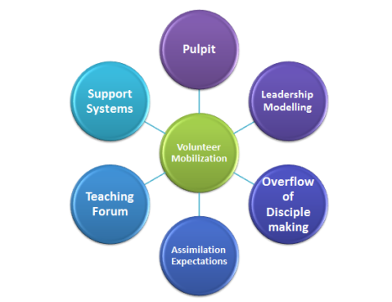
The Volunteer Mobilization Wheel
Anti-Silo Synergy Defined
Intentionally have each part of
The wheel understand and value
The other parts of the wheel.
E.g. “preach the announcements”
on the Teaching Forum, or on
your Assimilation Forum.
E.g. Teaching Forum refer to the
pulpit and tell stories of how leaders
model gift-based ministry
Note: this is secondary to the wheel

Slide 42
Session #5 Outline
1
Evangelism
2
Ministry
3
Prayer

Slide 43
Prayer
The Church Health Encyclopedia Definition
Prayer is... drawing near to God through faith in quiet contemplation and with bold requests. Prayer is one of the most underused weapons in our spiritual arsenal. Paul encouraged the Ephesians to put on the armor of God to fight the spiritual battle, but he emphasized above all that prayer be made on all occasions (Ephesians 6:18). Jesus also reminded his followers to pray through his example of often withdrawing to a quiet place to pray (e.g. Matthew 14:23).

Slide 44
Prayer
Standard Classification Format for this Component of Church Health
Organic or Organizational | Organic
Side of the Fishbone Diagram | Top
Relational or Task | Relational
Timeless or Timebound/Contextual | Timeless, all churches, all times
Acts 2 Reference | 42 devoted to prayer 46 gladness (joy) 47 praising God
Complimentary Component | No

Slide 45
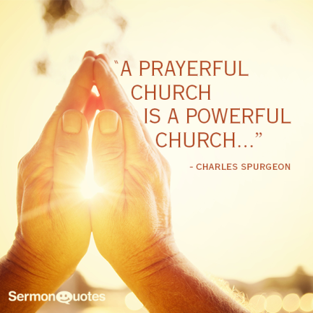
Prayerful Assessments
A. Consider prayer partners
B. Pray about every consultation
C. Avoid “template” consulting
D. Build prayer into facilitations
E. Require a prayer team

Slide 46
Prayerful Consultations Understand Unhealth
Potential Leadership Modelling Weakness
Q9 Leadership … emphasizes the importance of prayer
Q21 Before … any major effort … we bathe it in prayer
Q33 Prayer is a central facet of our worship services
Q39 We have special prayer emphases in our church

Slide 47
Prayerful Consultations Understand Unhealth
Potential Disciple-making weakness
Q57 We pray regularly for world missions in our church
Q131 I feel adequately trained in prayer
Q137 I pray regularly for missionaries
Q143 I pray regularly for lost people

Slide 48
Prayer Revitalization
Offer the church prayer ministry ideas
1. Prayer cards
2. Prayer chain – use social media
3. National Day of Prayer
4. Prayer retreat
5. Prayer walks
Notes:
GOSSIP!

Slide 49
Prayer Revitalization
prayer ideas (cont.)
6. Prayer room or prayer chapel
7. Concerts of prayer
8. Pastor’s prayer partners
9. Praying the Scriptures
10. Lighthouses of prayer

Slide 50
Questions / Comments
What questions do you have?
Or comments + or – about the material?
jim@churchconsulting.org
1-866-221-6313

