Slide 1
Revitalization Training
Session #4

Slide 2
Online Training 10 Sessions
Session | Title
1 | 7 Church Revitalization Tools: Tools 1 and 2
2 | 7 Church Revitalization Tools: Tools 3-5
3 | 7 Church Revitalization Tools: Tools 6-7
4 | 12 Church Health Components: 1-3
5 | 12 Church Health Components: 4-6
6 | 12 Church Health Components: 7-9
7 | 12 Church Health Components: 10-12
8 | Certification and Consulting
9 | Consulting: Comprehensive Church Health Assessment
10 | Consulting and How To Launch a Consulting Practice
Top Components
Bottom Components

Slide 3
Session #4 Outline
1
Introduction to Top Components
2
Worship
3
Fellowship
4
Discipleship

Slide 4
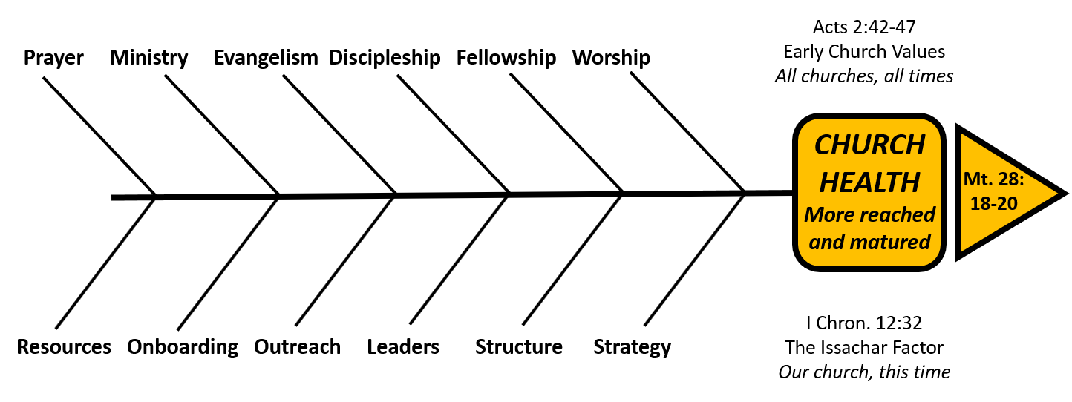
Introduction to Top Components
Moving away from Assessment / Revitalization Tools
Going deeper to characteristics of Component health and
revitalization steps for each of them

Slide 5
Introduction to Top Components
A Church Health Definition
Standard Classification Format
Organic or Organizational
Side of the Fishbone Diagram
Relational or Task
Timeless or Timebound/Contextual
Acts 2 Reference (for Top Bones Only)
Complimentary Component (i.e. in the Bottom Components)
Health, unhealth, and action steps for revitalization

Slide 6
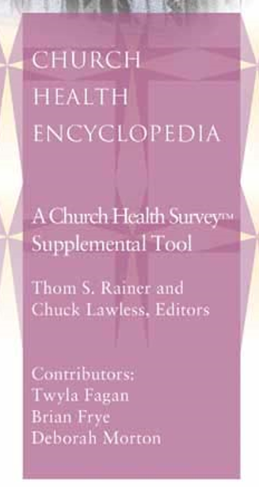
Introduction to Top Components
Developed at same time as the CH Survey, 2002
181 pages with commentary on all 150 questions
Covers all six “Top bones” components of health
This resource is free with membership or training
Definitions will be taken from here
Some revitalization action steps will be from here

Slide 7
Session #4 Outline
1
Introduction to Top Components
2
Worship
3
Fellowship
4
Discipleship

Slide 8
Worship
*A Church Health Definition
Worship is... attributing the honor and giving the devotion to God that He alone deserves.
True worship has nothing to do with a particular style of worship or liturgy. It is, instead, a matter of the heart.
The questions related to worship in the Church Health Survey seek to ask one question of the church: Are members inspired to worship in your church’s worship service?
* See the Church Health Encyclopedia

Slide 9
Worship
Standard Classification Format for this Component of Church Health
Organic or Organizational | Organic
Side of the Fishbone Diagram | Top
Relational or Task | Relational
Timeless or Timebound/Contextual | Timeless, all churches, all times
Acts 2 Reference | 42 devoted to teaching, … breaking of bread, 43 sense of awe 45 day by day in the temple 47 praising God
Complimentary Component | None

Slide 10
Worship
Church Health Survey
Worship Categories Question Number
Spirituality of Service 1,73,109,139
Music and Worship Style 13,19,37,91
Welcoming to Guests 31,85,127,145
Facility 55,61,121
Sermons 7,25
Emphasis on $ 115
General Satisfaction 43,49,67,79,97,103,133

Slide 11
Worship
Recognize that this is usually the healthiest category
Based on CH Survey database of 1,700 actual churches
However, worship wars are alive and well and live just below the surface for some

Slide 12
Worship
Church Health Survey Q19 on Worship Wars
Step 1: Diffuse the bomb. If the war hinges on the introduction of a new drum set or an electric guitar, get rid of it. Your first step is to neutralize your problem.
Step 2: Affirm the positive …. use it as a teaching experience. As you model Christ, teach people about the importance of worship and that the true focus of worship is upon God and not man.
Step 3: Determine the compromise.
Step 4: Blend the music…. allow complete integration of both old and new styles. They decrease the conflict associated with worship wars and they help congregations maintain a current and healthy balance in worship. Options: Adding a second Sunday morning service with a different worship style; Adding a contemporary Saturday evening service; Reformatting the Sunday evening service.

Slide 13
Cultural Relevance Example: Worship Wars Insight
Local U.S.
See Percept
Psychographic info.
Barrier or Accommodation %
 | Prefer | Offer Just Contemp. | Offer Just Trad. | Offer Blend | Offer Venues
Trad. | 23% | 23% | 0 | ? | 0
Contemp. | 21% | 0 | 21% | ? | 0
Both | 33% | 33% | 33% | 0 | ?

Slide 14
Worship
To be culturally sensitive, assess the church service
All emotion and all intellect are missing the audience

Slide 15
Session #4 Outline
1
Introduction to Top Components
2
Worship
3
Fellowship
4
Discipleship

Slide 16
Fellowship
A Church Health Definition
Fellowship is... communion with other believers in order to encourage one another’s walk with the Lord. Christian fellowship is unique. It is something that occurs only as we unite ourselves first with Christ and then to other Christians. Indeed, it is only the love of Christ that can unite people from diverse backgrounds and with distinctive personalities so that they are able to call each other “brother” and “sister.”

Slide 17
Fellowship
Standard Classification Format for this Component of Church Health
Organic or Organizational | Organic
Side of the Fishbone Diagram | Top
Relational or Task | Relational
Timeless or Timebound/Contextual | Timeless, all churches, all times
Acts 2 Reference | 42 devoted to fellowship 44 together 46 one mind … together
Complimentary Component | Structure (polity; governance)

Slide 18
Fellowship
Church Health Survey
Fellowship Categories Questions
Groups and Cliques 5 (cliques),11,233,59,95(groups)
Conflicts 29,35,41,65
Bonded Relationships 47,53,71,77,83,101,107,125
Internal Focus 17,138
Accountability 89,144
Community Perception 113,119,132,150

Slide 19
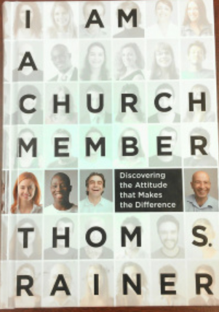
Fellowship
The Importance of Membership
I will seek to be a source of unity in my church....
there are no perfect pastors, staff, or other …
members. But neither am I. I will not be a source
of gossip or dissension….
Signed _______________________

Slide 20
Fellowship
The Important of Leadership
Conflict resolution Training
Understand the nature of conflict
Understand conflict resolution principles
Write a Matthew 18 policy: follow the steps including
removal from membership and fellowship as needed
(see also Titus 3:10)
Demonstrate the grace and truth of conflict resolution

Slide 21
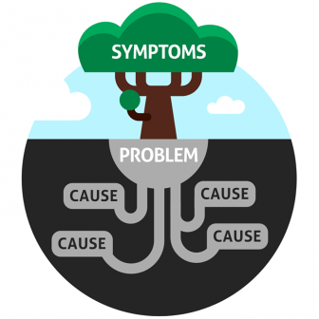
Fellowship: Conflict Causes
Unmet Need – perceived or real?
Misunderstood intention
Unrealistic expectation
Sense of devaluation
Change
Fear
Unmanaged personality differences
Unmanaged generational differences
Sin

Slide 22
Fellowship: Conflict Responses
Some flee conflict – they will leave rather than experience conflict, but the conflict must be dealt with appropriately (Stuffing)
Some yield to others and
“give in to get along”
Some seek to win the conflict

Slide 23
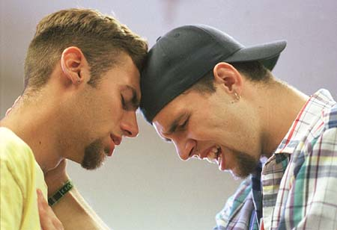
Fellowship: Resolving Conflict
After diagnosis: Go to God in prayer and the Word!!!
Use Scripture with the church: Matthew 5:21-24 and 18:15-20
Confession and repentance will likely be necessary
Resolution often requires replacement
May require replacing old structures and rules with new
May require new leadership

Slide 24
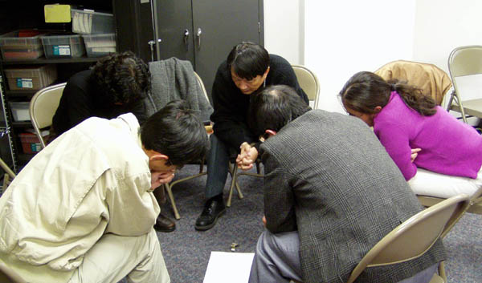
Fellowship: Resolving Conflict
Resolution may require discipline and accountability
Must replace the negative with positive - serious issue
If not, doomed to repeat
Sometimes mutually agreed separation may be the only possible action they will take
e.g. Acts 15:36-41; 2 Tim 4:11
Paul and Barnabas over John Mark
even godly people can disagree

Slide 25
Fellowship: Conflict Consulting
Recognize this as a specialty
(Also one of the most common needs)
Assess your strengths
Consider denominational resources
Example: EFCA North Central District
Consider other resources
e.g. The Peacemaker - Ken Sande
The Alban Institute Levels of Conflict (next slide)

Slide 26
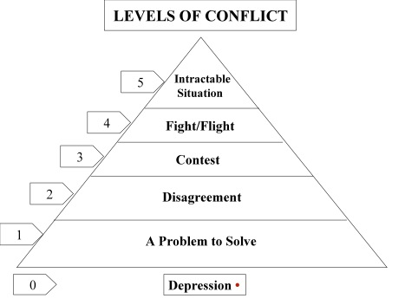
Fellowship: Conflict Consulting
Understand
(See handout)
Consider Skills
Get Training
Possibly:
Make it a specialty

Slide 27
Session #4 Outline
1
Introduction to Top Components
2
Worship
3
Fellowship
4
Discipleship (and Disciple-making)

Slide 28
Discipleship
A Church Health Definition
Discipleship is... loving obedience. Jesus calls his disciples to follow his teachings through self-denial. This attitude of self-denial is not particularly popular today, but it was not popular during Jesus’ time either. Being a disciple of Christ, however, demands it.
While discipleship is not a program, it can be encouraged through special mentoring relationships and training classes. New Christians should have the opportunity to learn how to study the Bible and how to develop a personal devotional life. Older Christians should continue to mature while lending guidance

Slide 29
Discipleship
Standard Classification Format for this Component of Church Health
Organic or Organizational | Organic
Side of the Fishbone Diagram | Top
Relational or Task | Relational
Timeless or Timebound/Contextual | Timeless, all churches, all times
Acts 2 Reference | 42 devoted to teaching, fellowship, … prayer
Complimentary Component | Leaders (Leadership Development)

Slide 30
Discipleship
The Complimentary Component is Leaders and specifically
Leadership Development
Leadership Development (LD) is a sub-component of discipleship
Weak LD can lead to weak disciple-making and discipleship

Slide 31
Discipleship
Church Health Survey
Discipleship Categories Questions
Personal Experience of Growth/Training 2,8,86,110,123,129,141
Children Training 26
Programming Strength 14,20,38,68,74,80,92,98,116,135,147
Fruit of Training 32,44,50,56,62,104
Intentional, focused, clear, simple

Slide 32
Missional Focus
Correct vs. an Incorrect Mission from Aubrey Malphurs
The mission is to teach the Bible?
• The mission is to take care of people?
• The mission is to worship God?
• The mission of the church is to serve?
• The mission is to feed the hungry?
• The mission of the church is to keep everyone happy?
The mission is to make disciples!
“Go therefore and make disciples…”

Slide 33
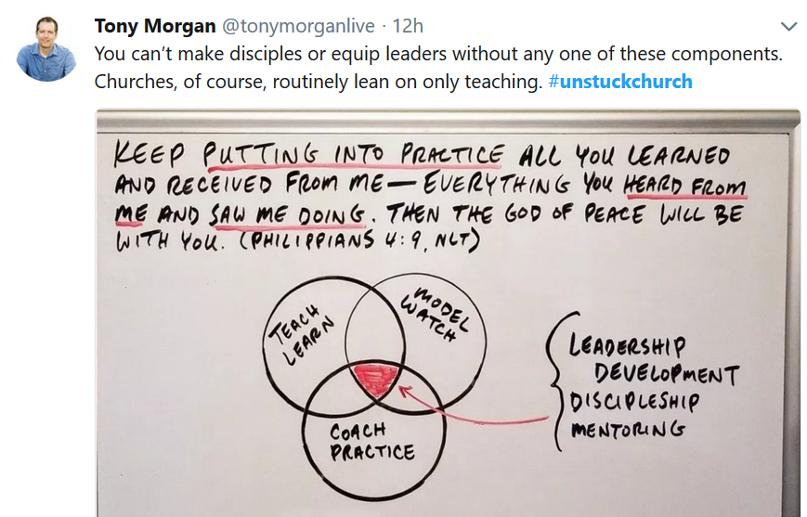
Discipleship
It is more than
teaching. It was
with Jesus too:
“ … appointed 12
that they might be
with Him and that
He might send them…”
Mark 3:14

Slide 34
Discipleship
Five principles of making disciples
1. Develop an intentional plan with biblical core competencies and outcome goals: Who, What, How
2. Work one on one (mentor) and/or in small groups
3. Start immediately upon conversion
4. Particularize the approach
5. Accept a slow process
Notes:
Target!

Slide 35
Disciple-Making Who?
Children: Pre-School, Elementary, Etc.
Students: Middle vs. Sr. High
Young Adults through age________
Adults
Adult Leaders

Slide 36
Disciple-Making Methods/ How?
Organic as God Leads? Will likely fail
Be Intentional: Design and Plan
Groups? Adult Ed. S.S. ?
One-on-one?
Groups Methods: Rotation frequency?

Slide 37
Disciple-making
Groups: Define the Term Broadly
S. School or ABF (Adult Bible Fellowship)
on site
Small Groups in homes (facility multiplication)
Specialty Groups
- Divorce Care
- Grief Care
- Men
- Women
- Recovery

Slide 38
Disciple-making
Groups: Define the Term Broadly
What is each group’s purpose?
- Fellowship, training, discipleship
- Recovery, evangelism, assimilation
How does that fit the church mission?
How do we define a disciple?
How do groups help us make disciples?
How do we do curriculum planning?

Slide 39
Disciple-making
An Intentional Tool
“To have a simple church, you must design a simple
disciple-ship process. This process must be clear. It
must move people toward maturity. It must be
integrated fully into your church, and you must get
rid of the clutter around it.” Rainer/Geiger p. 26
Simple Church Process Design Survey - Handout
http://ericgeiger.com/process-design-survey/#.UyNdj4XEQqg
Group process to answer with as much consensus as possible
Result: Score relative to others
CLARITY - MOVEMENT - ALIGNMENT - FOCUS

Slide 40
Disciple-making
An Intentional Tool (cont’d)
1. Clarity - Design a simple process
2. Movement - Place current programs in the process
3. Alignment - Unite all ministries around the process
4. Focus - Eliminate things outside the process
Notes:
This approach is based on research by Thom Rainer & Eric Geiger, who discovered a 4-step process shared by disciple-making churches:
Clarity – Design a simple process on a blank sheet. Don’t threaten anyone with change, just discuss and clarify what a disciple in your church should look like, and what steps they might go through to get there. There should be clear steps to the process (such as the examples given on the “Discipleship Process” slide).
Movement – Implement the process by choosing one existing churchwide program for each phase of the simple process. The pain of transition may begin here. You may need to change the focus of some of the programs to better fit the process steps.
Alignment – The rest of your ministries must be strategically aligned around the same process. In other words, every ministry should be a self-contained discipleship program based on the plan you developed in step 1.
Focus – This is where the most painful change happens. It involves eliminating programs or events that do not fit the discipleship process. Tradition may need to be sacrificed for the process to work. A cluttered, busy church is an ineffective church. Activity does not mean productivity.
Target!

Slide 41
Disciple-making
Sunday School
Is our Sunday School a barrier or help?
Does it need revitalization?
What does revitalization look like?
Who will lead revitalization?
Do we need to transition to elimination
(see Simple Church Focus criteria?)

Slide 42
Disciple-making
Groups: Participation % Guidelines
McIntosh 7 for every 100 adults (70% +)
Larry Osborne 80% (Sticky Church)
Tony Morgan Adults and Students incl. S. School
> 56% is above avg.
< 46 % is below avg.

Slide 43
Disciple-making: What? Age Appropriate
What is a mature disciple? Example from one church
We will measure maturity by these Biblical characteristics:
1. Settled about their salvation and relationship with God
2. They are secure about their identity in Christ
3. Devoted to God’s purposes for their lives and His church.
4. Freed from bondage to besetting and life-dominating sins.
5. A relationship with and are reliant on the Holy Spirit

Slide 44
Disciple-making: What?
What is a mature disciple? Example from one church
We will measure maturity by these Biblical characteristics:
6. They have begun the regular practice of basic disciplines:
- Spending time in God’s Word
- Practicing a life of prayer
- Participating in fellowship with other believers
- Practicing proportional giving and generosity
- Sharing their faith with others
7. They are experiencing ongoing spiritual transformation
8. They are able to help others with their spiritual walk
9. They are an example for others who want to follow Jesus

Slide 45
Disciple-making: What?
What is a maturing disciple? Example from my pastor July 6, 1980
A disciple is a learner - 6 Marks
Puts Jesus first and takes steps to do so. Lk 9:23; Rom 12:1-2
Continues in the Word of God. Jn 8:31; Jas. 1:22-25
Has consistent daily devotions and prayer life. Eph 6:18; Jn 15:5-7
Serves other believers. Gal. 5:13
Identifies with Christ and actively shares faith. Mt. 5:16; Col. 4:6
Growth in the first five areas above. 2 Pet. 1:8

Slide 46
Disciple-making: What?
Use disciple-making content to improve all organic health
EXAMPLES:
Reinforce importance of Worship
Use some sermon-based lessons
Reinforce membership and fellowship disciplines
train in conflict styles and biblical reconciliation
training in our church’s Mt 18 policy

Slide 47
Disciple-making: What?
Use disciple-making content to improve all organic health
EXAMPLES:
Train in how to share your faith
Train in discovering your ministry and serving
Train in prayer methods
Practice praying for non Christians
Train in and practice Outreach
Train in practicing personal financial stewardship Acts 2:44-45

Slide 48
Questions / Comments
What questions do you have?
Or comments + or – about the material?
jim@churchconsulting.org
1-866-221-6313

