Slide 1
Revitalization Training
Session #3

Slide 2
Online Training 10 Sessions
Session | Title
1 | 7 Church Revitalization Tools: Tools 1 and 2
2 | 7 Church Revitalization Tools: Tools 3-5
3 | 7 Church Revitalization Tools: Tools 6-7
4 | 12 Church Health Components: 1-3
5 | 12 Church Health Components: 4-6
6 | 12 Church Health Components: 7-9
7 | 12 Church Health Components: 10-12
8 | Certification and Consulting
9 | Consulting: Comprehensive Church Health Assessment
10 | Consulting and How To Launch a Consulting Practice

Slide 3
Fishbone Diagram Process of Revitalization
Biblical and Cultural Definition of Health
Assess Today's Reality
Use Today's Reality to Develop Vision
Measure, Coach, Align and Keep Vision Fresh
Action Plan to Reach Vision
Tool # 1-2 3-5 6 6 7
Session # 1 2 3 3 3

Slide 4
Session #3 Outline
1
Tool #6 How to Action-Plan Church Vision
2
Tool #7 How to Align and Achieve Church Vision
How to Create a Transformational Plan
How to Execute Your Plan

Slide 5
How to Action-Plan Vision
Do not leave Today’s Reality Out of the Vision Ingredients

Slide 6
How to Action-Plan Vision
We Can’t Assess Reality without a Health Definition. So,
Do not leave a Comprehensive Definition of Health, Today’s Reality, and Culture out of the
Vision Ingredients
Health Definition
OUR VISION
Assess Today’s
Reality
Exegete Culture

Slide 7
How to Action-Plan Vision
When churches leave a Comprehensive Definition of Health, Today’s Reality, and Culture out of the
Vision Ingredients, we often get:
A vision statement
versus a vision (a preferable future that we see but have not attained).
OUR VISION STATEMENT

Slide 8
How to Action-Plan Vision
A vision statement
that is not grounded in a
Comprehensive Definition of Health, Today’s Reality, and Culture,
is often:
A surrogate, “cooler” mission statement, or
A borrowed statement
we like the sound of
OUR VISION STATEMENT

Slide 9
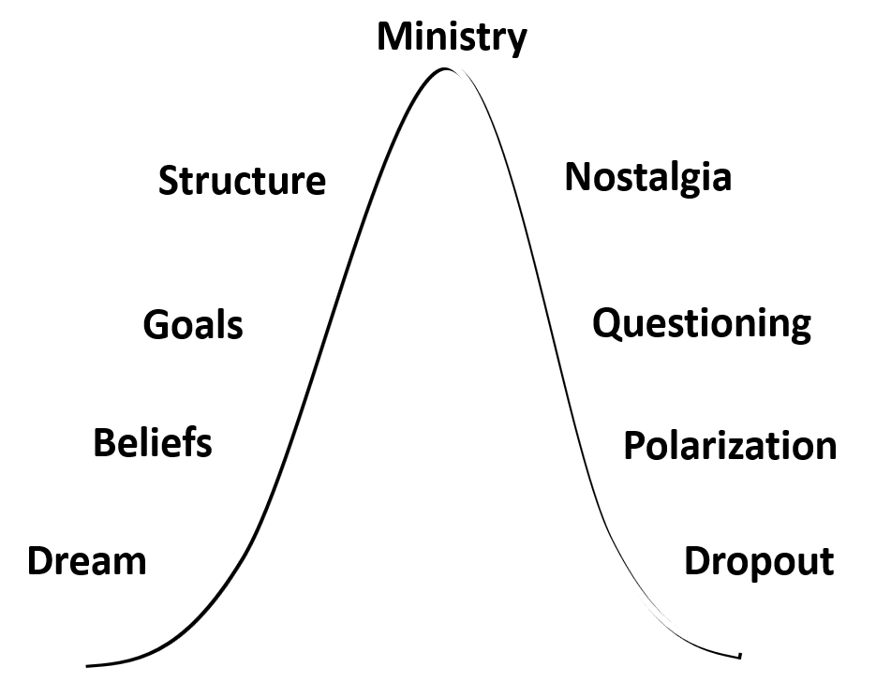
How to Action-Plan Vision
This is another example of unsatisfying approaches to revitalization. Vision Statements alone cannot get us on the left side of the
Life Cycle Curve
Compare to Others
OUR VISION STATEMENT
Don’t Assess
Blinders to Culture
Much
Inferior
Ingredients

Slide 10
How to Action-Plan Vision
Make Vision Statement a By-Product
EXAMPLE
From assessment of health: Discipleship and Disciplemaking is weak
A healthy vision statement might be:
“We see a church with dynamic disciplemaking that regulary produces active disciples making a difference for God’s kingdom in (insert city or county name here).”
We see it, i.e., we have a vision for it.
But we are being honest that it is not who we are now
and our vision is connected to Today’s Reality!
We are trusting God and striving to see it become true.

Slide 11
How to Action-Plan Vision
Work with Leadership Style Preference
Rt
High Relational Low Task
RT
High Relational High Task
rT
High Task Low Relational
rt
Low Task Low Relational
We live in a Work
With Me Culture!
People want
a place at the
directional
table
Support
Me
80%
12%
Let
Me
4%
4%
Tell
Me
Percept Demographic Studies of American Culture
Leadership Preference See ethos p. 15

Slide 12
How to Action-Plan Vision
Work with Your Polity and With Culture
Our Polity
All
Older
Males
Create a team with
Diversity
Kotter calls
this
a guiding coalition
Add for Age, Gender, Ethnicity
Total of 20-25 People

Slide 13
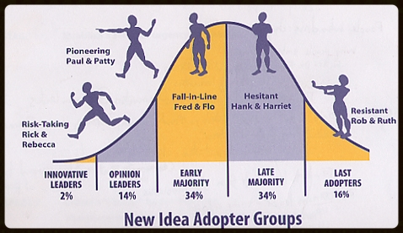
How to Action-Plan Vision
Work with Change Leadership Dynamics
Train your guiding coalition
to see themselves
as Opinion Leaders
Graphics Credit: Dave Travis, Leadership Network
Concept Credit: Everett Rogers, Diffusion of Innovations

Slide 14
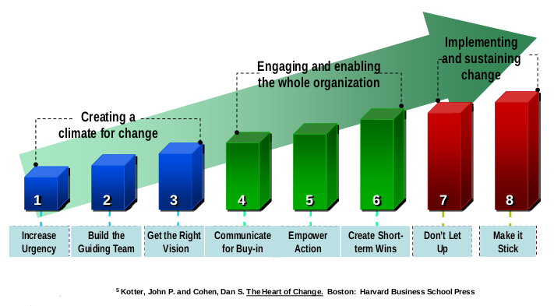
How to Action-Plan Vision
Work with Change Leadership Dynamics
Be selective about what you work on:
Aim for early win(s).
Preparing for Change Reaction , Dr. Bob Whitesel
“Positive Legitimizing Event”

Slide 15
How to Action-Plan Vision
Do Disciplined Work
Prayerful
Dependence
Biblical Definition of Health
Assess Reality
Exegete Culture
If it seems easy, you are probably not doing it right. This requires heavy lifting.

Slide 16
How to Action-Plan Vision
Focus on “Bridging the Gap”
You should eventually gain an understanding of
A gap between what is and what should/could be.
Unhealth
Not Growing
Aspirations
Health
Growth
Actual Values
A Gap

Slide 17
How to Action-Plan Vision
Focus on “Bridging the Gap”
A church’s congregational culture is its
unique expression of its shared values and beliefs
Dr. Aubrey Malphurs
Look Before You Lead, Baker, 2013
Skin- Outward Appearance and Behavior
Unhealth comes from having aspirational values
and possibly a lack of conviction of belief
Flesh: Values that drive Behavior
May be actual or aspirational
Core: Beliefs on which values are based
Think Statement of Faith: head knowledge
Notes:
I will frequently bring a bag of apples
Have each cut and look at it

Slide 18
How to Action-Plan Vision
Focus on “Bridging the Gap”
Todays Reality
Vision: Preferable Future
Aspirational Value
Attractional Outreach
Family Fellowship
20% do 80%
Actual Value
Attractional/Missional
Fellowship of Disciplemaking
Volunteer Mobilization
Notes:
Church culture: today’s reality +pref. future.
Cultural change: moving from one to other
Revitalization: moving many things
Finally get a new apple
NEXT: dig down into conceptual framework

Slide 19
How to Action-Plan Vision
Select from a Full Palette of Strategies
Growth Philosophy
External Alignment
Positive Nos
Organic Top Bone(s)
Unique to Us
Deferred Barrier Elimination
Organizational Bottom Bone(s)
See Handout Definitions
Today’s
Reality
Vision

Slide 20
How to Action-Plan Vision
Prioritize at Most 4-7 Initiatives
We need a manageable number
You can update your list annually (see Tool #7 next)
Select what will bring the most important change
Think about sequence, i.e., some will precede others
Examples
1. Strategy can precede everything
2. Top Bones can precede the need for resources
3. Discipleship can preceded most Top Bones

Slide 21
How to Action-Plan Vision
Set a Realistic Timeline
Growth Philosophy
Bottom Bone(s)
Top Bone(s)
Deferred Barrier Elimination
Today’s
Reality
Vision
2018 2019 2020 Beyond

Slide 22
How to Action-Plan Vision
Assign for Accountability
S.M.A.R.T. Goals, by each owner
measured and monitored
Bill
Wendy
Roy
Dave
Today’s
Reality
Vision
2018 2019 2020 Beyond

Slide 23
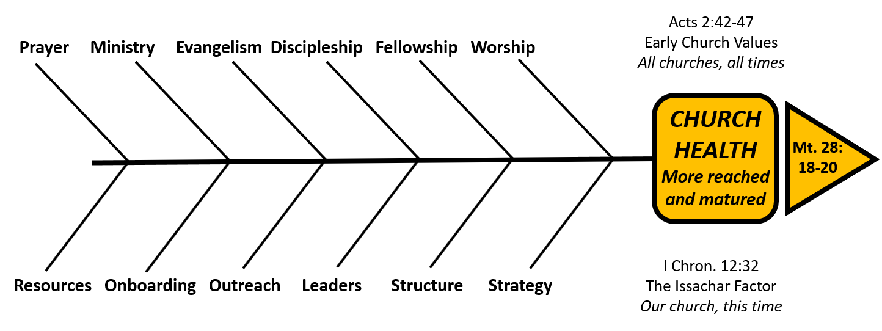
How to Action-Plan Vision
Example #1: Many Areas of Unhealth
Start with Strategic Planning – Get help with this as needed
Form a guiding coalition team and put a plan together

Slide 24
How to Action-Plan Vision
Example #2: Weak Disciplemaking
Lack of organic health can often be traced to weak disciplemaking
Could start with Strategy but could also start with Disciplemaking

Slide 25
How to Action-Plan Vision
Example #3: Broken Fellowship
Conflict resolution skills may be lacking: get training
May need a reconciliation of individuals or a service for this

Slide 26
How to Action-Plan Vision
Example #4: Unhealthy Leadership
When leaders are personally unhealthy, or lacking vision for health/growth this must be priority. May start with 1 or 2

Slide 27
How to Action-Plan Vision
Example #5: A Hindering Structure
In the midst of other unhealth, Structure may be hindering change
May need to prioritize changes in Structure first before others

Slide 28
Session #3 Outline
1
Tool #6 How to Action-Plan Church Vision
2
Tool #7 How to Align and Achieve Church Vision
How to Create a Transformational Plan
How to Execute Your Plan

Slide 29
How to Align and Achieve Vision and Execute Your Plan
Title quote from Peter Drucker
Coffman co-authored with Marcus Buckingham
Doesn’t mean you can’t change culture
It means you need to know how to use your plan
It means that it is difficult to do so!!!
It means that it takes discipline

Slide 30
How to Align and Achieve Vision
1. Plan
Cultural Change/
Revitalize
Missional Refresh Every 3-7 years
Daily, Weekly, Monthly Coaching
Annual Cultural “P&L”
More in Strategy
3. Assess
And Align
2. Coach
More in Leaders

Slide 31
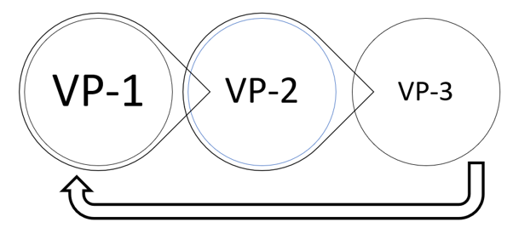
How to Align and Achieve Vision
Intro to VP 1-2-3: A Cultural P&L Tool
The Tool I will introduce
is a ministry leadership
discipline with three
phases that should be
repeated annually.
Co-developed in ministry
setting from 1993-2010 with
annual use.
Vision and Partnering 1-2-3

Slide 32
How to Align and Achieve Vision The “VP” in Vision & Partnering 1-2-3
See Vision and Partnering 1-2-3
User Guide, Society 2016
To Actively Seek God’s Vision for His church,
and to Partner with Him and each other to see that Vision realized

Slide 33
How to Align and Achieve Vision The “1-2-3” in VP 1-2-3
VP-1
Vision
VP-2
Staff Goals
VP-3
Budget
Strategies
Program Plans
Three phases, 2-3 months each, seeking alignment
in direction, behaviors, and resource development and use
User Guide: p. 6-7 8-9 10-11
Appendix A B C

Slide 34
VP 1-2-3 An Annual Rhythm
VP-1
Vision
VP-2
Staff Goals
VP-3
Budget
Strategies
Program Plans
Repetition creates culture of missional change

Slide 35
The VP 1-2-3 Calendar
VP-1
Vision
VP-2
Staff Goals
VP-3
Bottoms up budget by month for next fiscal year
Strategies Refresh for next 3+years
Program Plans for next fiscal year
Tops- Down $
Tops Down $ informs
Fall: Sep-Nov Wtr: Jan-Mar Spring: Apr-Jun
Fiscal
Yearend
Jun 30
User Guide: other fiscal years or conversion, App. D/E

Slide 36
VP-1 The First Phase of VP 1-2-3 Strategic Refreshing
VP-1
Vision
VP-2
Staff Goals
VP-3
Budget
Strategies
Program Plans
Many are the plans in a person’s heart
But it is the Lord’s purpose that prevails Pv 19:21
Repetition creates culture of missional change

Slide 37
VP-1 Overview “Who are we, but especially: where are we going, how will we get there?”
When | Who | Time Horizon | What
Sep-Nov Every year | Primary Board and Sr. Staff. Other Staff and Lay Leaders for input, discussion A point person, initiates the process; consensus on a calendar of events and administrates the process. | Long-Range: the next fiscal year and up to 3 years with more specificity in the first 2-3 years. Will Mancini: Years 1-2 are Content Years 3ff are Context | Vision and strategy refreshing. Assessing progress and barriers. Ending some, adding others. U. Guide App A Reset timeline and owner for each strategy A “Tops-down” budget for the next fiscal yr.

Slide 38
VP-1 Objective: A Refined List of Strategic Initiatives
Fiscal Year 2016 VP-1 Fall 2015 | Fiscal Year 2017 VP-1 Fall 2016
Clarify Disciplemaking Path | Clarify Disciplemaking Path
Improve Volunteer Mobilization | Improve Volunteer Mobilization
Achieve 60% of adults in Small Groups | Achieved (Delete from List)
Add Children’s Ministry Staff Member | Achieved (Delete from List)
Hire Architect for Phase 2 Design | Hire Architect for Phase 2 Design
 | Launch Capital Campaign
 | Find a Lender for Phase 2 Project
You are seeking to learn, be Spirit-led, and adjust to greater discernment
You are seeking a Strategic Mix of Organic and Organizational Health

Slide 39
VP-1 Strategic Ownership / Accountability
Fiscal Year 2017 VP-1 | Timeline Completion Date | *Owner
Clarify Disciplemaking Path | Prior to fall of 2017 | Jessie
Improve Volunteer Mobilization | By January 2017 | Samantha
Hire Architect for Phase 2 Design | By July 2017 | Dave
Launch Capital Campaign | By January 2018 | Bill
Find a Lender for Phase 2 Project | By June 2018 | Tom

Slide 40
VP -1 Tops-Down FY2018 Budget $ in 000s
Income
General Fund $ 500
Ministry Income 25
Total Income $ 525
Expenses
Missions (10%) $ 50
Ministry (incl. Admin) 50
Facilities (incl. Mortgage) 115
Salaries and Benefits 300
Total Expenses $ 515
Net Income $ 10
Cash Beginning Balance $ 65
Net Income (above) 10
Capital Expenses -5
Cash Ending Balance $ 70
FY2018 tops down
completed fall 2018
to guide VP-3 budget
in spring of 2017
Planned in broad
categories with
ministry specific
escalation guidelines.
See USER GUIDE pg 17
You can also use to
create and
manage a cash
reserve policy

Slide 41
VP-2 The Second Phase of VP 1-2-3 Staff and Program Alignment
VP-1
Vision
VP-2
Staff Goals
VP-3
Budget
Strategies
Program Plans
Repetition creates culture of missional change

Slide 42
VP-2 Staff Goal Alignment Overview
When | Who | Time Horizon | What
January Every year | Sr. Staff Other Paid Staff Lay Leaders with VP-1 Initiatives A point person, who initiates the process; consensus on a calendar of events and administrates the process. | This calendar year starting in Jan of this year and ending in Dec. Note: Staff mgmt. calendar year and June fiscal year interplay | Integration of any changes from VP-1 Staff Performance Reviews and Goal-setting aligned with VP-1 and Mission, Values and Vision

Slide 43
VP-2 Staff Goal Alignment
Annual Staff Performance Reviews
In January after VP-1 and before
VP-2 Program Planning
Appendix B has an example
Key VP-1 Initiative Changes require Goal-Setting Priority
Call an all staff meeting to discuss the refined VP-1
Initiatives, then start one-on-one performance assessment and
Goal-setting with each paid staff member
For any lay leader affected by VP-1 directly, meet one-on-one
with them as well.

Slide 44
VP-2 The Second Phase of VP 1-2-3 Staff and Program Alignment
VP-1
Vision
VP-2
Staff Goals
VP-3
Budget
Strategies
Program Plans
Repetition creates culture of missional change

Slide 45
VP-2 Programming Alignment
When | Who | Time Horizon | What
Jan - Mar Every year | Sr. Staff. Other Paid Staff Lay Leaders Ministry Participants A point person, who initiates the process; consensus on a calendar of events and administrates the process. | The next fiscal year starting in Jul of this year and ending in Jun of next calendar year. This is the next ministry and fiscal year. | Integration of any changes from VP-1 Program plans for weekly events, lay leader and participant staffing, facility use See Exercises:

Slide 46
VP-2 Programming Alignment
Point Person leads Kickoff Meeting with all Staff / Ministry Team Leaders
Review the VP-2 Programming Calendar and reporting
due dates for completion of exercises
3 Sample Exercises (See Handouts)
Exercise #1 | Seeking God’s Vision for His Ministry | U. Guide 20
Exercise #2 | Our Recurring Ministry Partnering Plan | U. Guide 21
Exercise #3 | Our Team Org. and Volunteer Plan | U. Guide 22

Slide 47
VP-3 The Third Phase of VP 1-2-3 Budget Alignment
VP-1
Vision
VP-2
Staff Goals
VP-3
Budget
Strategies
Program Plans
Repetition creates culture of missional change

Slide 48
VP-3 Funding Alignment
When | Who | Time Horizon | What
Apr - Jun Every year | Elder Board and Sr. Staff. Other Paid Staff Lay Leaders A point person, who initiates the process; consensus on a calendar of events and administrates the process. | The next fiscal year starting in Jul of this year and ending in Jun of the next calendar year. | Integration of any changes from VP-1 and Tops-Down $ Integration of Staff Goals and Program Plans from VP-2 Detailed budgets: income broken out and every month of the next fiscal year.

Slide 49
How to Align and Achieve Vision
VP 1-2-3 is a Church Flywheel
VP-1 Strategies
VP-2 Staff Goals
VP-2 Program Plans
VP-3 Aligned Budget
See Article by Jim Collins
Flywheel is turned over and over
and stores and releases energy
Organizations can do this too
VP 1-2-3 is a flywheel
It creates a culture of missional change

Slide 50
Questions / Comments
What questions do you have?
Or comments + or – about the material?
jim@churchconsulting.org
1-866-221-6313

