Slide 1
Revitalization Training
Session #2

Slide 2
Online Training 10 Sessions
Session | Title
1 | 7 Church Revitalization Tools: Tools 1 and 2
2 | 7 Church Revitalization Tools: Tools 3-5
3 | 7 Church Revitalization Tools: Tools 6-7
4 | 12 Church Health Components: 1-3
5 | 12 Church Health Components: 4-6
6 | 12 Church Health Components: 7-9
7 | 12 Church Health Components: 10-12
8 | Certification and Consulting
9 | Consulting: Comprehensive Church Health Assessment
10 | Consulting and How To Launch a Consulting Practice

Slide 3
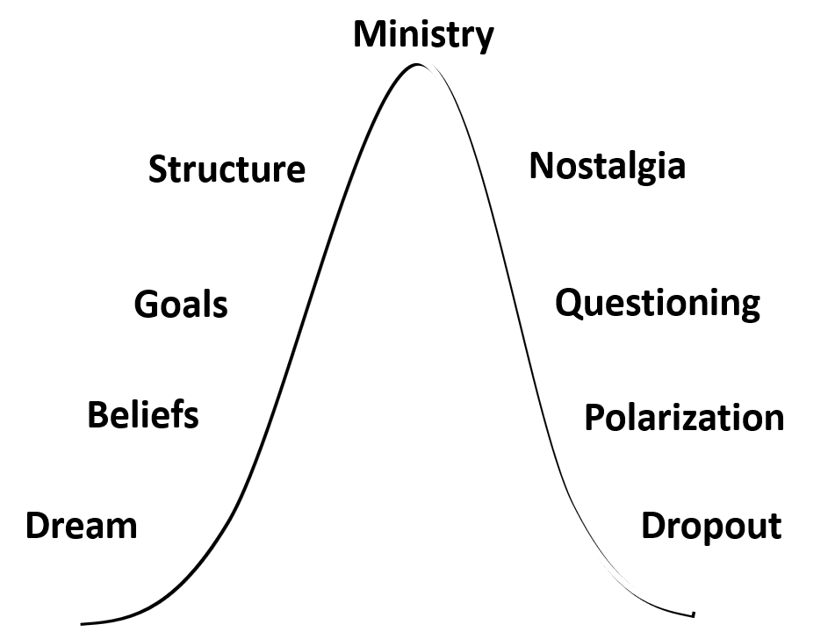
Session One Recap
A Biblical and Cultural Definition of Health
Tool # 1 The Lifecycle Curve Tool #2 The Fishbone Diagram
Church Health Assessment

Slide 4
Fishbone Diagram Process of Revitalization
Biblical and Cultural Definition of Health
Assess Today's Reality
Use Today's Reality to Develop Vision
Measure, Coach, Align and Keep Vision Fresh
Action Plan to Reach Vision
Tool # 1-2 3-5 6 6 7
Session # 1 2 3 3 3

Slide 5
Session #2 Outline
1
Tool #3: The Church Health Survey
2
Tool #4: The Organizational Health Survey
3
Tool #5: How to Analyze External Culture

Slide 6
The Lawless Group Church Health Survey
Developed by Thom Rainer and Chuck Lawless
Rainer is President of Lifeway Christian Resources
Chuck Lawless is Dean of Doctoral Studies and Vice-President of Spiritual Formation and Ministry Centers at Southeastern Seminary in Wake Forest
Survey developed in 1995 and used by 1000s of churches
Lawless companion book called Discipled Warriors 2002

Slide 7
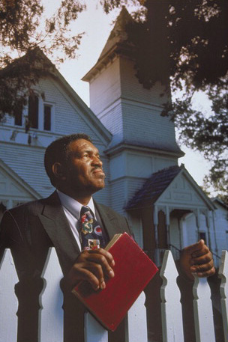
The Lawless Group Church Health Survey
"Church health recognizes that local fellowships of believers are best instruments for the Kingdom when the six purposes of Acts 2:42-47 are intentional, active, and balanced: worship, evangelism, discipleship, ministry, fellowship, and prayer."
Thom Rainer

Slide 8
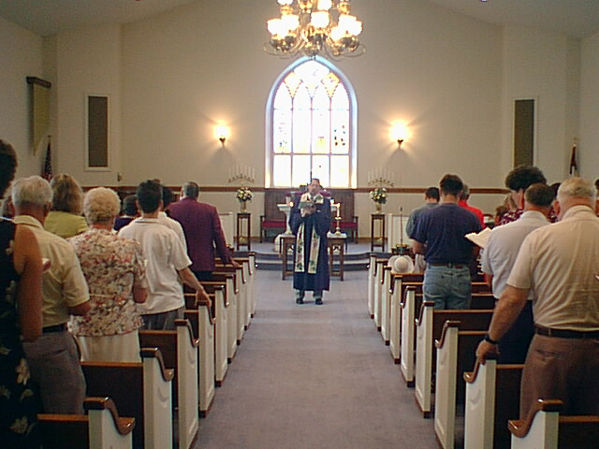
The Lawless Group Church Health Survey
Why a Survey?
Actions related to the church are first a function of participants’….
Attitudes, Beliefs and Perceptions
Perception is reality

Slide 9
The Lawless Group Church Health Survey
160-Item Questionnaire See questionnaire
Measuring Perceptions in the six purposes of Acts 2:42-47
Using 5-point scale:
Strongly Agree, Agree, Undecided, Disagree, Strongly Disagree
Worship 25 questions 4 points maximum = 100 maximum
Fellowship 25 questions Same
Prayer 25 questions Same
Ministry 25 questions Same
Evangelism 25 questions Same
Discipleship 25 questions Same
+ Beliefs 10 questions

Slide 10
The Lawless Group Church Health Survey
Scoring for each of 6 areas: Worship, etc.
Very Healthy 88-100
Healthy 75-87
Marginally Healthy 69-74
Marginally Unhealthy 63-68
Unhealthy 50-62
Very Unhealthy 38-49
Extremely Unhealthy 0-37

Slide 11
The Lawless Group Church Health Survey
Survey Process
Assess how many surveys are needed (minimum of 30)
15% of average worship attendance infant through adult
Survey only adults
Order the Church Health Survey from the Lawless Group
http://thelawlessgroup.com/church-health-survey/
Designate staff person responsible for survey / follow instructions
Return answer forms as directed and analysis/report is delivered to the consultant (or church) within 10 working days of receipt
Note: Online version to be released summer 2018

Slide 12
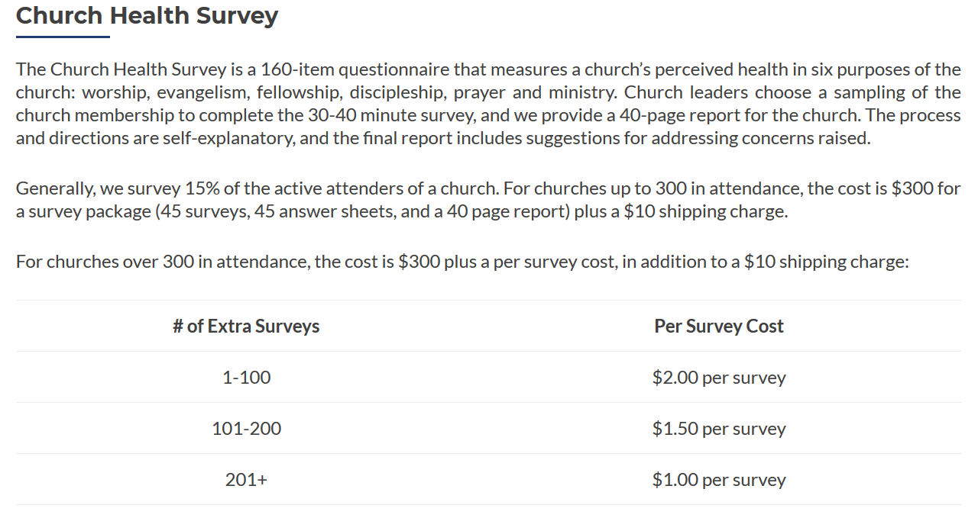
The Lawless Group Church Health Survey
Society Members receive
A $75 discount on
each order

Slide 13
The Lawless Group Church Health Survey
40-page report
Overall score
Participant demographic Data
Response highlights
Scores by church function
Detail of responses
How to improve areas of strength & weakness
See Sample Report

Slide 14
The Lawless Group Church Health Survey
Church Health Survey Math Example 1
Healthy statement you hope people agree with
Q7 I learn a lot about the Bible from the pastor’s sermons
SA A U D SD Total Score
Points 4 3 2 1 0
% answering 55 38 7 0 0
Multiply 2.22 1.13 .14 0 0 3.49

Slide 15
The Lawless Group Church Health Survey
Church Health Survey Math Example 2
Unhealthy statement you hope people disagree with
Q35 A number of people in our church are angry with one another.
SA A U D SD Total Score
Points 0 1 2 3 4
% answering 8.9 28.6 42.9 16.1 3.6
Multiply 0 .286 .858 .483 .144 1.77

Slide 16
The Lawless Group Church Health Survey
“Our church utilized the Church Health Survey….. It played an integral role in helping us discern who we are and thus, where we should be heading. We have transitioned from a dying downtown church to a vibrant inner city church with hope and promise.”
Pastor
Westminster Presbyterian Church
Beaumont Texas

Slide 17
Session #2 Outline
1
Tool #3: The Church Health Survey
2
Tool #4: The Organizational Health Survey
3
Tool #5: How to Analyze External Culture

Slide 18
The BCC Organizational Health Survey
Currently in development by Barber Church Consulting
Based on the Fishbone Diagram White Paper
Release 1.0 will be an online version
Discount for Society Members

Slide 19
The BCC Organizational Health Survey
While the top bones of the Fishbone Diagram are timeless, for all churches, in all times, in all places, the
bottom bones support those organic, relational characteristics of health with organizational practices.
“… the sons of Issachar, men who understood the times, with knowledge of what Israel should do ….” 1 Chron. 12:32
“ … Paul … said, “Men of Athens I observe that ….” Acts 17:22
“ … to the Jews I became a Jew …. To those who are without the law, as without the law …. 1 Cor. 9:20-23

Slide 20
The BCC Organizational Health Survey
Strategy- clear definition and communication of who we are, where we are going, and how we will get there.
Structure- organizing the relationship of the staff, our board(s), and our congregation to allow us to accomplish our strategy.
Leaders- recruiting leaders based on the needs of the church, coaching them to develop their strengths and ministry impact, and
using a leadership forum for both paid staff and lay leaders.

Slide 21
The BCC Organizational Health Survey
Outreach- Impactful expression of love and good deeds in the community that meets specific social and economic needs.
Onboarding- organized ministry that communicates with guests, helping them to become an active part of the church, and with those whose attendance is decreasing, helping them see the value of active fellowship with the church.
Resources- active attention to the church facilities, finances, and information technology as essential tools for effective ministry.

Slide 22
The BCC Organizational Health Survey
Survey Participants
The Organizational Health Survey will recommend that 100% of the paid ministry staff, and the board or boards of the church participate. However, a sample of the entire congregation will not be required.
Many of the organizational matters in the survey will not be well known by the congregation.

Slide 23
The BCC Organizational Health Survey
Survey Design
The survey will be administered online in two parts:
Part One will include 10 questions for each of the six areas of organizational health on the Fishbone Diagram.
Part Two will address the life cycle curve of the church and calculate up to nine other ratio analyses for the church. The ratio analysis will include discussion of a healthy range and compare the church’s ratio to the healthy range.

Slide 24
The BCC Organizational Health Survey
Part Two 10 Analyses and Ratios 1-4
*Lifecycle Curve versus community growth trend over 10 years
*Attendance by adult decade group compared to community groups
(shows if the church is younger or older than its community)
Attendance percentages by town or city
Number of volunteer positions per 100 people vs Guideline
*requires completion of a demographics study

Slide 25
The BCC Organizational Health Survey
Part Two 10 Analyses and Ratios 5-10
General Fund giving trend
Budget allocation %s vs Guideline
Weeks of cash on hand vs Guideline
Flock Ratio (average attendance over ministry staff FTE) vs Guideline
Per centage of adults in groups vs Guideline
Facility Traffic Light (green, yellow, or red light for five areas)

Slide 26
The BCC Organizational Health Survey
Guideline Percentages and Ratios
Volunteer positions per 100 adults (McIntosh and Arn (What Every Pastor…)
Growing churches: 55:100 (high expectations)
Plateaued churches: 43:100
Declining churches: 27:100
Budget Allocation %s (Malphurs)
Ministries (not Missions, but includes admin./ops. 20%
Missions 10-15%
Facilities (includes mortgage and capital reserves) 20-25%
Staff compensation and benefits 40-60%

Slide 27
The BCC Organizational Health Survey
Guideline Percentages and Ratios
Weeks of Cash on Hand (Maximum Generosity
and ECFA) 6-9 wks or more
Flock Ratio – McIntosh (Staff Your Church …) 100-150:1
Per centage of adults in groups - McIntosh/Osborne 70-80%
(100 Rules…. and Sticky Church)
Facility Traffic Light percentages – McIntosh/Others 80% full is full

Slide 28
The BCC Organizational Health Survey
Part Two Examples : Attendance vs. Poplulation

Slide 29
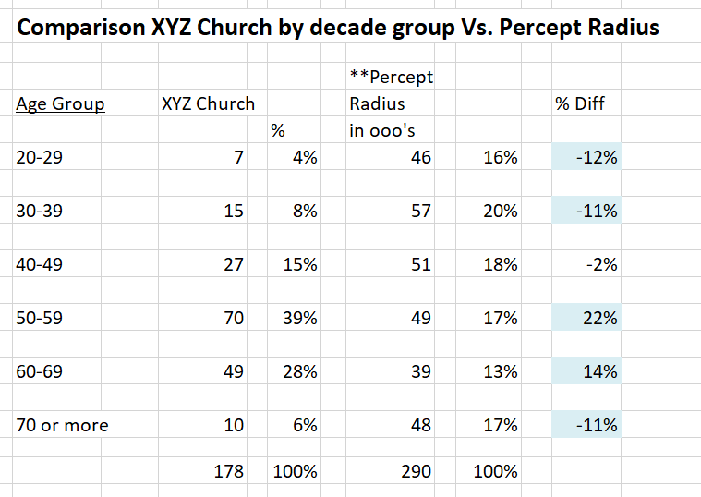
The BCC Organizational Health Survey
Part Two Examples: Ages vs. Community Ages

Slide 30
The BCC Organizational Health Survey
Part Two Examples: Flock Ratio
Full time equivalent ministry staff: not admin/ops.
Sr. Pastor 1.0
Worship Pastor .75
Children’s Director .5
Total FTE 2.25
“Flock” (Avg. worship attendance) 300
Flock Ratio (Flock / FTE) 133:1
Healthy upper limit ration 150:1

Slide 31
The BCC Organizational Health Survey
Report Pages Content: subject to change
Page # Content
Cover Page
Participant statistics
Part One Summary Score of all 6 Components
- 9 Part One Summary Scores for each question
10 - 15 Part One Detail for each question
16 – 26 Part Two Results for Analysis and Ratios

Slide 32
Session #2 Outline
1
Tool #3: The Church Health Survey
2
Tool #4: The Organizational Health Survey
3
Tool #5: How to Analyze External Culture

Slide 33
How to Analyze External Culture
How to Exegete Your Culture: Ed Stetzer
2. 14 Ways to Better Understand Your Community:
TMG (The Malphurs Group)
The Percept Demographic Tool:
A Purchased Service

Slide 34
Another Consulting/Revitalization Tool
Stetzer: Exegete Your Culture
Ed Stetzer &
Mission Group
2016
Quotes
1 Chron. 12:32
See handout

Slide 35
Stetzer: Exegete Your Culture
Exegete Yourself – humility to want to reach the community
you are in from head and heart, from a
calling. Give up preferences. Empower
others. Preach a gospel that effects all of life not just salvation but transformation.
Teach disciplemaking and mission in the
marketplace.

Slide 36
Stetzer: Exegete Your Culture
10 Checkpoints
Get Counselors from the Context
Invite people into your home for a meal.
Go to cafes. Talk with people. Get to know them.
2) Review the Stats – Get demographic info
3) Talk to local experts (mayor, city leaders, planning, etc.)
4) Know the area churches (map, network)

Slide 37
Stetzer: Exegete Your Culture
10 Checkpoints
5) Identify Natural and Other Barriers (rivers, lakes, grasslands, stockyards, railroad yards, industrial areas, or
socio-economic)
6) Identify People Groups and Cultural Tribes
7) Move Beyond Demographics – e.g. windshield survey, eat and shop local

Slide 38
Stetzer: Exegete Your Culture
10 Checkpoints
8) Prayer Walk : open doors, person of peace, understand needs
9) Identify Spiritual Strongholds (from #7-8): idols such as
materialism, alcoholism, etc.
10) Discover Cultural Preferences: music, dress, leadership styles, learning style, etc.

Slide 39
Another Consulting Tool: Malphurs-
Better Understand Your Community
See handout

Slide 40
Another Consulting Tool: Malphurs-
Better Understand Your Community
Do demographic research (see 5 resources, some free some not e.g. arda free and Percept not
Identify the churches and religious groups in your community. Whose growing? How? Candidate for adoption?
Look at how churched/unchurched your community is
Discover how many schools there are and see if there are
opportunities to serve. Interview for needs
5) Look at the shopping centers: where are they? Used for plants?

Slide 41
Another Consulting Tool: Malphurs-
Better Understand Your Community
6) Take note of how many church plants. Meet pastors.
Partner with them.
7) Be a networker: church and city leaders, understand
issues.
8) Ride with a police officer or firefighter.
9) Interview people especially city leaders.
10) Spend time in local establishments.

Slide 42
Another Consulting Tool: Malphurs-
Better Understand Your Community
11) Find what organizations provide social services. Ask
how you can help. Connect your members.
12) Do a neighborhood survey: felt needs, spiritual needs, views of the church.
13) Form (sp? Inform?) a portion of the community. Let
them know you exist, be willing to serve and pray for.
14) Prayer-walk, -run, -drive

Slide 43
Percept Demographics and Psychographics
(see also MissionInsite alternative)
Go to ministryarea.com
User defines radius around the church (any shape)
Government Census Date and other door-to-door or phone survey info of beliefs/values
40 page report (See Sample)
Summary/detail
Both for $239 and $10 discount
for SCC members

Slide 44
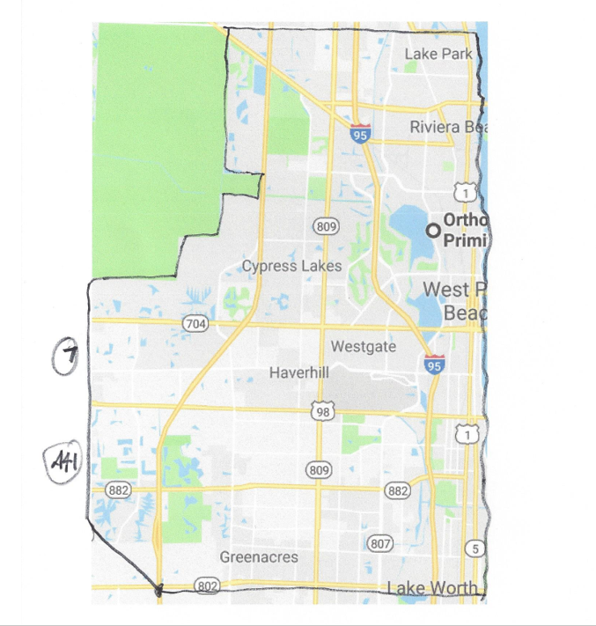
Percept Demographics and Psychographics
(see also MissionInsite alternative)
Use 10 mile radius to start
Win Arn study (20 min drive time)
Discuss where congregants live now (Google Maps Plot)
Discuss where they could come from if more missional
Draw around natural barriers
Ensure leadership team ownership before ordering

Slide 45
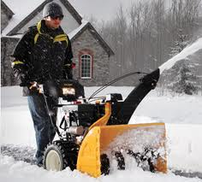
Percept Report Example: Belief in God and Church involvement
*36,000 in church radius
and growing 3% thru 2020
87% = 31,000 believe in God
(Ps 14:1; Rom. 1:20)
* A church in western MN
Fall of 2015
Data from Percept
demographics/psychographics

Slide 46
Example: Belief in God and Church involvement
36,000 in church radius
and growing 3% thru 2020
87% = 31,000 believe in God
39% 14,000 Strong *faith involvement
34% 12,000 Some faith involvement (C+E?)
27% 10,000 No faith involvement at all
*faith=historic Christian religious affiliation

Slide 47
Example: Belief in God and Church involvement
36,000 in church radius
and growing 3% thru 2020
87% = 31,000 believe in God
He more than likely believes in God and more than likely
thinks the local church is irrelevant
most or all of the time
39% 14,000 Strong *faith involvement
34% 12,000 Some faith involvement (C+E?)
27% 10,000 No faith involvement at all
*faith=historic Christian religious affiliation

Slide 48
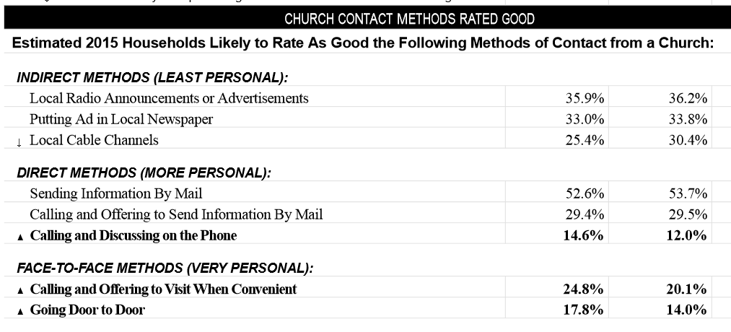
Example #2: Church Contact Methods
Source: Percept Compass Page 6
More than half like getting mailers from churches

Slide 49
Questions / Comments
What questions do you have?
Or do you have any troubles with the material?
jim@churchconsulting.org
1-866-221-6313

