Slide 1
Revitalization Training
Session #1

Slide 2
Online Training 10 Sessions
Session | Title
1 | 7 Church Revitalization Tools: Tools 1-2
2 | 7 Church Revitalization Tools: Tools 3-5
3 | 7 Church Revitalization Tools: Tools 6-7
4 | 12 Church Health Components: 1-3
5 | 12 Church Health Components: 4-6
6 | 12 Church Health Components: 7-9
7 | 12 Church Health Components: 10-12
8 | Certification and Consulting
9 | Consulting: Comprehensive Church Health Assessment
10 | Consulting and How To Launch a Consulting Practice

Slide 3
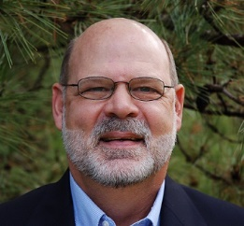
Introductory Information
Reporting requirement if you want credit toward certification
If you intend to pursue certification with the Society, and you miss a live session, listen to the recording and write a 400-500 word summary of the session (approx. one page, single space, 11-pt font). Write what you liked, or disliked, and how this may help you with your church consulting goals. The summary must be emailed to the Society President for review and approval.
Optional follow-up individual discussions with the Society President You are welcome to contact the Society President for follow up discussions by phone or email after each online webinar.
Consultant's Development Plan Template - Sent
Optional: A 30% discount on The Church Consulting Starter Kit

Slide 4
Introductory Information
Use of Material: You have unlimited use of all PowerPoint files and handouts for your church ministry and church consulting purposes. However, if others want the training material, please direct them to our training opportunities. I.e., you cannot use the material to train others.
Reading - None required, but see Recommended Reading for each Session
PowerPoint- Will be sent by Wednesday noon
Handouts - Will be sent by Wednesday noon and may be a link vs. document
Chat Function- Use to write questions as you think of them or at end

Slide 5
Session #1 Outline
1
Revitalization Tool #1: Lifecycle Curve
2
American Culture and The Church
3
Overcoming Growth Barriers
4
Tool #2: The Fishbone Diagram
Society Future Trends Report
5

Slide 6
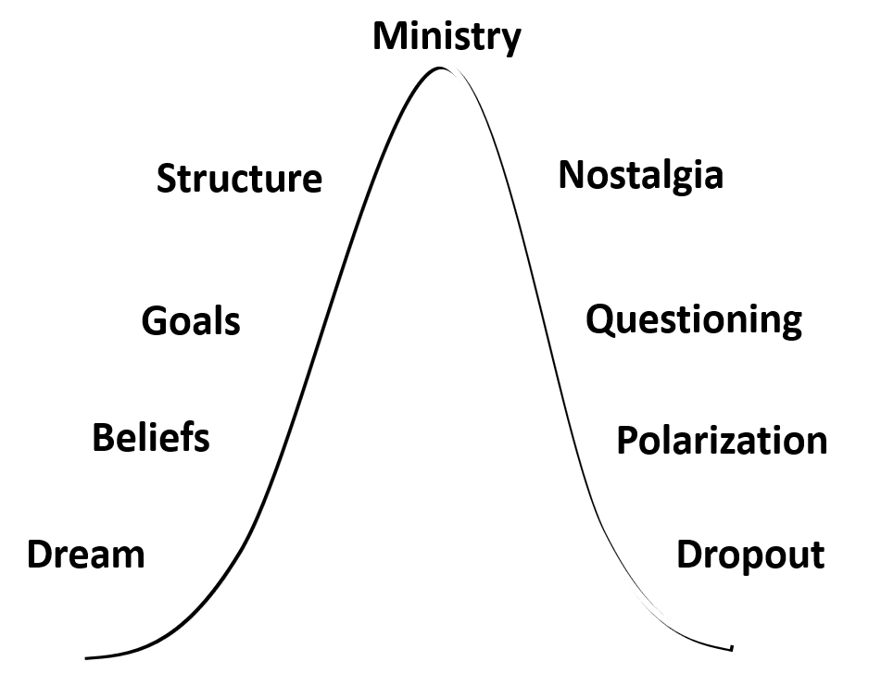
Revitalization Tool #1: The Church Lifecycle Curve
Every church fits on this curve
(plot with at least 10 years of history)
Every church starts with a dream
(interview to learn)
Every church starts externally focused
Churches are born and grow
They tend to become internally focused
They may plateau and even die
Example: A Florida Church
Example: Constance Free Church
Example: Twin Cities MN avg. 70 yrs.
See to dream again Robert Dale

Slide 7
Revitalization Tool #1: The Church Lifecycle Curve
Most churches can get a new curve
It starts with assessing today’s reality
To assess, must define church health
We then need to agree on change
Change requires leadership
Change also requires consensus
The degree of change depends on the
the degree of unhealth
See to dream again Robert Dale

Slide 8
Session #1 Outline
1
Revitalization Tool #1: Lifecycle Curve
2
American Culture and The Church
3
Overcoming Growth Barriers
4
Tool #2: The Fishbone Diagram
Society Future Trends Report
5

Slide 9
Changes in American Culture
1. Uncertainty of Truth
2. Uncertainty of Security
3. Uncertainty of Community
4. Uncertainty of Social Structures
5. Uncertainty of Morality
6. Uncertainty of Doctrine
7. Uncertainty of Change
This is where the Church is seeking to be effective. This presents barriers and opportunities, and informs the forms of ministry.

Slide 10
Changes in American Culture
National Geographic Article quoting Pew Research
The Word’s Newest Religion: No Religion
Pew Research: “The Rise of the Nones”
Book by James Every White
Baker Books, 2014
Percentage of Americans Claiming No Religious Identity
1940 5%
1990 8%
2008 15%
2012 19.3% 33% of Millenials
21% of Gen-Xrs
15% of Baby Boomers
2018 26%

Slide 11
Changes in American Culture
Modernity: Autonomous individualism led to a selfish narcissism
Modernity left man void and empty – man needs the spiritual
Characteristic | Premodern | Modern | Postmodern
Time Frame | Up to 1650 | 1650-1950 | 1950+
Knowledge | Revelation | Scientific Method, Reason | Revelation, Science, Relationships, Feelings
Authority | The Church | Gov’t, University | Questioned, Deconstructed
Next??? Post Christian? Metamodernism?
911 ???
Internet
See www.postmodernpsychology.com Louis Hoffman Ph. D.

Slide 12
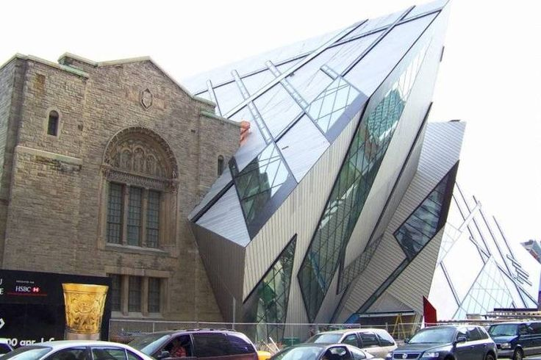
Changes in American Culture
Postmodernism does not reject absolute truth or universal morals. It rejects the idea that any one individual has the ability or right to determine absolute truth for another person.
Problem – leaves people spiritually void.
People are trying to reconstruct their broken lives with experience as the final arbiter of truth.

Slide 13
Changes in American Culture
Our response is not to become modern or postmodern in our thinking but to become biblical in our worldview – we must understand our culture not become it.
- Syncretism – absorbing too much
- Sectarianism – rejecting everything
We must focus upon the supra-cultural and not ride the wave of cultural shift.
We must not hold too firmly to our forms of ministry.
(More on analyzing culture in Session #2)

Slide 14
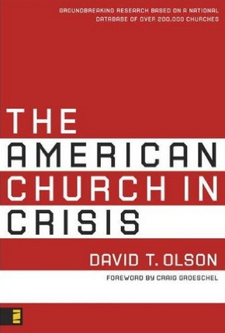
State of the American Church Part A Approx. 2000-2017
Analysis of the real numbers reveal that only about 17.5% of Americans actually attend church on any given weekend.
The American Church in Crisis
David Olson
research based on a national database of
over 200,000 churches
Zondervan 2008

Slide 15
State of the American Church Part A Approx. 2000-2017
Over 85% of our churches are non-growing…
Thom Rainer, Breakout Churches: Discover How to Make the Leap
(Grand Rapids: Zondervan, 2005) 45.
Only 6% are growing faster than their community population rates.
In the past decade, the U.S. population has increased by around 9% while the U.S. church population has decreased by 9.5% (Catholic decrease, Mainline flat, Evangelical Increase)

Slide 16
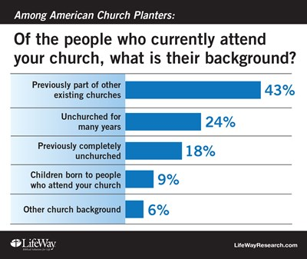
State of the American Church Part A Approx. 2000-2017
The American church is becoming less and less evangelistic (includes church plants)

Slide 17
State of the American Church – Part B Biblical Perspective
“… Who do you say that I am?
… the Messiah… I tell you that
you are Peter, and on this rock
I will build my church…”
Mt. 16:13-18
Jesus is still building His Church

Slide 18
State of the American Church – Part B Ed Stetzer Article Sep 2016
The State of The Church in America:
When Numbers Point To A New Reality
Ed Stetzer Christianity Today Sep 12, 2016
Three part article in Christianity Today
“Facts are our friends”
Mainlines declining /Evangelicals steady
There is a rise of the “Nones”
Complexity: Growth and decline simultaneously
Evangelicalism largest growth
Growth
Decline

Slide 19
State of the American Church – Part B Thom Rainer: 9 Hopeful Signs May 2017
A new wave of corporate prayer
A rekindling of evangelism
A balance between theological and practical
The waning of worship wars
A heightened emphasis on church revitalization
A surge of re-birthed churches
A renewal of meaningful membership
A concerted focus on impacting the community
Numbers (focus on healthy accountability)

Slide 20
State of the American Church – Part B Thom Rainer: Dispelling The 80% Myth - Jun ‘17
Survey of 1000 Southern Baptist Churches
Data from 2013-2016
Statistically valid to 95% +/- 3.1%
Results:
56 % declining
9 % plateaued
35% growing
65% are declining or plateaued vs. 80% myth

Slide 21
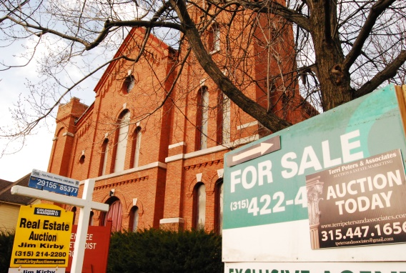
State of the American Church – Part B Trends and Positive Signs: Church Plants vs. Closures
More than 4,000 new churches opened their doors in 2014, outpacing the 3,700 that closed, according to estimates from the Nashville-based research organization based on input from 34 denominational statisticians.

Slide 22
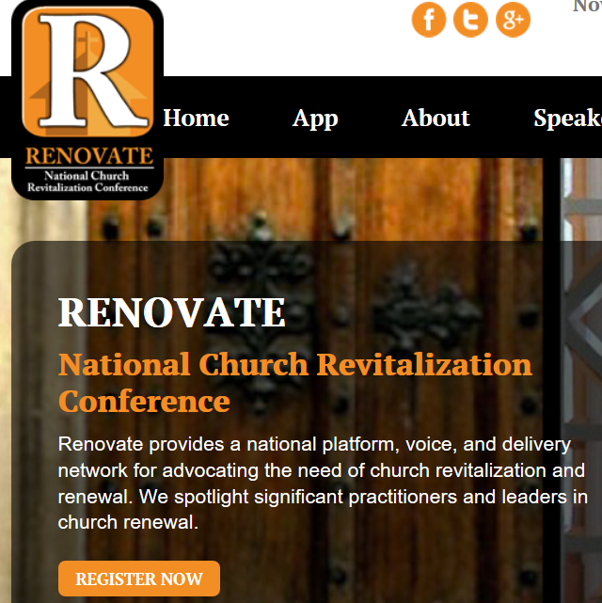
State of the American Church – Part B Trends and Positive Signs: Organizations Devoted to Revitalization
Independent Consultants and Consulting Groups
Pastors and Denominational
Leadership

Slide 23
Session #1 Outline
1
Revitalization Tool #1: Lifecycle Curve
2
American Culture and The Church
3
Overcoming Growth Barriers
4
Tool #2: The Fishbone Diagram
Society Future Trends Report
5

Slide 24
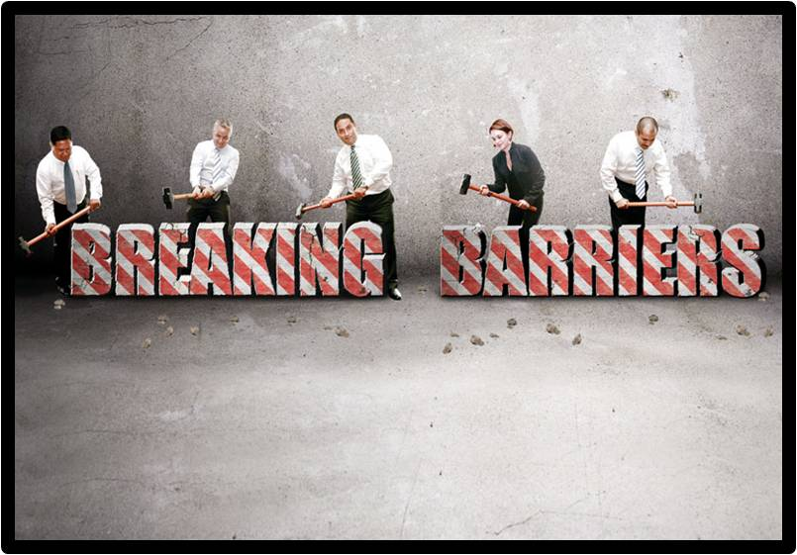
Growth Barriers See Handout for Overcoming - Rainer
The barrier of “comfortitis”
“inflammation from injury or infection”
2. The barrier of participatory democracy
3. The barrier of the power group
4. The barrier of the not-like-us malady
5. The barrier of ministry misplacement
6. The barrier of the pastoral care pastor
Notes:
B. We just like the church the way it is.
- Very stagnant thinking leads to stagnant growth.
- Too much work to change
- New people think differently
- Easier to stay where you are
- Pastor may see it; Church may not.
C. Sometimes we get bogged down in how we make decisions.
- We get stuck in process.
- Committee to committee to church…
- Does the church need to know? Yes!
- But so many churches have structures that lead to discouragement.
- Many pastors say, “It’s not worth the hassle.”
Overcoming Comfortitis
Preaching
Demonstrate history of non-growth
Look for examples of turnaround churches
Short-term mission trips
Overcoming Participatory Democracy
Preaching
Empowering Teams
Demonstrate lack of efficiency in present methods

Slide 25
Growth Barriers
7. The barrier of biblical blindness
8. The barrier of small-church mentality
9. The barrier of the stepping-stone pastor
10. The barrier of staff shortage
11. The barrier of purposeless church
Notes:
H. Theological issue – we are church consultants.
- If your theology is wrong, your growth cannot/will not be blessed.
- “What do you really believe?”
- What do we throw out?
- Faith
- Lostness and hell
- Authority of text; Exclusiveness of the Gospel
- You can get away with a lot more than the pastor can.
I. How does a small church think?
- Have to know everyone.
- Cared for by pastor
- We have to prepare churches for growth rather than reacting to growth.
- Ex: Consult at church with no preschool
- “You need to update your preschool area”
- “Why, we don’t have any.”
- That’s not faith!
- “What do you have in place when God blesses you with a bunch of preschoolers?”
Overcoming People Blindness
Preaching
Small group studies
Systematic discipleship (Recommend a book)
Short-term mission trips
Overcoming Small Church Mentality
Preaching (Esp. Acts)
Communicate mandate to grow and make disciples
Demographic study of lost community
Revival is happening! Where? Why?
Mormons at my conf: “Not work! Faulty theology!”
John MacFarlin: UMC 1) liberal 2) Missionary attitude

Slide 26
Growth Barriers
12. The barrier of ex-neighborhood church
13. The barrier of finite facilities
14. The barrier of “fundingitis”
15. The barrier of a dissenting minority
16. The barrier of the ghost town
Notes:
M. Ethnikitis (Peter Wagner says “Terminal”)
1) Church never adjusts to changes.
2) I do not believe its terminal, meaning a body of Christ can exist there, but the original church is gone!
3) People move out…but drive in…until children.
4) Not reaching the people around their community.
5) Ignorance
6) Close eyes
7) May even be socio-economic
N. Wagner calls this sociological strangulation.
Rainer’s term makes more sense!
1) Too many people in too little space.
2) Auditorium
3) Parking
4) Nursery
5) Used to be 80% rule: Now 70%
Ethnikitis
Sociological Strangulation
Overcoming Ex-Neighborhood Church
Preaching
Staff demographics reflect community demographics
Relocate
Rebirth
Overcoming Finite Facilities
Multiple services; decentralized small groups
Consider unused space in present facilities
Utilize local businesses or member homes
Plant a new church
Build

Slide 27
Session #1 Outline
1
Revitalization Tool #1: Lifecycle Curve
2
American Culture and The Church
3
Overcoming Growth Barriers
4
Tool #2: The Fishbone Diagram
Society Future Trends Report
5

Slide 28
Future Trends Report Overview
Our 2010 Report:
Survey of Society and Church Central
(now biblicalleadership.com)
320 consultants 515 pastors
Essays by established consultants
Free with Society Membership
Updated Summer 2017

Slide 29
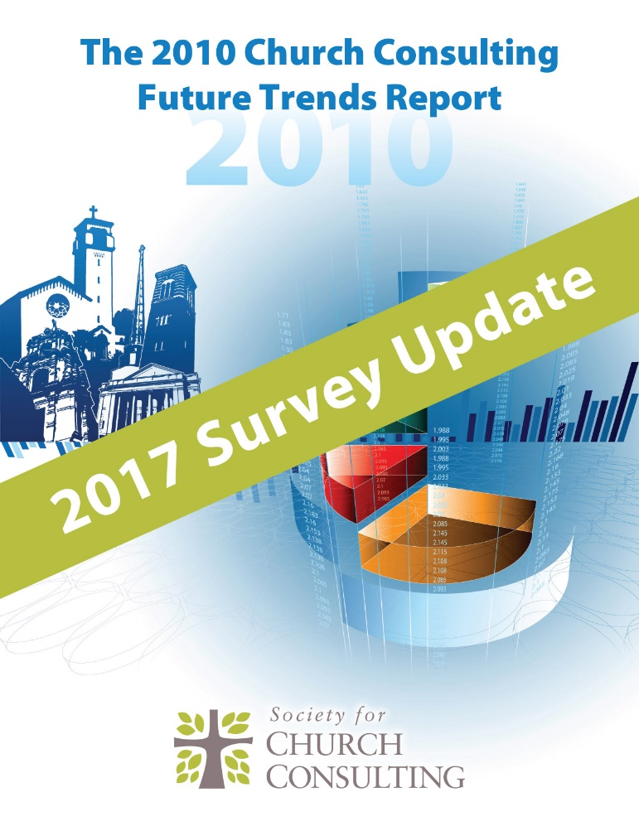
Future Trends Report Overview
Our 2017 Update Report:
Survey of Society and Church Central
Repeated all of the 2010 questions
Added more questions
No Essays
Free with Society Membership

Slide 30
Society Future Trends Report 2017 Update Motivations to Seek a Consultant
11% is decline in new members

Slide 31
Summary Thoughts on Tool #1
The Lifecycle Curve
This is a powerful tool for assessing/helping a church
Most churches are plateaued or declining
There are cultural factors for decline
There are leadership factors for decline
Jesus is still building His Church
Birth, growth, decline can lead to rebirth and growth

Slide 32
Session #1 Outline
1
Revitalization Tool #1: Lifecycle Curve
2
American Culture and The Church
3
Overcoming Growth Barriers
4
Tool #2: The Fishbone Diagram
Society Future Trends Report
5

Slide 33
Tool #2: The Fishbone Diagram
This starts with a concern for His Church
See Lifecycle tool statistics on plateau decline
Motivated in part by questions about individual
assessments and comparisons of one to another
Motivated in part by being a student of church health
e.g. always curious about Kennon Callahan vs. Rick Warren
“What do you
think about NCD
compared to the
Lawless Group
Church Health Survey?”

Slide 34
Fishbone Study of Assessments
Kennon Callahan 12 Keys to an Effective Church
Rick Warren 5 Purposes of the Church (12 Characteristics)
Schwartz NCD 8 Essential Qualities of Healthy Churches
Stephen Machhia 10 Traits of a Vital Ministry
George Barna 9 Habits of Highly Effective Churches
So is it 5, 6, 7, 8, 9, 10, or 12???

Slide 35
Fishbone Study of Assessments cont’d
Chuck Lawless 6 Pillars of a Healthy Church
Jim Fann EFCA 10 Leading Indicators of a Healthy Church
Stanley/Joiner/Jones 7 Practices of Effective Ministry
Rainer/Stetzer 7 Health Categories (TCAT)
Mark Devers 9 Marks of a Healthy Church
So is it 5, 6, 7, 8, 9, 10, or 12???

Slide 36
Fishbone Study – Other Key Sources
Biblical and Systematic Theology
Ken Sande The Peacemaker
McIntosh and Martin Finding Them, Keeping Them
George and Bird How to Break Growth Barriers
McIntosh One Size Doesn’t fit All
Malphurs Advanced Strategic Planning
Lewis Church of Irresistible Influence

Slide 37
Fishbone Other Sources
WCA Reveal
SCC Future Trends Report
Rainer Closing the Back Door Article
Thumma / Bird The Other 80%
Rainer / Geiger Simple Church
Whitesel Cure for the Common Church

Slide 38
Fishbone Other Sources
Rogers Diffusion of Innovations
Kotter Leading Change
Galbraith Designing Organizations
Coffman / Sorenson Culture Eats Strategy for Lunch
Barber Church Consulting Ministry/Consulting Experience

Slide 39
15 Analytical Observations
Health assessments are backed by varying degrees of research
Mt. 28:18-20 Health and growth are inseparable
Acts 2:42-47 Descriptive functions of church prescriptive in NT
Purpose Driven is predated by the Reformation
Not all health assessments purport to be all inclusive: e.g. 9 Marks
6. Effective outreach includes Great Commandment good deeds
especially in postmodernism or post-postmodernism
7. There are both organic and organizational aspects of health
ANALYSIS

Slide 40
15 Analytical Observations cont’d
8. Strategic planning with follow-up can lead to health
9. Church size is a significant contextual factor for defining health
10. Conflict resolution and church discipline are an dimension of health
11. Awareness of cultural context is another aspect of health
12. 20% doing 80% of ministry is not a myth (and not biblical!)
13. Church values, functions, purposes may be aspirational or actual
14. Change-leadership-understanding is essential
15. Assimilation or “onboarding” systems are a part of health

Slide 41
A Definition of Church Health
A church is healthy if it is growing¹ and maturing disciples² because it is balancing both the timeless purposes³ of the church in Acts 2:42-47, and other⁴
organizational and contextual characteristics.
1- Conversion church growth should be the priority but it could be
biological, transfer, or prodigal growth as well. The head and spine of the fish.
2 - Health is a measure of both church growth and maturing disciples
3 - Top Bones Components
4 - Bottom Bones Components

Slide 42
The Fishbone Head and Spine
Jesus is the original church growth guy: Mt 16:13-19; Jn 17:18-20
Book of Acts is consumed with attention to numbers: 2:47, 6:7, 11:21, 16:5, 17:12
Health, including a priority on growth, must inform all other components
Healthy churches define, implement, and refine an action plan for growth

Slide 43
The Fishbone Top Bones
We will drill
down on each
of these in
Sessions 4-7
The categories of health break into two major categories:
organic top bones, and organizational bottom bones
Acts 2:42-47 is descriptive but prescriptively in NT for all churches
Six categories is from Chuck Lawless which = Rick Warren + Prayer
They are also primarily relational: God, the church, the unchurched

Slide 44
The Fishbone Bottom Bones
We will drill
down on each
of these in
Sessions 4-7
The Bottom Bones are organizational, somewhat more task driven,
and more contextual about our church in this time, this place
Strategy is first for a reason, and Structure and Leaders are sequential
Outreach is Great Commandment and postmodern (Robert Lewis)
Onboarding is Assimilation Front Door and Back Door Ministry
Resources: Facilities, $, Information Technology, Policies, Systems

Slide 45
Fishbone Simplistic Use
Top Bones: purchase the Church Health Survey at thelawlessgroup.com
Note: this will be covered in detail in Session #2: Revitalization Tool #3
Bottom Bones: the white paper gives you five questions each for these
Note: this will be covered in detail in Session #2: Revitalization Tool #4
The tool will have more than 30 questions (6 x 5 in the white paper)
(planning to expand this to 10 questions for each of 6 components = 60 total)
(also planning to have my board help me define need for statistical validation)
White Paper Exercise #1: Is our church Organic or Organizational p.45
Exercise #2: How many Strengths and Weaknesses out of the 12

Slide 46
Fishbone Comprehensive Use
Top Bones: purchase the Church Health Survey at thelawlessgroup.com
and have a denominational or independent consultant help interpret
http://thelawlessgroup.com/church-health-survey/
Discount for Society members
Bottom Bones: purchase the BCC Organizational Health Survey
and have a denominational or independent consultant help interpret
This survey is currently in development – see Session #2
Society Certified Consultants: churchconsulting.org/search-consultants/

Slide 47
Disappointing Revitalization Methods
#1: Optional Growth
Symptoms
- casual about growth for a variety of reasons
- ghost town (economics), ex-neighborhood (ethnic) barriers
can lead to a defeatist attitude
- lack of planning and execution
- extremes: separatism, suspicion of motives for interest in growth
- attractional to the exclusion of missional ministry
SOLUTIONS:
- Go back to the Bible - Repentance
- Planning e.g. grow on site, plant, multisite, merge
- Redefine Top and Bottom Bones Health with External Focus

Slide 48
Disappointing Revitalization Methods
#2: Organic but not Organizational
Symptoms
No Strategic Planning in the past five years or more
Structure is not right sized or not aligned with vision and strategies
Weak Leadership Development
Lack of Outreach and Onboarding Ministries
Lack of Resource Development
SOLUTIONS:
- Redefine Church Health: Organic and Organizational
- Start with Strategic Planning – Get help as needed
- Right size or align as needed

Slide 49
Disappointing Revitalization Methods
#3: Organizational but not Organic
Symptoms
Worship: poor teaching, music, no interest in inviting (not common)
Much more common: weak disciple-making
Lack of definition of what a disciple is
Lack of programming process to make disciples
Lack of clear communication of priorities
SOLUTIONS:
- Start with Strategy (Bottom Bones) which can improve all
- Improve Disciplemaking (evangelism, prayer, ministry, fellowship
Can all flow from this if it is designed well)

Slide 50
Disappointing Revitalization Methods
#4: Silver Bullet Mentality
Symptoms
Trying to solve everything with one discipline element like Prayer
Trying to solve everything with one tool like Reveal
Trying to solve everything with one book, or one conference
Adding more of what you already have
(adding broth to broth when you want crab meat and asparagus soup)
SOLUTIONS:
- Face into the difficult discipline of assessing today’s reality for both
the top and bottom bones, all of them, and each of them
- Strategic Plan your way to health
Reality, Action Plan, Vision (See Tool #6)

Slide 51
Disappointing Revitalization Methods
#5 Waiting for 100% Consensus
Symptoms
Not moving ahead with changes leaders see the need for
Not leading the leadership team to consensus
Not leading the congregation to consensus
Bowing to a power group in the church
SOLUTIONS:
- Learn change leadership principles (Rogers, Kotter, Whitesel)
- Agree as a leadership how to move forward if vote is 7 to 2
- Find an early win (positive legitimizing event)
- Confront divisive people and call it sin (Mt 18:15-17)

Slide 52
Fishbone Diagram Process of Revitalization
Biblical and Cultural Definition of Health
Assess Today's Reality
Use Today's Reality to Develop Vision
Measure, Coach, Align and Keep Vision Fresh
Action Plan to Reach Vision
Tool # 1-2 3-5 6 6 7
Session # 1 2 3 3 3

Slide 53
Questions / Comments
What questions do you have?
Or comments + or – about the material?
jim@churchconsulting.org
1-866-221-6313

